Slide 1
SQL Query Joins
ASP.Net 2.0 – Visual Studio 2005
CSE686 – Internet Programming
Instructor: James W. Fawcett
TA: Murat K. Gungor
Summer 2006

Slide 2
Query Joins
Why do we need query joins?
  View information from two or more separate database tables
Type of query joins
  Inner Join
  Outer Join
    Left Outer Join
    Right Outer Join

Slide 3
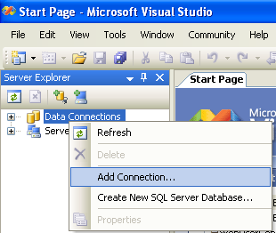
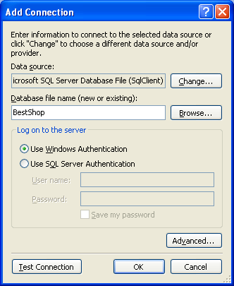
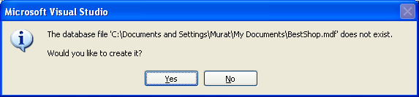
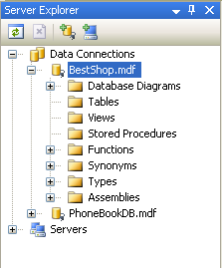
Add new SQL Database File
Let’s Open Visual Studio .NET 2005
Using Sever Explorer
Add Connection…
We just created BestShop.mdf
(mdf =Master Database File)

Slide 4
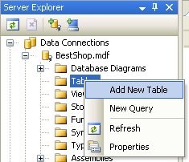
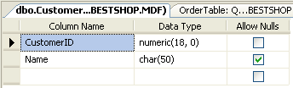
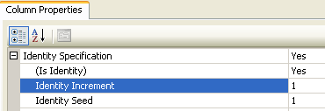
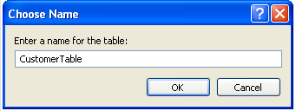
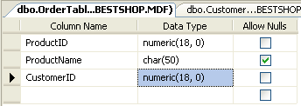
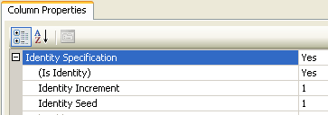
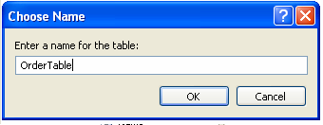
Lets add two tables
Customers and Orders
CustomerID is Unique and it is an Identity
ProducID is Unique and it is an Identity

Slide 5
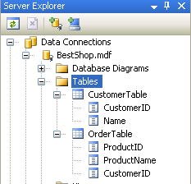
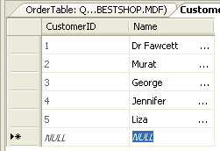
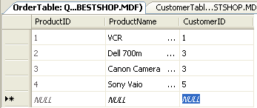
We have
CustomerTable and OrderTable
Lets add some data to our tables

Slide 6
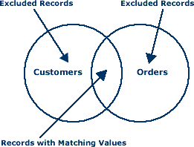
Inner Join
An inner join is a join that selects only those records from both database tables that have matching values.
Records with values in the joined field that do not appear in both of the database tables will be excluded from the query.
SELECT CustomerTable.Name, OrderTable.ProductName
FROM CustomerTable INNER JOIN OrderTable
ON CustomerTable.CustomerID = OrderTable.CustomerID

Slide 7
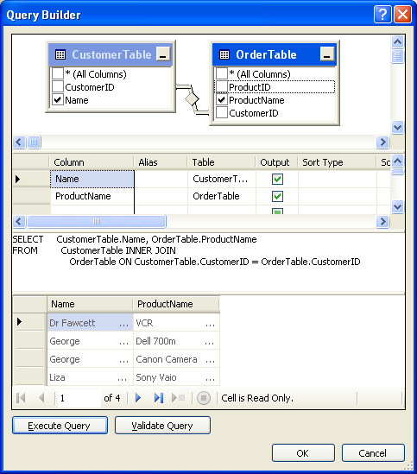
Inner Join Query Result
The INNER JOIN returns all rows from both tables where there is a match.
If there are rows in CustomerTable that do not have matches in OrderTable, those rows will not be listed.
We see ONLY matching values
SELECT CustomerTable.Name, OrderTable.ProductName
FROM CustomerTable INNER JOIN OrderTable
ON CustomerTable.CustomerID = OrderTable.CustomerID

Slide 8
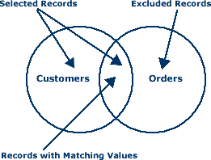
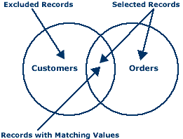
Outer Join
An outer join selects all of the records from one database table and only those records in the second table that have matching values in the joined field.
In a left outer join, the selected records will include all of the records in the first database table.
In a right outer join, the selected records will include all records of the second database table.
SYNTAX
SELECT field1, field2, field3
FROM first_table LEFT JOIN second_table
ON first_table.keyfield = second_table.foreign_keyfield

Slide 9
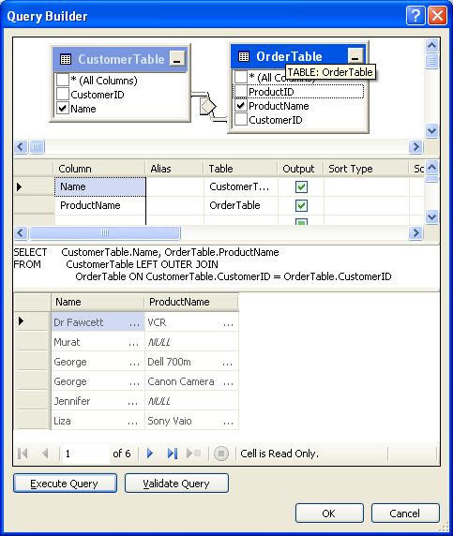
SELECT CustomerTable.Name, OrderTable.ProductName
FROM CustomerTable LEFT OUTER JOIN OrderTable
ON CustomerTable.CustomerID = OrderTable.CustomerID
NULL values also appears
The LEFT OUTER JOIN returns all the rows from the first table (CustomerTable), even if there are no matches in the second table (OrderTable).
If there are rows in CustomerTable that do not have matches in OrderTable, those rows also will be listed.

Slide 10
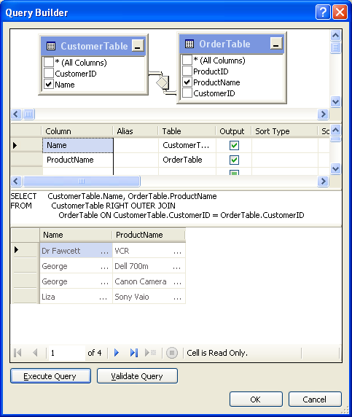
SELECT CustomerTable.Name, OrderTable.ProductName
FROM CustomerTable RIGHT OUTER JOIN OrderTable
ON CustomerTable.CustomerID = OrderTable.CustomerID
The RIGHT OUTER JOIN returns all the rows from the second table (OrderTable), even if there are no matches in the first table (CustomerTable ).
If there had been any rows in OrderTable that did not have matches in CustomerTable, those rows also would have been listed.

Slide 11
End of Presentation
Resources
  http://www.databasedev.co.uk/query_joins.html
  http://www.w3schools.com/sql/sql_join.asp
  http://en.wikipedia.org/wiki/JOIN
  http://www.databasejournal.com/sqletc/article.php/26861_1402351_1

