Slide 1
Help for Visual Studio Code
Jim Fawcett
CSE686 – Internet Programming
Spring 2019

Slide 2
Visual Studio Code (VS Code)
VS Code is a text editor build with the Electron.js JavaScript framework.
It is easy to use for building static web pages.
In conjunction with the dotnet command, and a default C# plugin, it is a capable Integrated Development Environment (IDE) for working with Asp.Net Core applications.
  Visual Studio has more facilities, and, once you learn how it works, it is a very effective tool for building static pages and working with Asp.Net Core projects.
  VS Code will do everything we need for the first half of the course.

Slide 3
Using VS Code
The first thing to do is download the latest version – it’s free. Just ask Dr. Google to take you to VS Code download.
That will download an installer in your Download directory. Run it – that takes just a minute or so - then start up VS Code.

Slide 4
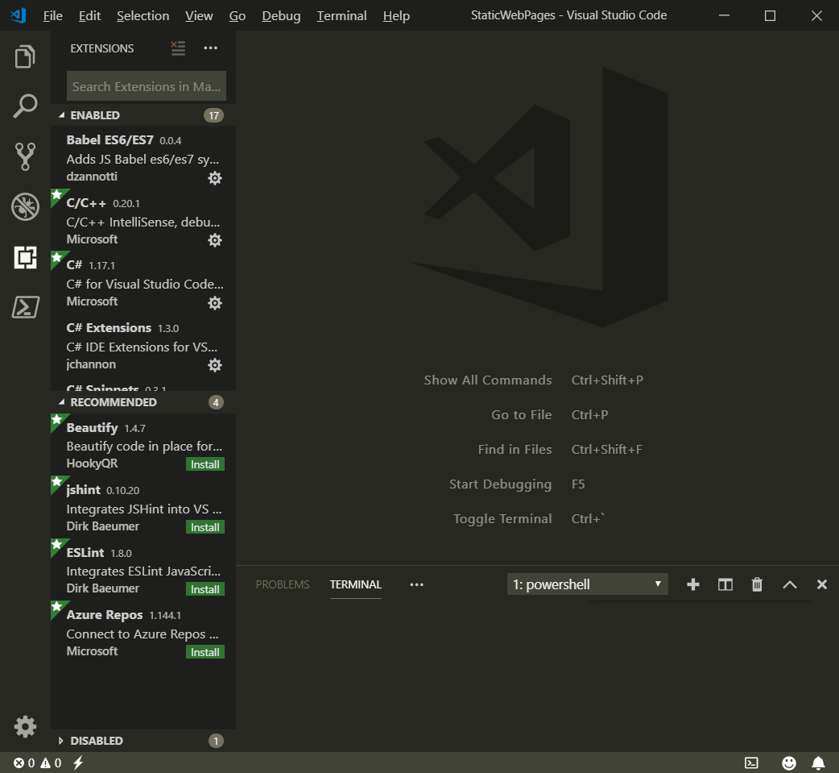
VS Code Window
In the left panel VS Code shows folder, search, Source Control, Debugging, Extensions, and a PowerShell command views.
To start, you open the Folder view.
VS Code doesn’t have projects, but it does have settings for build and launch.
Extensions
Terminal

Slide 5
Building Static Web Pages
File > Open Folder > select work folder in dialog (or create)
File > New File > Enter opens editor on an un-named text file
Enter some small amount of text
File > Save As > Enter File name (ext html, css, js) > Save
Made sub folders css and js in work folder
  File > Save As > right-click on dialog > new > folder > CSS
  File > Save As > right-click on dialog > new > folder > JS
Now you fill in the html, css, and js details.

Slide 6
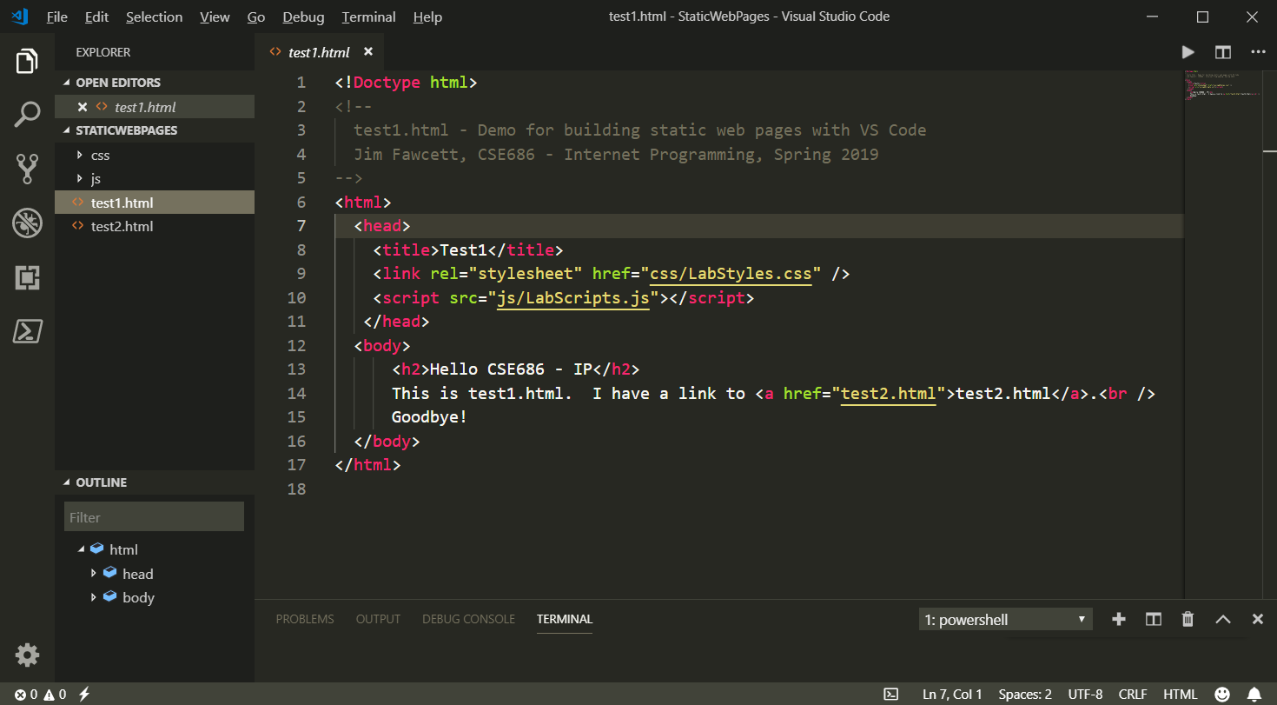
Building Static Web Pages with VS Code

Slide 7
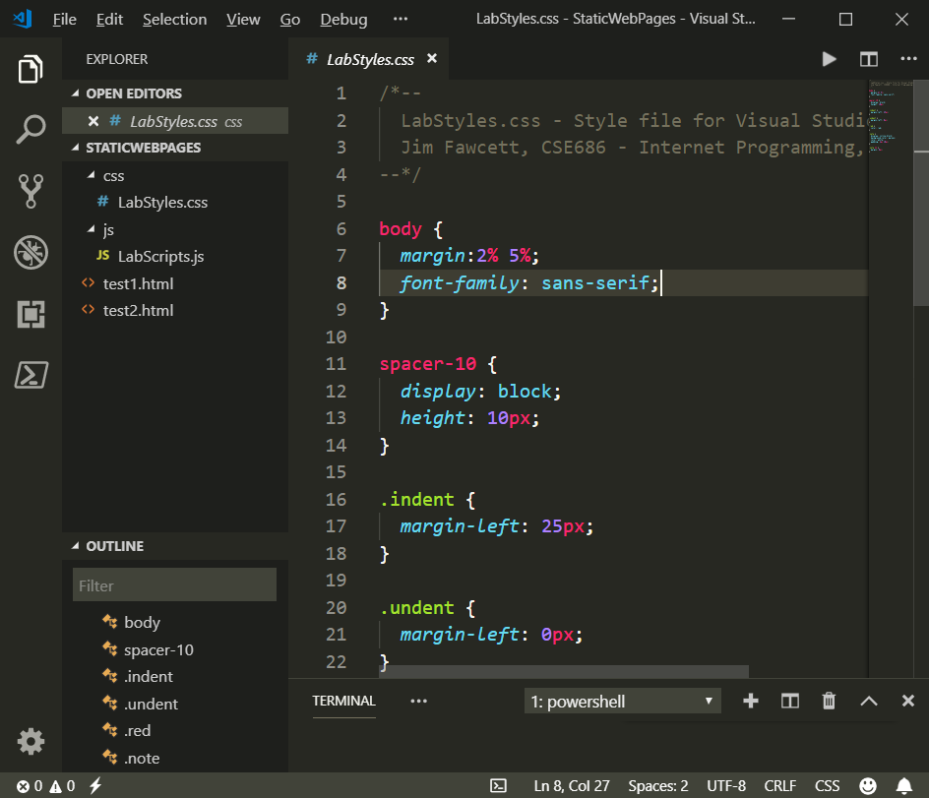
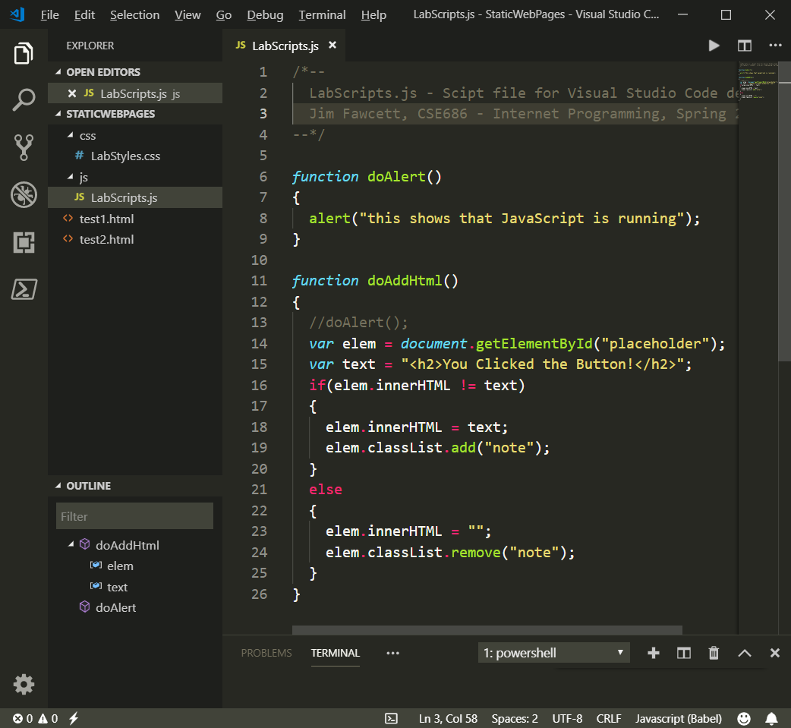
Building Static Web Pages with VS Code

Slide 8
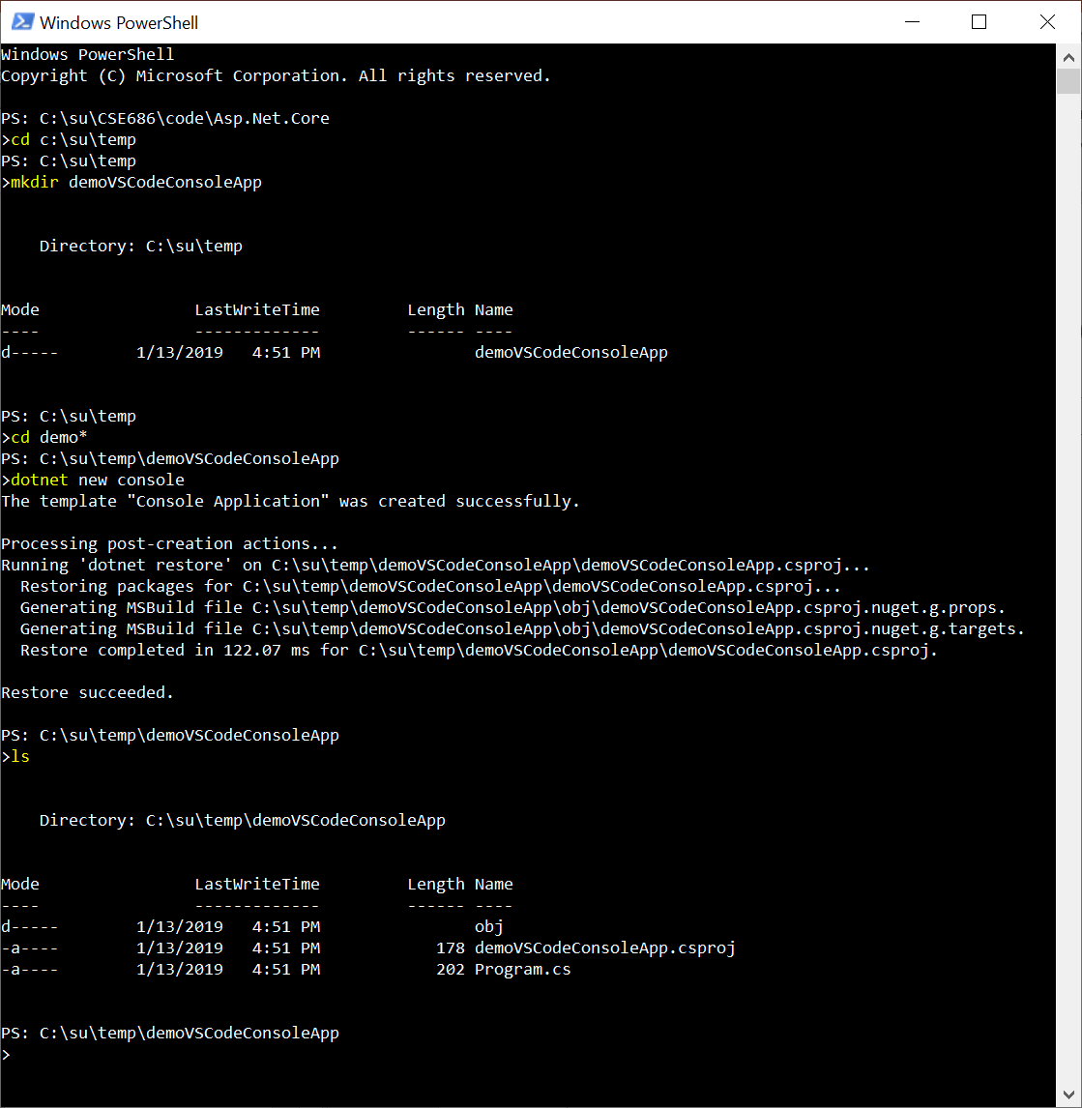
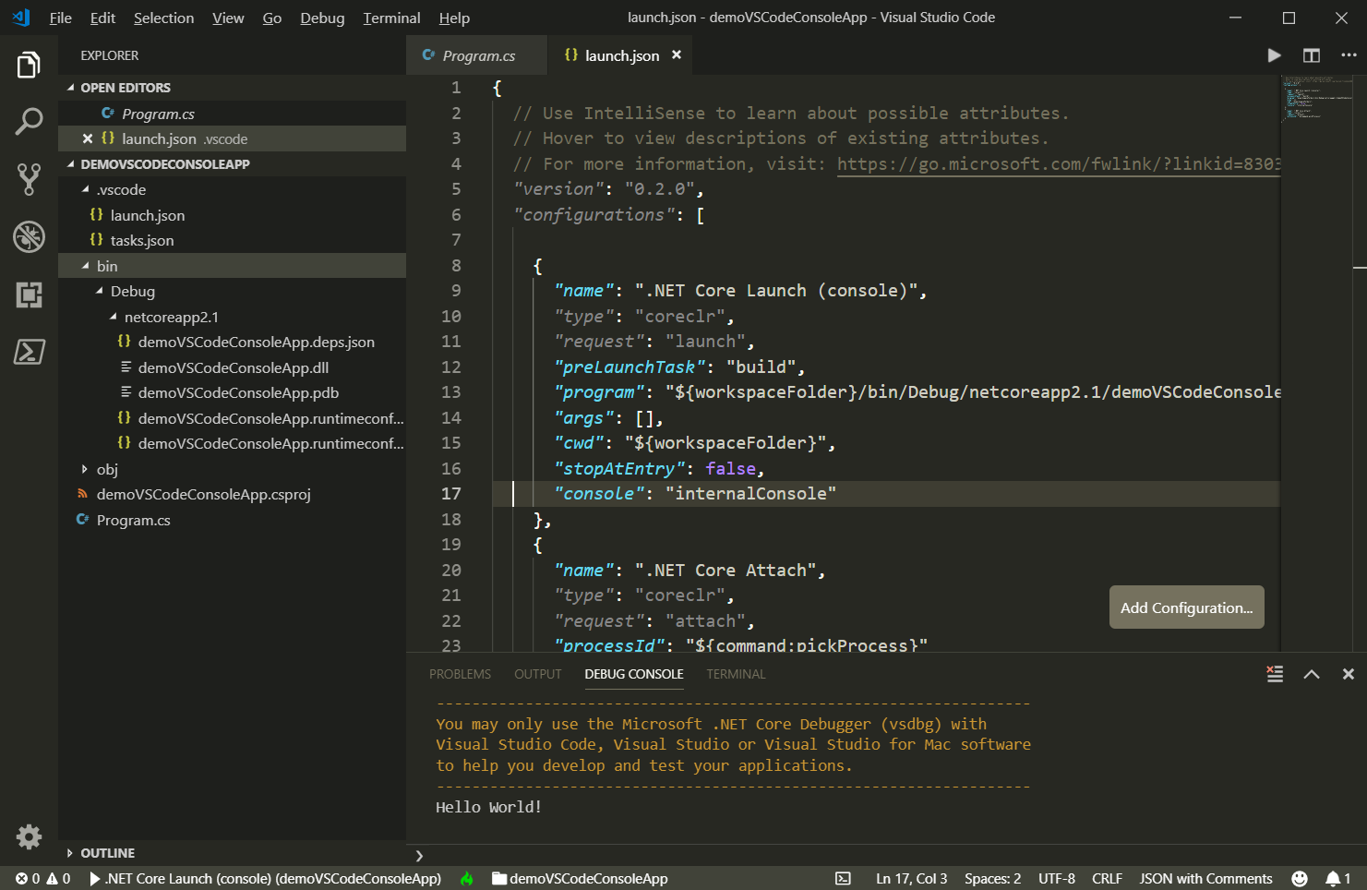
Building Console Applications

Slide 9
So What?
If we use Visual Studio Code:
  VS Code can’t create .net core projects
  So we create a project folder, call dotnet new console (or whatever)
  Open Visual Studio Code
  Open the newly created folder
    When you do this VS Code will ask if you want to create resources to work with that folder.
    Select yes – that builds a json settings file to manage builds and debugging
  Start editing files and running
Note that it is dotnet runtime that does the launching and debugging, not VS Code.

Slide 10
That’s all Folks!

