Slide 1
Help for dotnet Command
Jim Fawcett
CSE686 – Internet Programming
Spring 2019

Slide 2
dotnet
dotnet is a command line utility that has commands for creating, building, and running Net Core projects.
You can do, in Visual Studio and (I think) Visual Studio for Mac, everything that dotnet does, but often dotnet is quicker and easier.
dotnet is especially convenient when using Visual Studio Code.
  We’ll talk about VS Code in a follow-on presentation.

Slide 3
The Command Line
The dotnet command runs from the command line. On Windows, That means either:
  Cmd.exe
    The default shell.
  Developer’s cmd prompt
    Cmd with added environment variables to support code tool chains.
  PowerShell
    A powerful, but complex, shell.

Slide 4
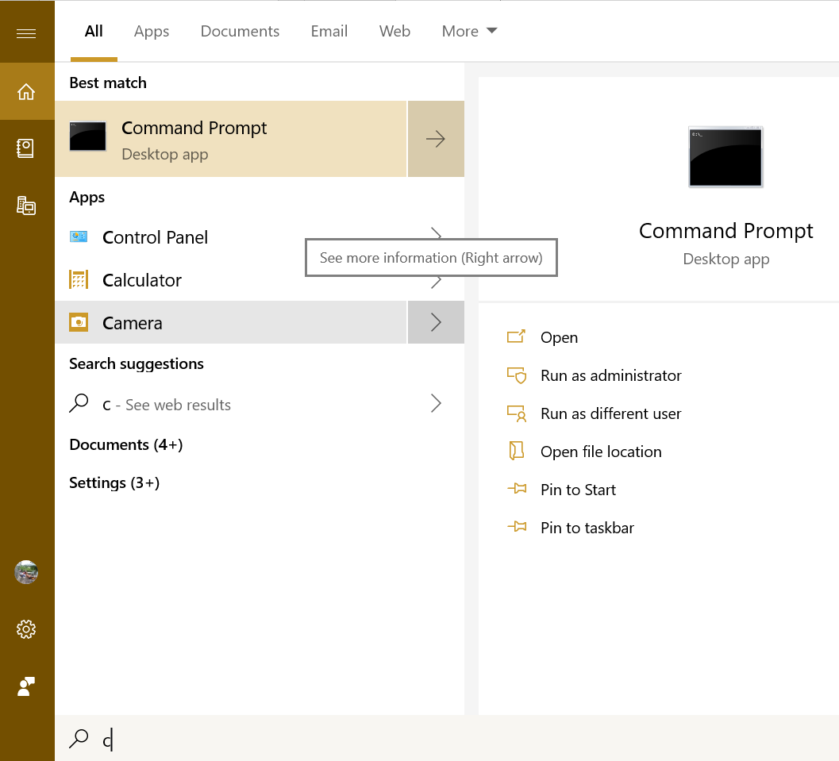
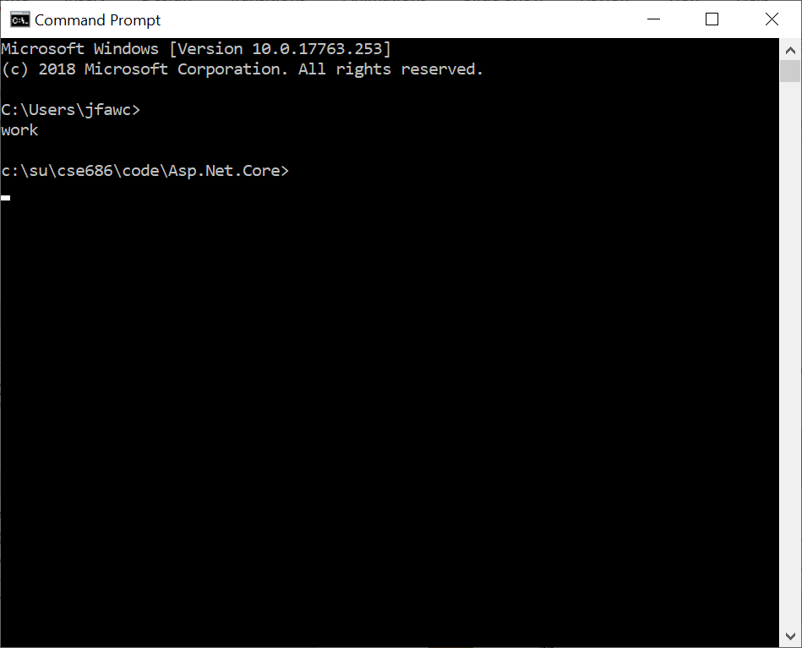
Cmd.exe

Slide 5
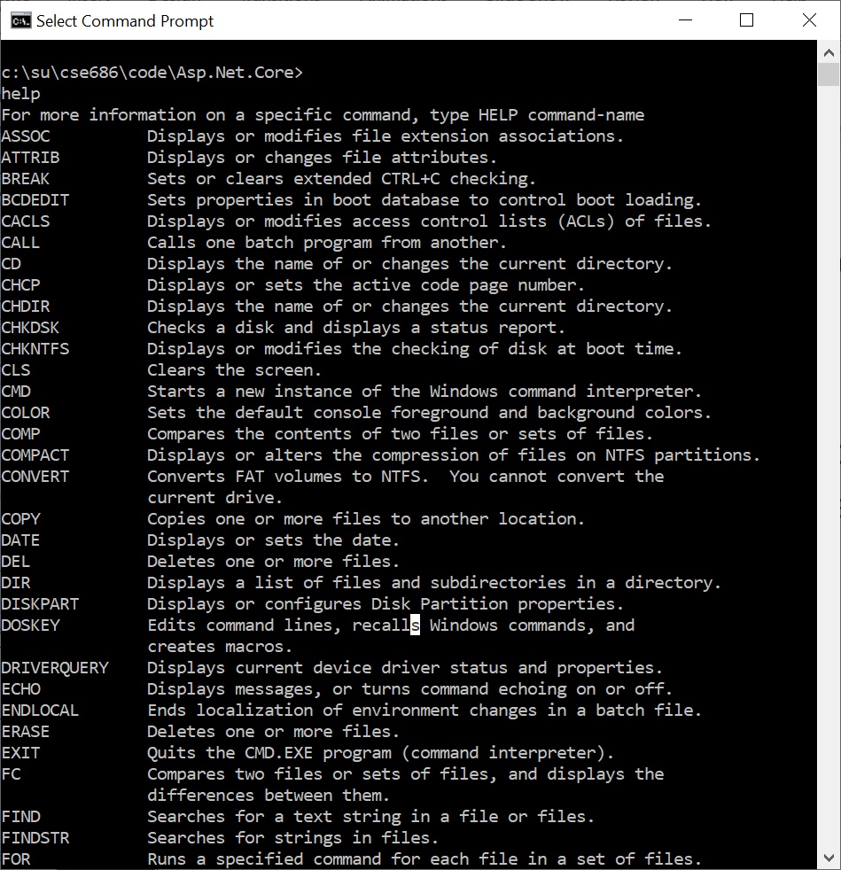
Functionality
Cmd.exe
  Create files and directories
  Run shell commands
  Run batch files and executables on your path
  Run dotnet command

Slide 6
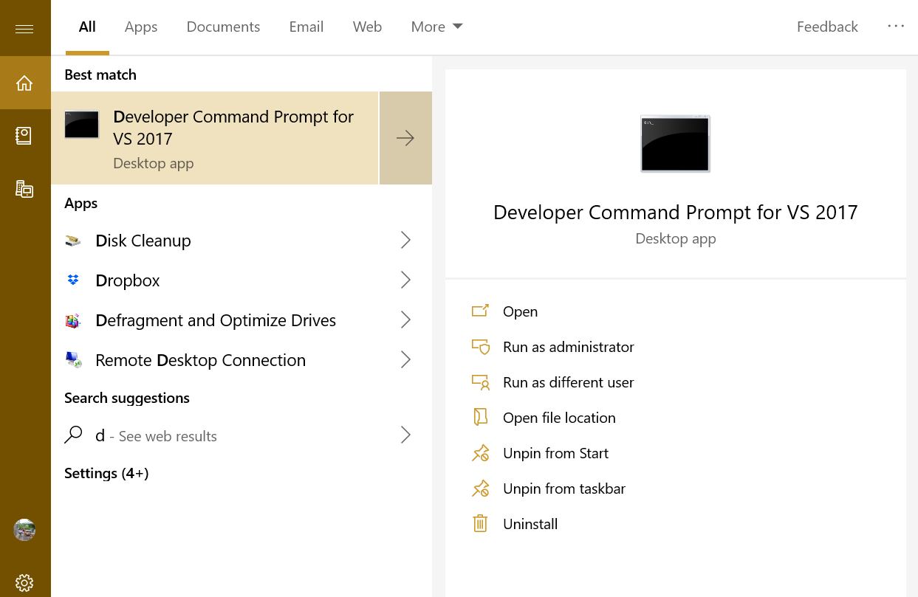
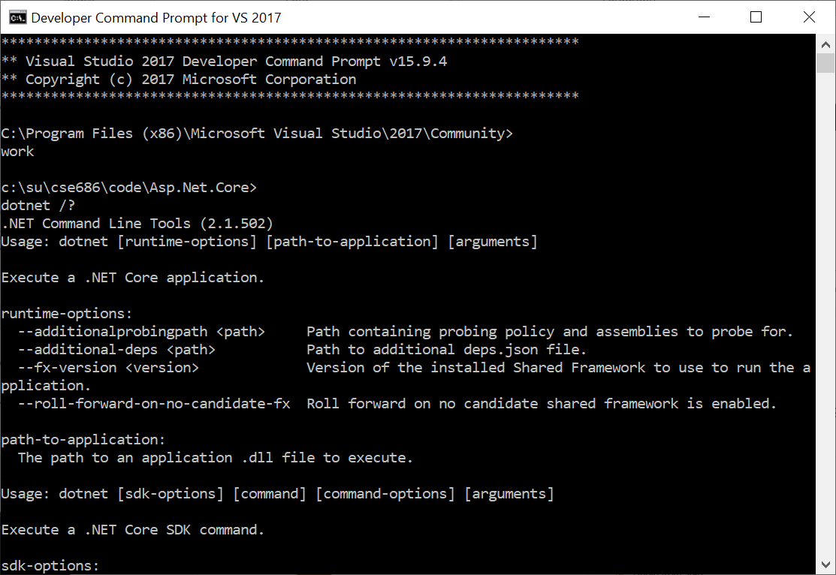
Developer’s Command Prompt

Slide 7
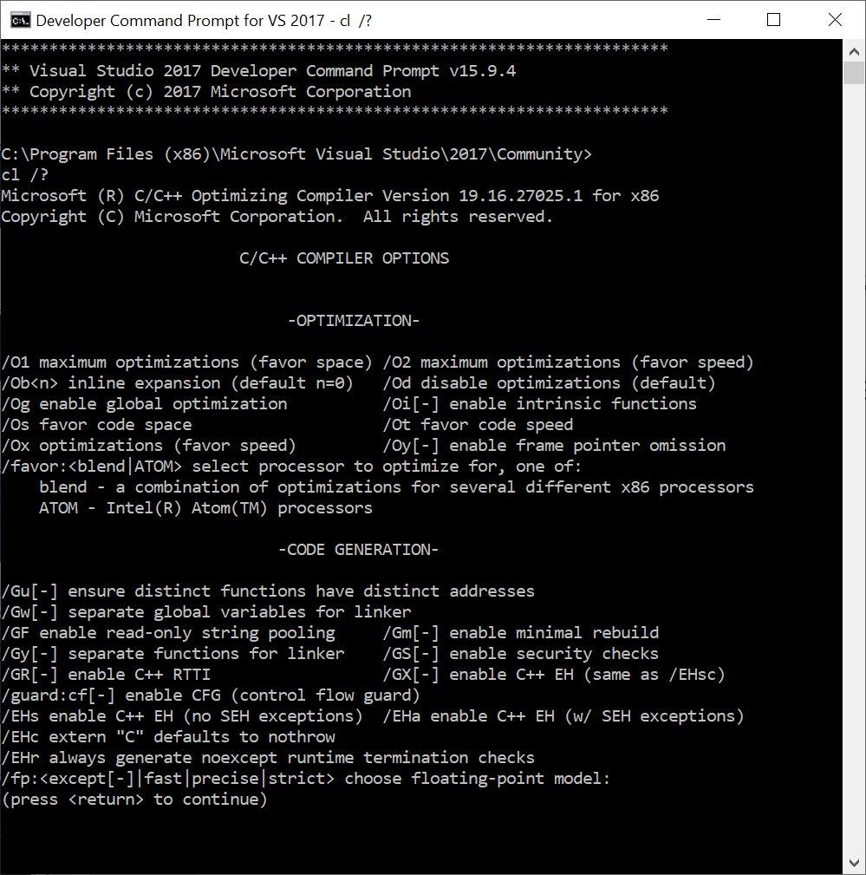
Functionality
Developer Command ….
  A superset of the Cmd.exe functionality
  Specifically, has environment variables to access C++ tool chain.
  We won’t need that capability in this course, but do in CSE687-OOD.

Slide 8
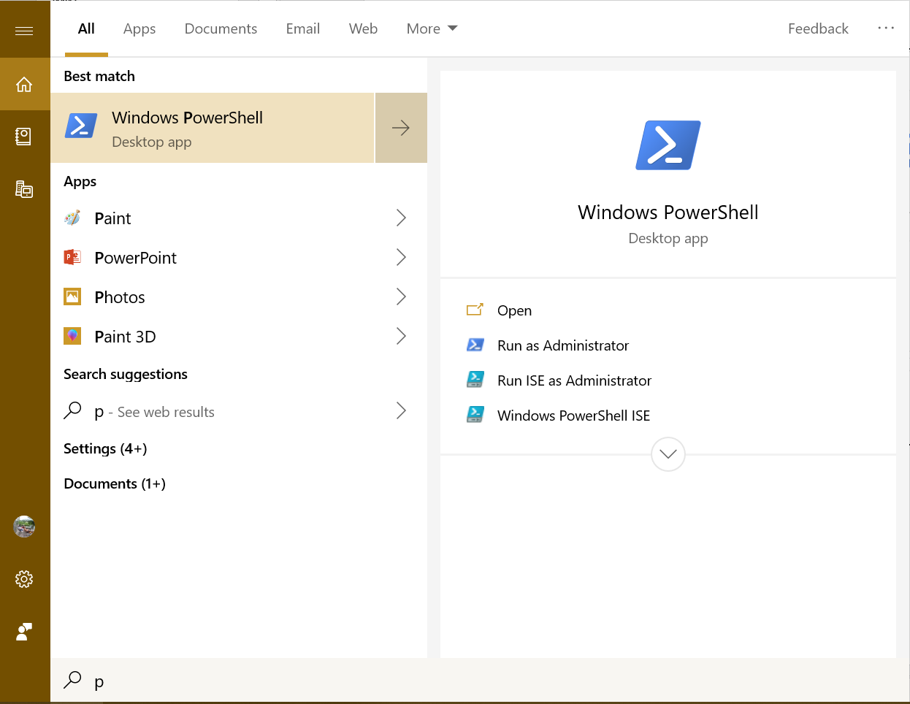
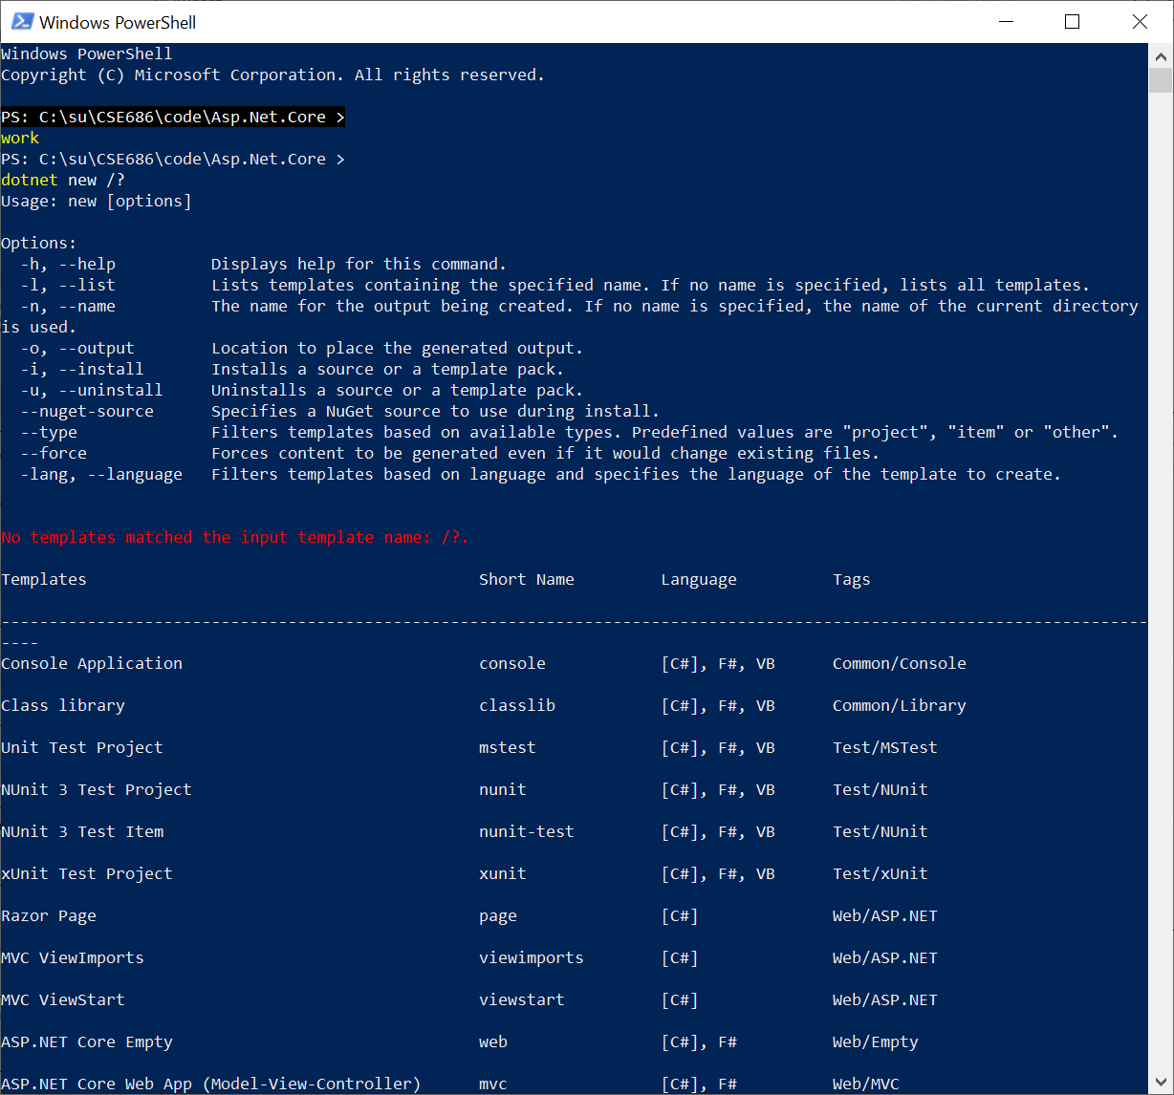
PowerShell

Slide 9
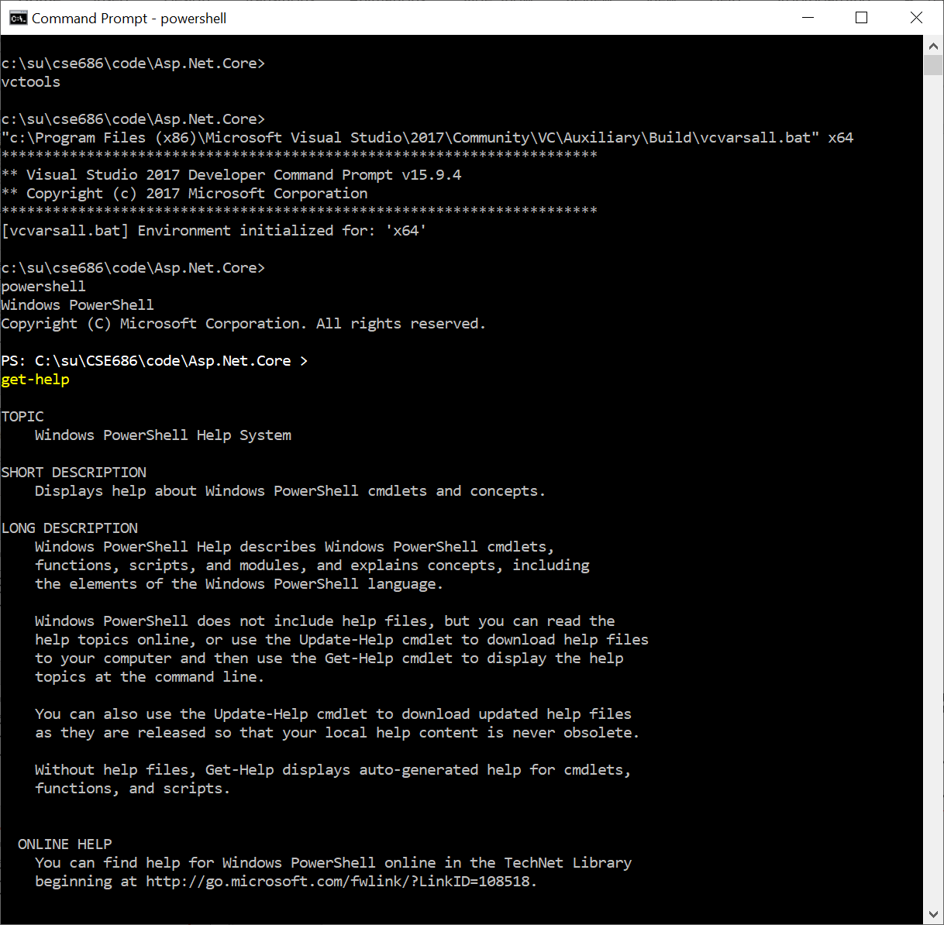
Functionality
PowerShell.exe
  A superset of the Cmd.exe functionality
  Has a lot of operations for system administration.
  Does not have environment variables to access C++ tool chain.
    We can add those by opening a cmd prompt, executing vcvarsall.bat, and then opening powershell from within the cmd shell.

Slide 10
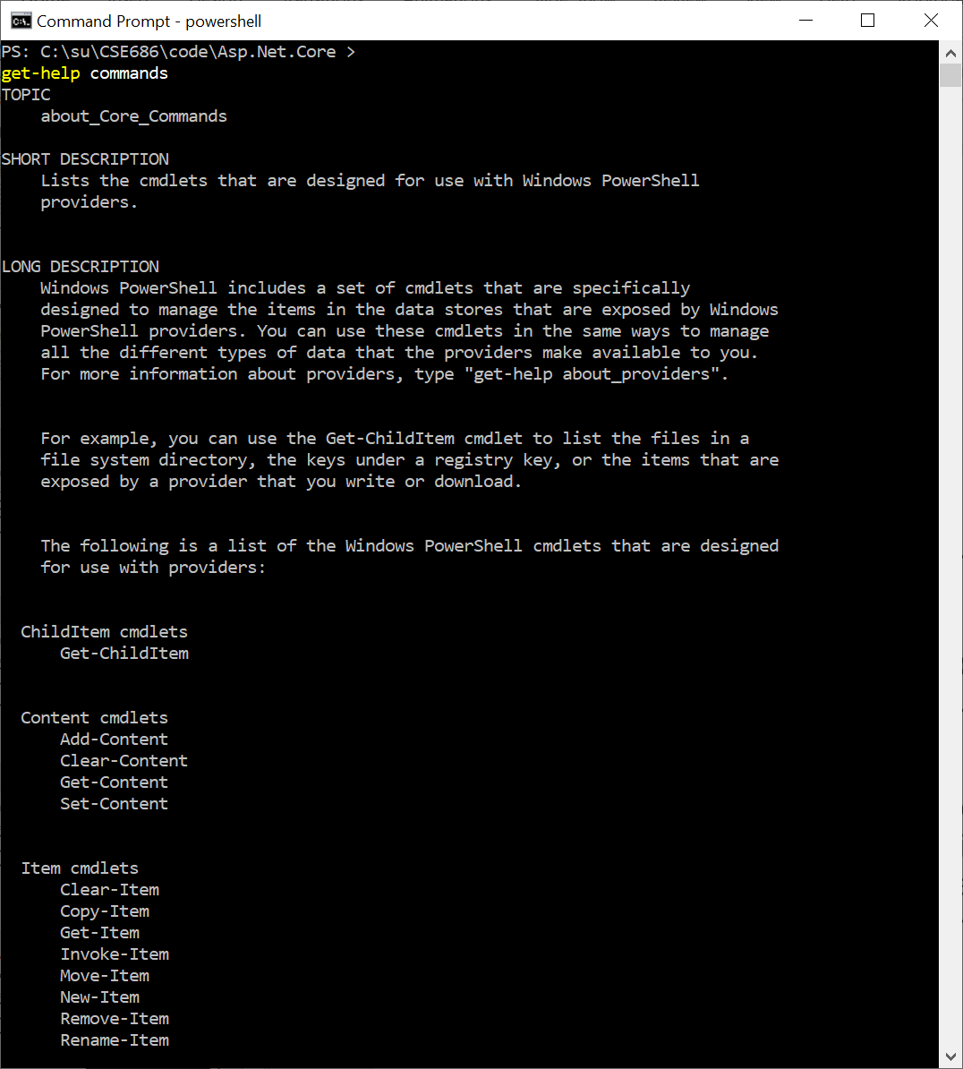
PowerShell Operations
PowerShell.exe
  Syntax for commands is:
    Verb Noun
    Example: get-Help commands
  Useful exploratory commands:
    Get-help
    Get-Help commands
    Get-Help objects
    Get-help About_Methods
    Get-help About_Properties
    Get-help About

Slide 11
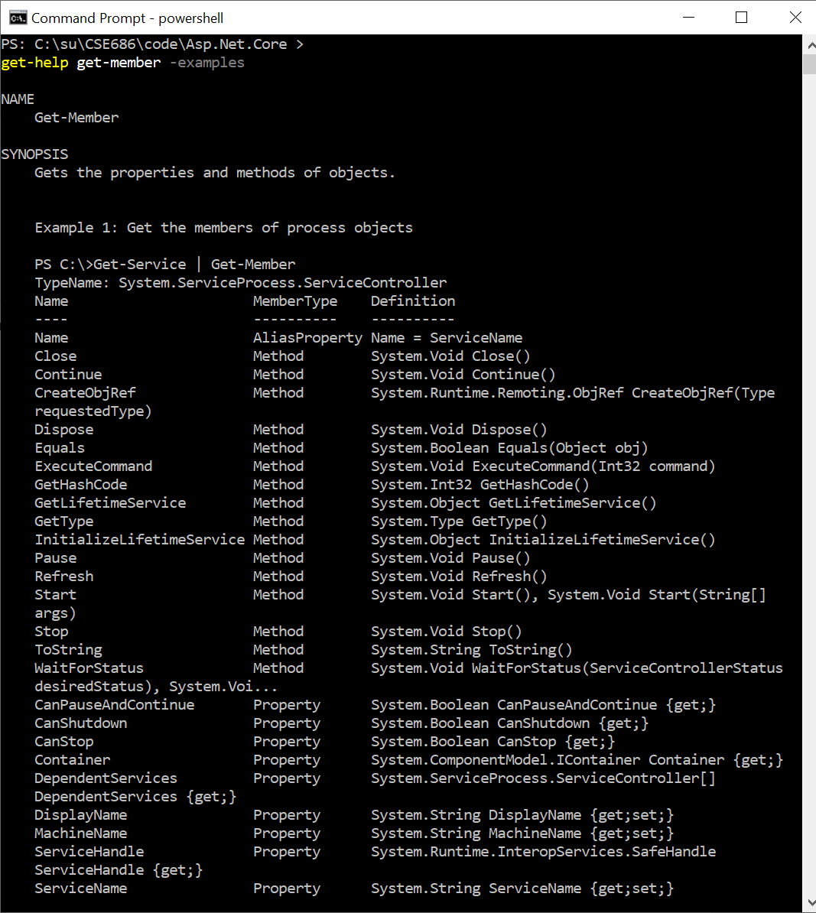
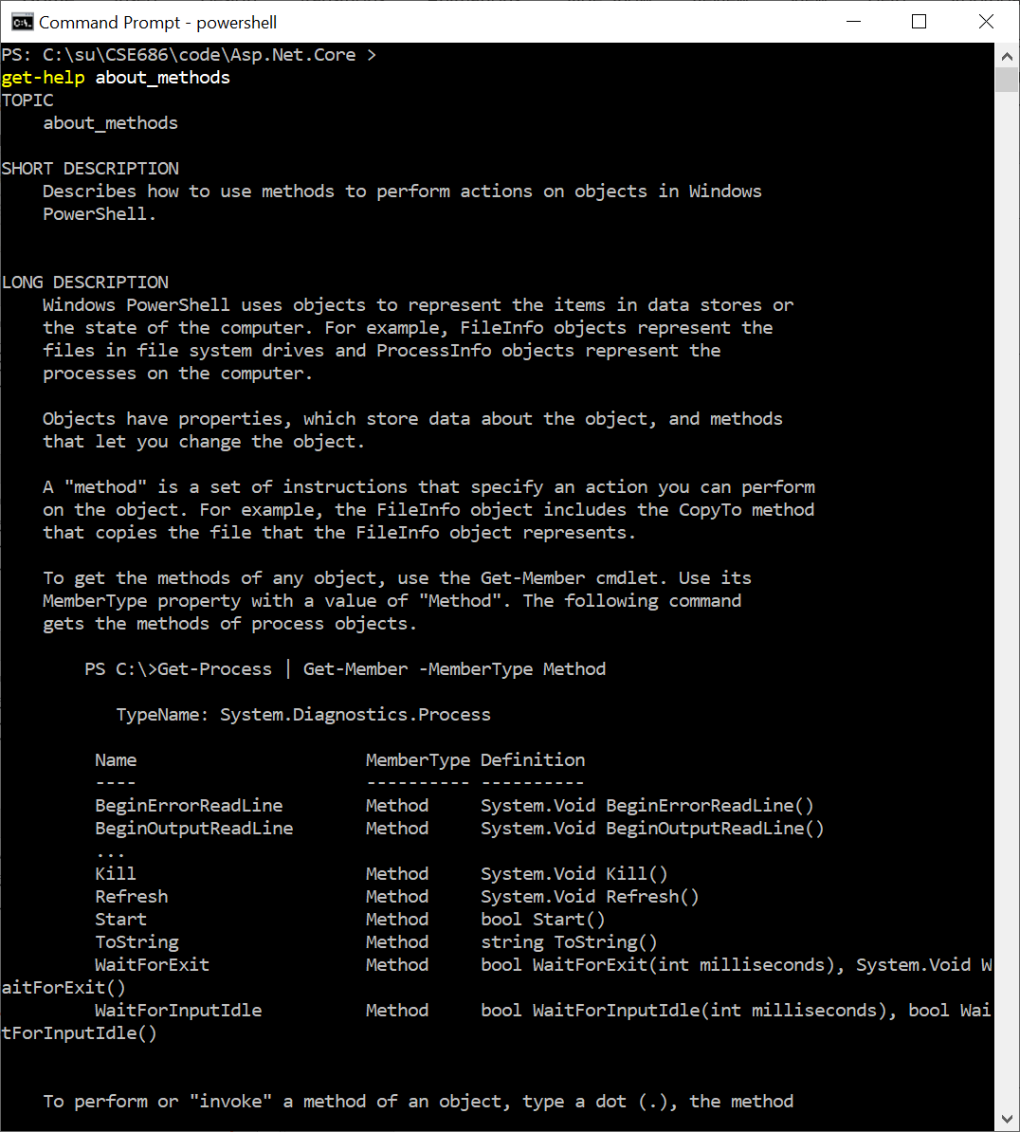
Examples

Slide 12
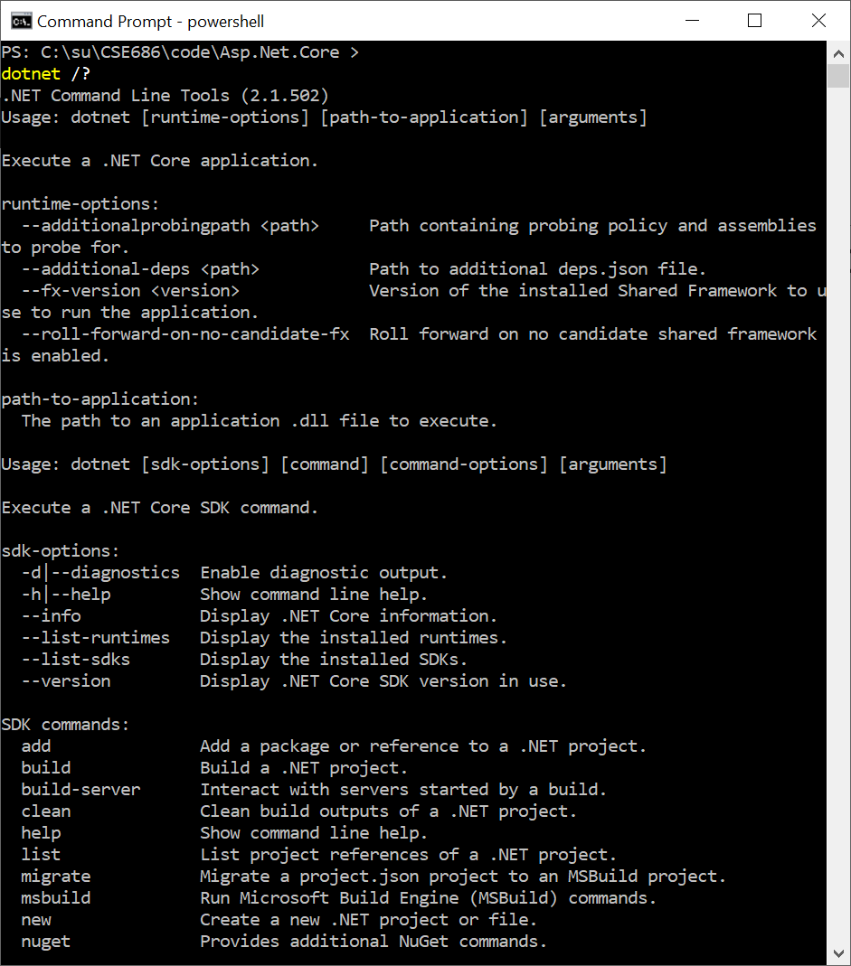
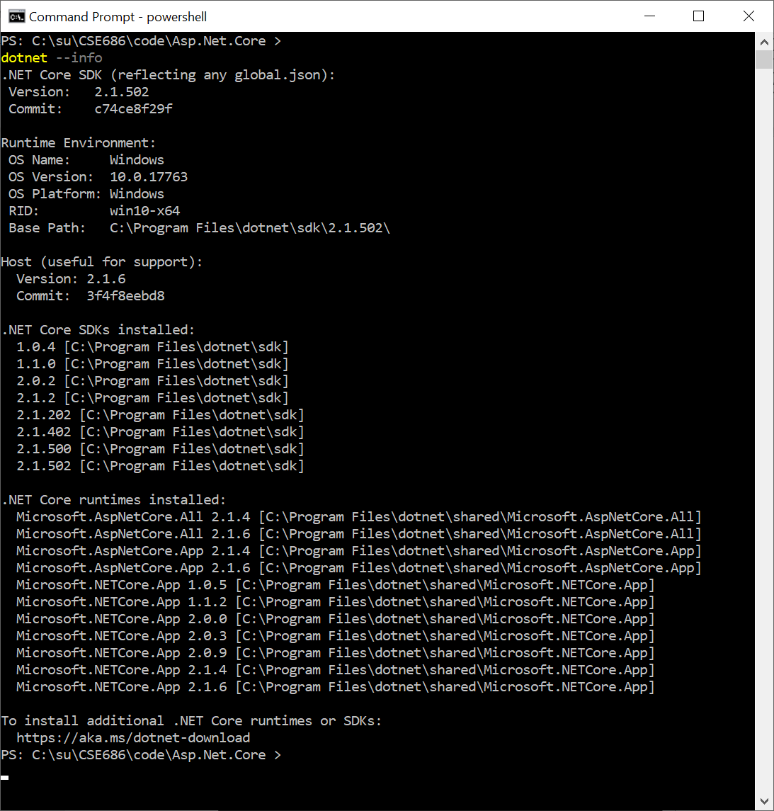
Now: dotnet command

Slide 13
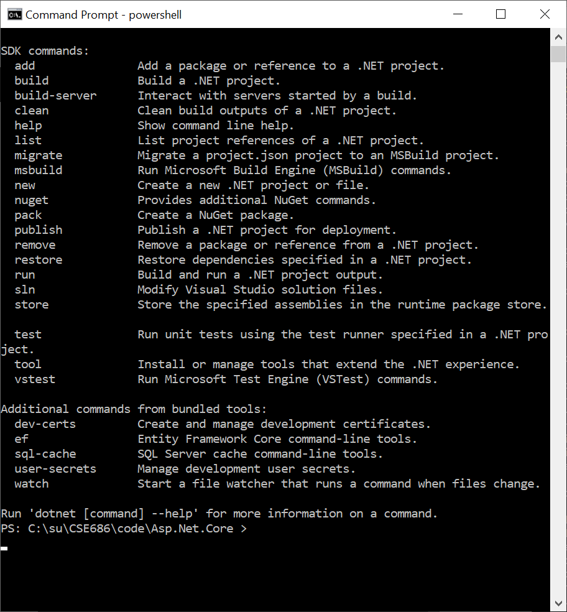
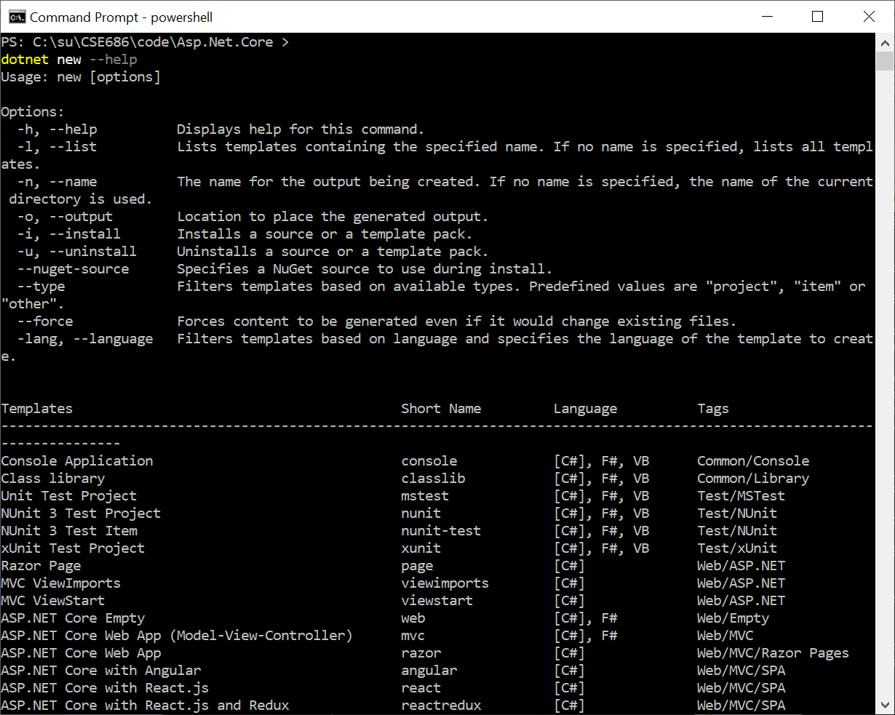
dotnet command

Slide 14
So What?
If we use Visual Studio Code:
  VS Code can’t create .net core projects
  So we create a project folder, call dotnet new console (or whatever)
  Open Visual Studio Code
  Open the newly created folder
    When you do this VS Code will ask if you want to create resources to work with that folder.
    Select yes – that builds a json settings file to manage builds and debugging
  Start editing files and running

Slide 15
That’s all Folks!

