Slide 1
Web Application
Secure Coding

Slide 2
Warning
Do not try any of the techniques discussed in this presentation on a system you do not own.
It is illegal and you will get caught.

Slide 3
Why do I care?

Slide 4
Why do I care?
do you use the internet?
visit forums?
use multiple tabs in your browser?
use online banking?

Slide 5
A quick example
you are logged into your bank
in a separate tab you visit a forum (or a webpage)
in the forum/page someone placed a JS code that executes and transfers money out of your account

Slide 6
How?
a very unsafe forum site or an evil page
  allows you to upload the script
slightly unsafe bank site
  allows the script to execute.. but there may not be much the bank can do here
code specific to a bank
  which bank?
    Bank Of America
    Chase
    Key Bank
    HSBC

Slide 7

OWASP
The Open Web Application Security Project
www.owasp.org
OWASP is a not-for-profit worldwide charitable organization focused on improving the security of application software.
OWASP Top 10
“The OWASP Top Ten provides a powerful awareness document for web application security. The OWASP Top Ten represents a broad consensus about what the most critical web application security flaws are.”

Slide 8
OWASP Top 10 for 2013
A1: Injection (A1)
A2: Broken Authentication and Session Management (A3)
A3: Cross-Site Scripting (XSS) (A2)
A4: Insecure Direct Object References (A4)
A5: Security Misconfiguration (A6)
A6: Sensitive Data Exposure (A9 renamed)
A7: Missing Function Level Access Control (A8 renamed)
A8: Cross-Site Request Forgery (CSRF)(A5)
A9: Using Components with Known Vulnerabilities (new)
A10: Unvalidated Redirects and Forwards (A10)

Slide 9
A1: Injection
untrusted data is sent to an interpreter as part of a command or query
hostile data can trick the interpreter into executing unintended commands or accessing unauthorized data
many types:
  SQL
  OS
  scripting languages
  SOAP
  XPath
  SMTP
  LDAP

Slide 10
A1: Injection - Mitigation
always assume that user input is hostile
use a safe API whenever possible
if not possible, use a parameterized interface
if not possible, canonicalize and validate user input
  canonicalization (aka c14n) – process of for converting data into a standard/normal representation/encoding
  validation – use white list validation

Slide 11
SQL Injection
  “SELECT * FROM users WHERE UserID = ‘” + userFromSite + “’”
    if userFromSite is aaa’ OR ‘1’ = ‘1
    SELECT * FROM users WHERE UserID = ‘aaa’ OR ‘1’ = ‘1’”
    if userFromSite is aaa’; DROP TABLE users; --

Slide 12
OS Injection
“move file1.txt “ + fileNameFromUser
  if fileNameFromUser is file2.txt & delete c:\*.* \quiet

Slide 13
SQL Injection Example

Slide 14
A2: Broken Authentication and Sessions
authentication and session management are often not implemented correctly
allows attackers to compromise passwords, keys, session tokens to assume other users’ identities
external travel site example

Slide 15
A2: Broken Authentication and Sessions – Avenues of attack
Weak or improperly implemented Authentication mechanisms
  username/password transmitted in plain text
  not restricting URL access
  creating your own, incorrectly implemented schema
Cross-Site Request Forgery (CSRF) (A8)
Session Hijacking
  stealing session cookie
Session Fixation
  getting someone to authenticate into an SID

Slide 16
A2: Broken Authentication and Sessions – Mitigation
Session ids and user passwords need to be stored and transported securely
Session ids should expire at the end of the session and a new session id should be generated at the beginning of each session (.Net reuses Session Ids)
Avoid using session ids in a URL if possible
SSL should be used to transport user passwords and session ids
When passing a user password, the client should use SSL to send a non-hashed password to the server. The server should then hash the password and compare it to the stored hashed password
Always use existing encryption and hashing routines. Never write your own.
Notes:
Validated crypto algorithms:
http://csrc.nist.gov/groups/STM/cmvp/documents/140-1/140val-all.htm

Slide 17
A2: Broken Authentication and Sessions – Mitigation continued
store credentials securely
  usernames and passwords – do NOT store in clear text
  connection strings
allow user to log out
force session timeout
force reauthentication before allowing a sensitive operation
prevent caching of sensitive areas

Slide 18
A3: XSS (Cross-Site Scripting)
application takes untrusted data and sends it to a web browser without proper validation and escaping
XSS allows attackers to execute scripts in the victim’s browser
can hijack user sessions, deface web sites, or redirect the user to malicious sites
“Good morning George”

Slide 19
A3: XSS - Mitigation
do the following to all input, even if it’s coming from the DB, which you trust
do c14n
validate input w/ a white list
encode output (HTTP or URL)
do NOT use HttpUtility.HtmlEncode
can use AntiXSS/Web Protection Library
  setup once in web.config, then everything is encoded

Slide 20
XSS with JS
<SCRIPT>alert(‘Hello’);</SCRIPT>
<SCRIPT>alert(document.cookie);</SCRIPT>

Slide 21
XSS/Session Hijacking Example
file exploder

Slide 22
Login Link Hijacking Example
WizzardAspNet

Slide 23
A4: Insecure Direct Object References
developer exposes a reference to an internal implementation object
without an access control check or other protection, attackers can manipulate these references to access unauthorized data
example: http://myserver2.com/scripts/results.jsp?docid=25

Slide 24
A4: Insecure Direct Object References - Mitigation
recognize:
  do not use DB keys to reference your data
  examples: dropdown key/value, GridView/Repeater
  do not use hidden fields
obfuscate references – use an index or a map
revalidate permissions
validate against a good list

Slide 25
A5: Security Misconfiguration
a secure configuration needs to be defined and deployed for the application, frameworks, application server, web server, database server, and platform
all of these settings should be defined, implemented, and maintained as many are not shipped with secure defaults
this includes keeping all software up to date, including all code libraries used by the application

Slide 26
A6: Sensitive Data Exposure
Sensitive data can be stolen from many places
  data at rest
  data in transit
  customers browsers
  backups
Mitigation
  do not collect/store sensitive data if possible
  encrypt sensitive data at rest but also in transit
  use strong and proven encryption algorithms
  use proper password hashing
  disable autocomplete of sensitive data

Slide 27
A7: Missing Function Level Access Control
Anyone on the network can send a request to your application
Changing a URL or replaying a request can access methods you thought “private”
Mitigation
  every function exposed to the outside needs to authenticate
  deny access by default, only allow if all conditions are met
  log invalid request attempts & actually review these

Slide 28
A8: Cross Site Request Forgery (CSRF)
logged-on victim’s browser sends a forged HTTP request to a vulnerable web application
the attackers forces the victim’s browser to generate requests which the vulnerable application thinks are legitimate requests from the victim

Slide 29
A8: Cross Site Request Forgery (CSRF) - Mitigation
create a CSRF token (random, hard to guess)
use it when sending data down
verify when data comes back
regenerate the token for a new page
use CSRFGuard or @Html.AntiForgeryToken()
[ValidateAntiForgeryToken]

Slide 30
A9: Using Components with Known Vulnerabilities
flaws are discovered every day in all sorts of components
  .NET flaw (html encoding)
avoid using code you didn’t write whenever possible
if you have to
  identify all components and their versions; keep your ears open
  consider adding wrappers around external components (security & design reasons)

Slide 31
A10: Unvalidated Redirects and Forwards
Web applications frequently redirect and forward users to other pages and websites, and use untrusted data to determine the destination pages
Without proper validation, attackers can redirect victims to phishing or malware sites, or use forwards to access unauthorized pages

Slide 32
A10: Unvalidated Redirects and Forwards - Mitigation
never perform redirects or forwards using client-side scripts based on DOM data, since the data is outside the control of the server and cannot be trusted
don’t use redirects and forwards
use direct links in the page, instead
if you have to forward, don’t use user-submitted data in determining the destination

Slide 33
Error Leakage
applications can unintentionally leak information about their configuration, internal workings, or violate privacy through a variety of application problems

Slide 34
Error Leakage Mitigation
display a generic message to the user
log necessary details, with the exception of sensitive data
ensure that log access is restricted
use custom errors

Slide 35
DB Access
least privilege principle
consider having multiple accounts
  user and admin
  …
  read only, R/W, admin read only, admin R/W

Slide 36
Case Study
Consultation

Slide 37
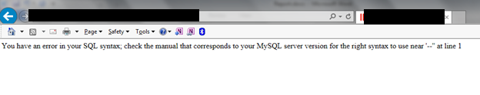
Error Leakage

Slide 38
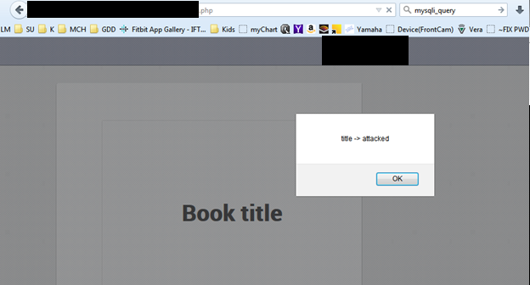
XSS Attack

Slide 39

Session Theft – Log in User 1

Slide 40
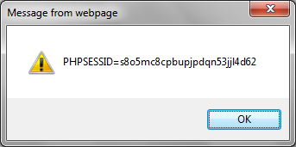
Session Theft – Obtain Session ID from User 2
alert(document.cookie );

Slide 41

Session Theft – Impersonate User 2
document.cookie = 'PHPSESSID=s8o5mc8cpbupjpdqn53jjl4d62;path=/';

Slide 42
Direct and Insecure Reference
http://www.XXXXX.com/read_book.php?book_id=1&chapt_id=1
http://www.XXXXX.com/deletebook.php?bid=5

Slide 43
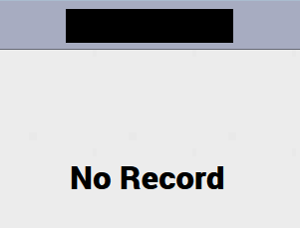
SQL Injection
http://www.XXXXX.com/deletebook.php?bid=5
http://www.XXXXX.com/deletebook.php? bid=5 OR 1=1

Slide 44
Case Study
Mvc-WebApi-FileService

Slide 45
Files
FileController.cs
  cookie handling
Session.cs
  session handling

