Slide 1
Segments
Basic Uses: slides 2–7 15 minutes
Advanced Uses: slides 8–11 10 minutes
Won’t present slides 12–18,
but they should stay in deck

Slide 2
Project Center Use Cases
Jim Fawcett
Software Modeling
Copyright © 1999–2017

Slide 3
Project Center
Project Center was a project assigned to another course, CSE784—Software Studio, but these slides are also relevant to our projects #1 and #4.
Project Center is a software development collaboration system, built from a number of open-source projects with code wrappers to enable them to communicate and collaborate effectively.

Slide 4
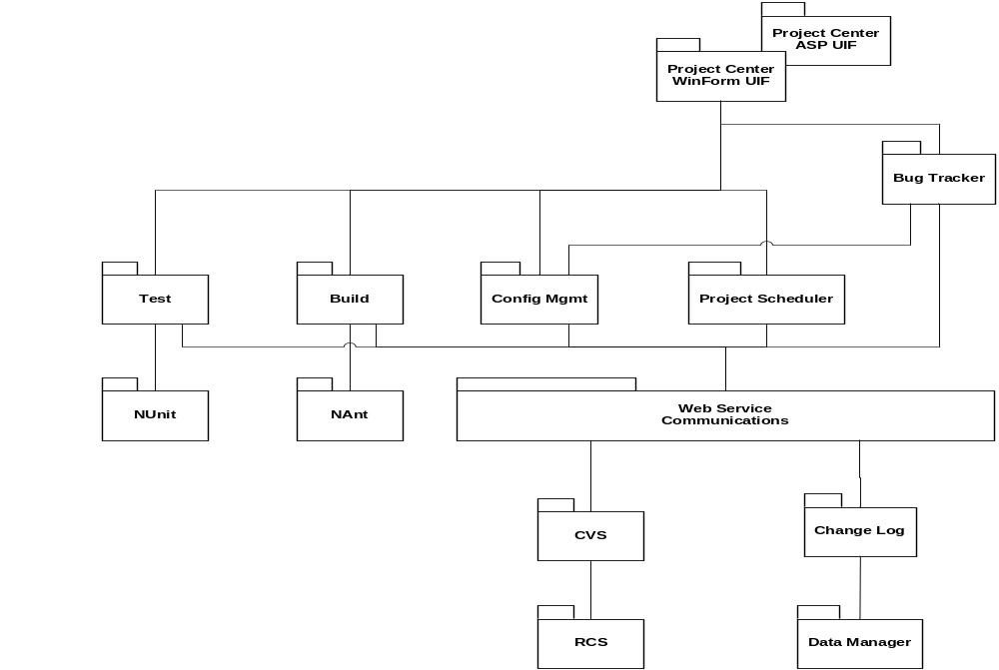
Project Center Packages

Slide 5
Developer’s Daily Use
Look at Project Center schedule, notices pages, alerts
Get today’s work from Project Center:
  Get latest source of my code from CVS including NAnt build script.
  Get latest build of other team’s code on which my code depends
  Make modifications or additions to my code.
  Build my source, incorporating libraries on which my code depends, using NAnt.
  Run NUnit on my source and iterate, recording and working off bugs.
  Commit changes to CVS. That automatically results in change log entry. Any components frozen cannot be committed to CVS.
Send libraries of my latest code that others need to Project Center via CVS.
Project Center tools used:
  CVS, NAnt, NUnit, Schedule, Change Log, Bug Tracker

Slide 6
Developer at Customer’s Site
Walk customer through requirements issues, demo part of code, record customer issues in P.C. from customer site.
  Login to P.C. via browser
  View Requirements Database
  Open CVS web interface from browser
  Extract demos from CVS and run at customer’s site
    Can modify and rebuild onsite if developer takes laptop with P.C. installed.
  Walk through bug reports and change logs to discuss progress
Project Center tools used:
  CVS, Requirements Database, Bug Reports, Change Log, all via Asp—possibly NAnt and NUnit run on laptop.

Slide 7
Use of Project Center for Qualification
All Qualification builds—typically four or five—ready to go in CVS with NAnt scripts to rebuild should the customer want to peek at internals.
  Usually extract just executables
  But may rebuild any of the test builds with single NAnt command
NUnit set up to run each of the Qualification Tests, showing, by default, only what is necessary for qualification.
  Each test procedure captured in help module
  Requirements database synchronized to qual test showing B-Spec requirement for this test and A-Spec requirements it maps to.
Project Center tools used:
  Requirements Database, CVS, NAnt, NUnit, Help

Slide 8
Customer’s Use of Project
Center for Maintenance
We deliver Project Center along with product
  CVS, NAnt, NUnit all set to run regression tests on delivered product
Project Center help has inserted module that documents product code—a supplement to delivered documents
Customer can now immediately do modifications and builds without studying the product packaging for weeks.
Project Center tools used:
  CVS, NAnt, NUnit, Help

Slide 9
Manager’s Use of Project Center
Review status of builds and tests through schedule-based status reports. What is important here is clarity of the information transfer, not having a pretty or fancy calendar. You are not asked to reinvent Outlook or Microsoft Project Manager.
  Schedule says Display team has scheduled integration build to integrate with Data Editing team.
  Schedule shows that Display team has not installed the required build the day before integration.
  Checks Quality Assurance report for last display build and reviews (from CVS).
  Checks bug tracker reports.
Checks to make sure that the notification for scheduled integration has been posted (a month ago).
Sends notice to Display team leader that there will be a meeting in half hour in manager’s office.
After meeting manager posts action items associated with that meeting, assigned to the Display team leader.
  Note that much of this functionality is fairly close to that supplied with the requirements database and other tools.
Project Center tools used:
  Schedule, CVS, Bug Tracker, Schedule Alerts, Action Item Database (Bug Reporter with a different name?)

Slide 10
Architect’s Use of Project Center
Reviews all interfaces held by CVS against the OCD.
Reviews CVS holdings for implementation and test of each interface’s implementations.
Extracts a team’s source and NAnt build script, builds executable and reviews functionality by running NUnit.
  Each team is required to deliver test drivers with their libraries.
  Each obligation of the team’s code is either demonstrated or a message is stubbed stating its current status.
  All of this runs under NUnit.
Architect reviews team’s view of its obligations using this process from the beginning of development.
  Each team is asked to declare its assigned interfaces and provide a fully stubbed implementation at the beginning. It then replaces each stub as the real code is developed.
  Each stub announces what it will be delivering.
Project Center tools used:
  CVS, NAnt, NUnit, Requirements DataBase

Slide 11
Quality Assurance Use of Project Center
QA member assigned to Display team extracts source from CVS, including NAnt build script.
Uses NUnit to run series of code standards conformance tests on source.
Builds executable or library with test drivers, supplied by Display team.
Notes warnings.
Runs QA build and notes functionality supplied.
  Each team is required to supply NUnit tests that display what works and have stub messages for what does not yet work.
Writes QA report and stores in CVS, associated with the Display build.
Project Center tools used:
  CVS, NAnt, NUnit with special QA tests

Slide 12
Some Observations about Design
Most of the custom tools are minor variants of a single design
  Requirements Database
  Bug Tracker
  Change Log
It would be extremely useful to have web service interfaces to add and modify entries in any of the databases.
Examples:
  When modified code is committed to CVS it would be simple to have Project Center user interfaces insert the change record to Change Log using its service interface.
  When Qual Testing, it would be simple to synchronize NUnit test with display of B-Spec requirement and A-Spec requirement in separate windows using web service access to Requirements Database to search for requirement by number.
  Meetings and reviews could be scheduled using web service interface to scheduler.
It may also be useful to provide a command line interface for insertion and modification of database entries. Will make our tools consistent with the open-source tools, which all have command line interfaces.

Slide 13
Observations about Design
Should designate Project Center server
Users have Project Center WinForms interfaces on their client machines.
Users can access most of the Project Center functionality through a browser, viewing Asp pages from server.
  All persistent data resides on Project Center server
    CVS/RCS code and document storage
      Should support private and public storage for each team
    NAnt build scripts (in CVS)
    Requirements
    Bug Reports, Change Logs
    Schedule and Tracking information
  Tools may reside on client or server. Architect will choose with help of team leaders.

Slide 14
Prototyping
The best way to decide how to glue all this together is to use the open-source tools before committing to the Project Center structure.
  Suggest we download all of them and use them with a couple of small example projects, perhaps CSE784, Project #1 for this year.
  Since the custom tools are entirely under our control, they can fit into the same structure needed for CVS, NAnt, and NUnit.

Slide 15
Distributing Workload across Teams
Database and Security:
  Designs queries for all accesses to any of the databases, providing interfaces with insertion, update, and extraction
Open-Source Tools team:
  Prototype use of open-source tools with Project #1
  Responsible for help subsystem design and implementation
  Provides help contents for open-source tools
Communication team:
  Provides web service message-passing for custom tools
  Provides web service message-passing wrapper for open-source tools.
    All open-source tools have command line interfaces so this should be straightforward.
    Tutorial links—later slide—indicate how command line interfaces work.

Slide 16
Distributing Workload across Teams
Scheduling and Tracking team
  Design and implement Scheduler, Requirements Database, Bug Tracker, Change Log.
  Design and implement support for inserting new tools.
WinForms Interface team
  Will have plenty of work with interface.
  Main problem is getting early access to code to call.
Asp Interface team
  Plenty of work with interface pages
  Same problem as WinForms team
Test team—plenty of work already
To get a quick start, User Interface teams could work out detailed use cases
Then start hooking up open-source tools using communication stub
  Comm stub is just post-message, get-message interfaces used in the local process as a stand-in for commlink to another machine until that becomes available.

Slide 17
Derived Requirements
User authentication
Interoperation between tools
  Bug Tracker cites CVS entries
  CVS writes to Change Log
  Project Scheduler reads CVS and/or Change Log, NUnit log

Slide 18
Open-Source Tool Tutorials
Tutorial links
  CVS: http://www.csc.calpoly.edu/~dbutler/tutorials/winter96/cvs/
  RCS—used by CVS: http://www.csc.calpoly.edu/~dbutler/tutorials/winter96/rcs/
  NAnt: http://nant.sourceforge.net/help/index.html
  NUnit: http://www.nunit.org/getStarted.html
Notes:
  You will find, looking at these links, that all these open-source tools provide command-line interfaces.
  That means that accessing them through a web service interface should be straightforward.

