Slide 1
Software Structure Presentation Notes
Segments
  Overview – slides 2-7, time 15 minutes
  Data Driven – slides 8-20
    Client Server – slides 10-15, time 15 minutes
    Three Tier – slides 16-20, 15 minutes
    Slides 12, 14, 21-23 are hidden but should stay in deck
  Layer Driven – slides 26-29, 10 minutes
  Distributed Services – slides 30-34, 10 minutes
  Analysis Driven – slides 35-38, 10 minutes
  Communication Driven – slides 39-49, 20 minutes
  Thread and Event Driven – slides 50-58, 20 minutes
    Slides 59-63 are hidden but should stay in deck
  Enterprise Computing – slides 64-70, 15 minutes
    Slides 71-76 are hidden but should stay in deck
  Total time 120 minutes

Slide 2
Software Structure
Jim Fawcett
CSE681 – Software Modeling and Analysis
Fall 2016

Slide 3
Introduction

Slide 4
What is Software Structure?
Partitions – classes, packages, systems
  Separation of concerns
Communication
  How do the parts make requests and send notifications?
Sharing
  How is data shared between the parts?
Control
  Which parts interact with which other parts?

Slide 5
Program Structure
Logical – class structure:
  Interfaces, classes, and class relationships
Package – code file structure:
  Package dependency tree, as shown in package diagrams
  Subsystems, e.g., collection of packages separated by interfaces with each focused on specialized processing
    For a radar those might be: signal processing, beam forming, data management, operator control, communication.
Execution – binary structure:
  Monolithic Program, e.g., an exe
  Program with loadable Dynamic Link Libraries (DLLs)
  Cooperating processes, e.g., client-server, server federation, etc.

Slide 6
Code Analyzer Example
The next slide shows the logical structure of a code analyzer, focusing on the front-end analysis.
There are four modules
  Lexical Scanner – reads token groups from stream
  Parser with Rules and Actions – builds AST
  Executive with builder - assembles all the parts
  Display – maps AST data into information
You will find more discussion in the Parser Blog

Slide 7
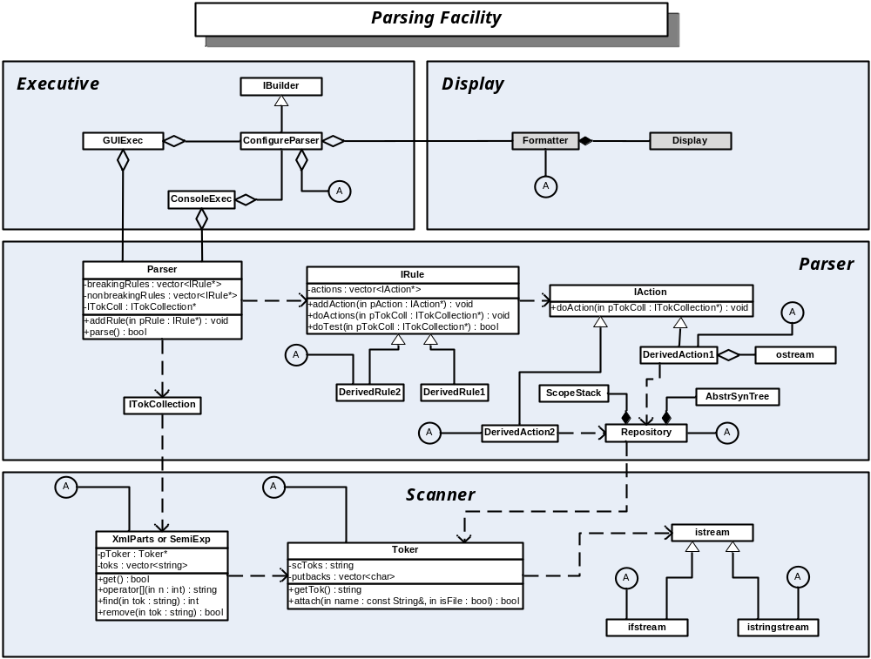

Slide 8
Software Structure Contents
Data Driven
  Client server
  Three tier
  Model-View-Controller
Layered Structure Driven
  Components
  Services
Analysis Driven
  One pass
  Two passes
Communication Driven
  Client Server
  Peer-to-peer
  Middleware
Thread & Event Driven
  Single Threaded Apartment (STA)
  Parallel execution
  Pipeline execution
Enterprise Computing
  Federated systems

Slide 9
Data Driven Structures

Slide 10
Data Driven Structures
Some program structures are driven by the presentation and management of data:
  Client-Server
  Three-Tier
  Model-View-Controller

Slide 11
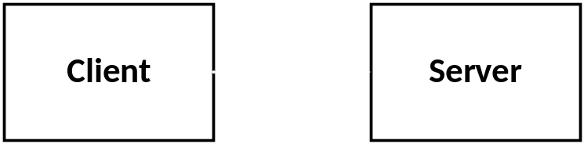
Structure: Client-Server
Behavior:
  Server is passive, waits for client requests
  Server contains data shared among its clients
  Server handles multiple concurrent clients
  Without additional structure system may become tightly coupled and difficult to change
Example:
  Web server and browser clients

Slide 12
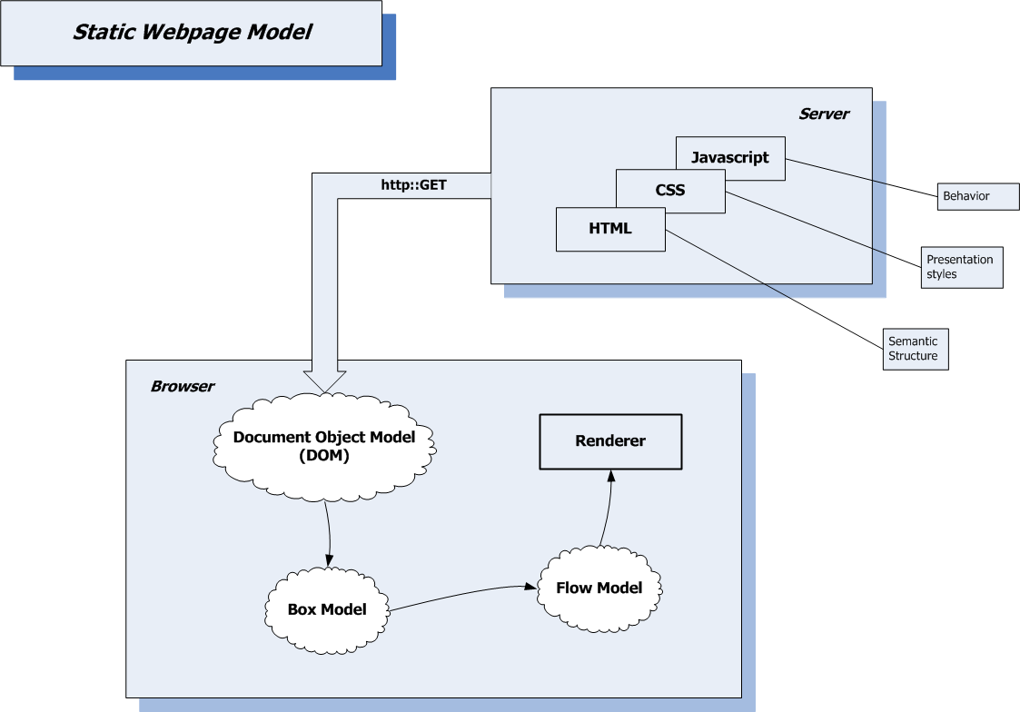

Slide 13
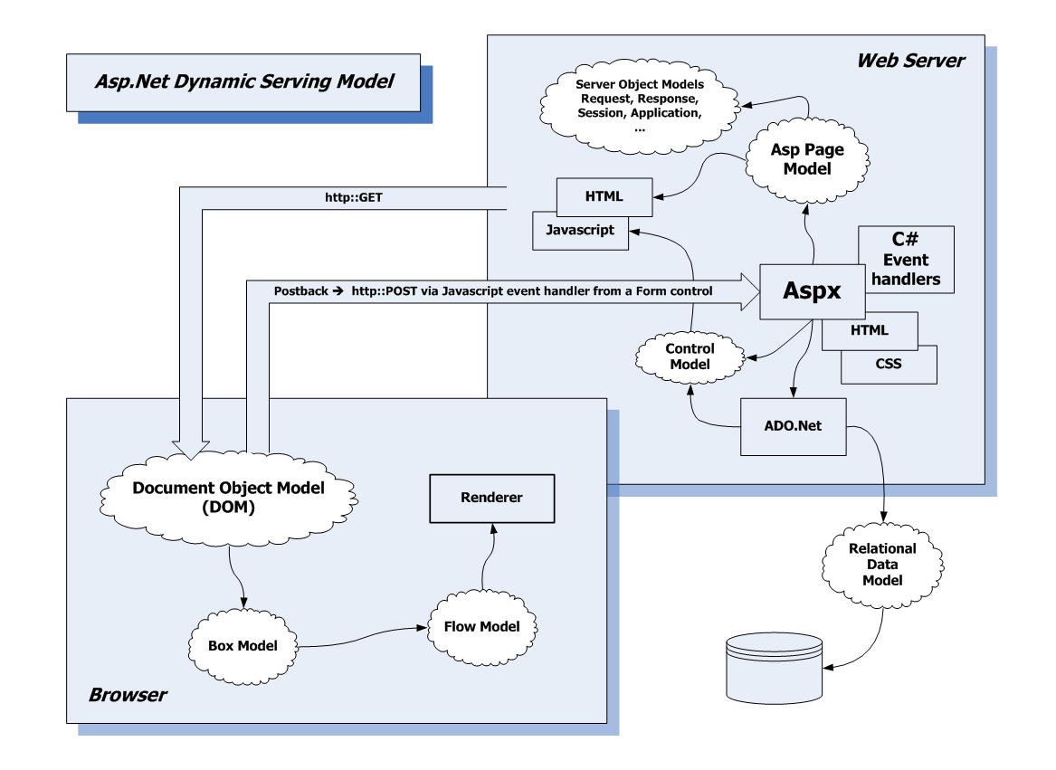

Slide 14
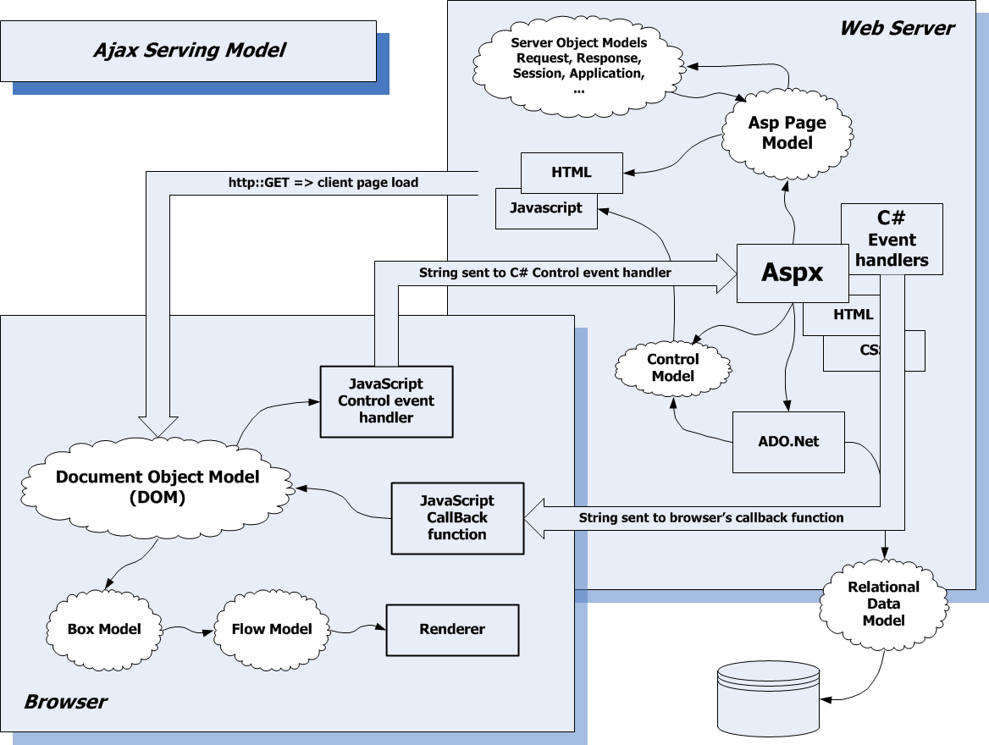

Slide 15
Sharing Data
Relational Databases – SQL Server, mySql, …
  ACID – Atomicity, Consistency, Isolation, Durability
  ACID => Transactional
No SQL Databases – MongoDB, CouchDB
  Key-Value, Document, Hierarchal
  Very flexible data structure
  Consistency is pushed onto the application
File Systems
Ad. Hoc. in-memory repositories
Extensible Record Stores – Google’s Big Table
  Distributed partitioned tables
Document Stores – CouchDB
  Multi-indexed objects aggregated into domains

Slide 16
Separation of Concerns
Except for the simplest of applications it’s not a good idea to bind presentation, control, and data together.
  There often are many views, more than one application mode, many sources of data.
  If we bind these all together we get spaghetti code
    Very hard to test, hard to maintain, hard to document.

Slide 17
Structure: Three-Tier
Structure:
  Partitioned into presentation, application logic, and data management.
  Intent is to loosely couple these three aspects of an application to make it resilient to change.
Examples:
  Most well-designed applications.

Slide 18
Model-View-Controller
Structure:
  MVC is a refined version of the Three-Tier structure, intended to support multiple views and data models.
  Models do all data storage management.
  Views present information to user, format output but do no other transformations on data.
  Controllers accept inputs, implement application processing, and use Models and Views to provide the application’s behavior.
  Application phases often have one controller each.
  Models may be shared between controllers.
Example: Asp.Net MVC

Slide 19
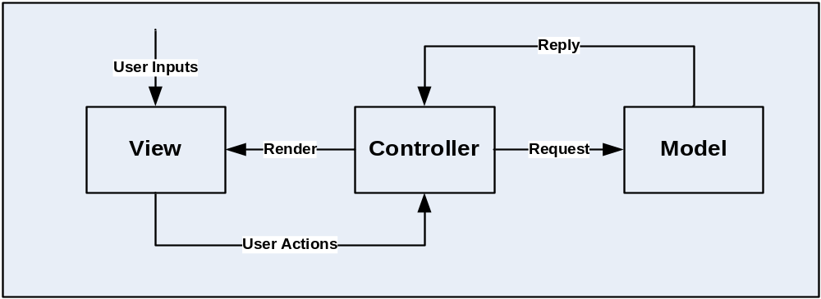
Basic MVC Structure

Slide 20
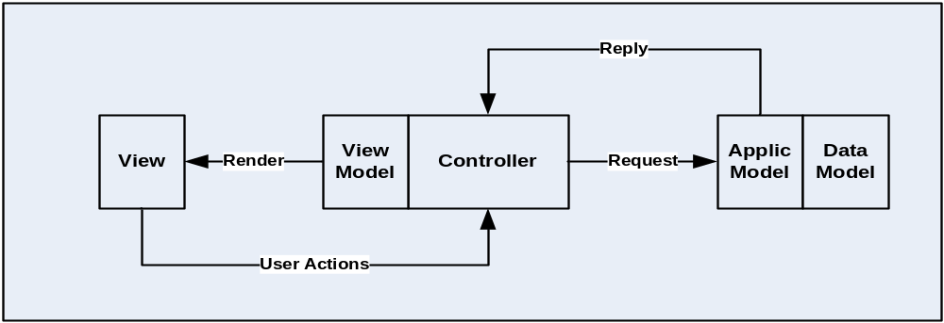
MVC – With View & Application Models
Views and Models often have some substructure, e.g.:

Slide 21
View – View Model
A view is what gets rendered
A view model is an abstraction that:
  Defines resources that many be used in several places.
  Defines styles that may be used in several places
  Defines an object model for the application to manipulate

Slide 22
Application vs. Data Models
Application model
  Defines classes for all the entities a user knows and cares about, e.g., orders, customers, products, etc.
Data model
  Defines wrapper classes for tables and stored procedures
  Manages connections
Object to Relational Mapping
  Relationships between application objects and data objects.

Slide 23
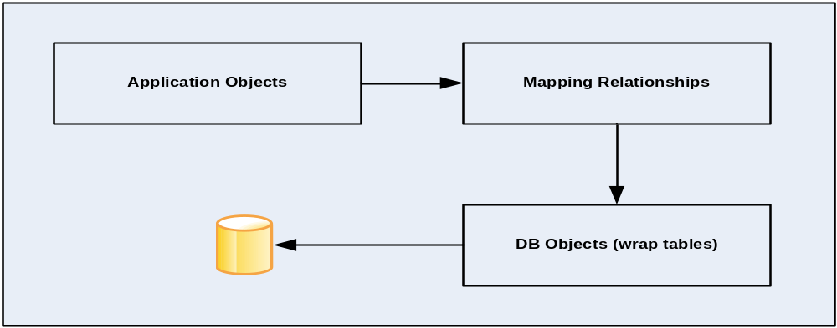
Object Relational Mapping
Data Layers often have an ORM substructure
Examples: Hibernate, Microsoft Entity Framework

Slide 24
N-Tier Structure
So, the three tier MVC has morphed into a five tier V-VM-C-AM-DM
  View – what gets rendered
  View Model – an abstraction of the view
  Controller – routes View events to handlers in the Application Model
  Application Model – classes that model the “business” logic
  Data Model – models data storage tables
    Database, XML file, custom data structures

Slide 25
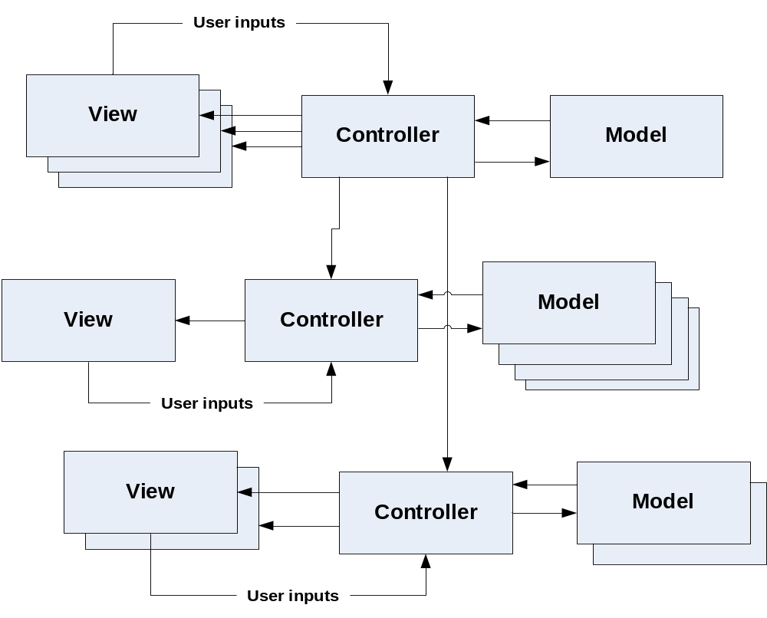
MVC – Multiple Controllers

Slide 26
Layer-Driven Structures

Slide 27
Component Layered Structure
Structure:
  A componentized system is composed of an application with many pluggable component parts.
  A component is pluggable if it implements a plug-in interface, published by the application, provides an object factory for activating its internal objects, and is packaged as a dynamic link library (DLL).
Example:
  http://www.ecs.syr.edu/faculty/fawcett/handouts/CSE681/code/Parser/ almost implements.

Slide 28
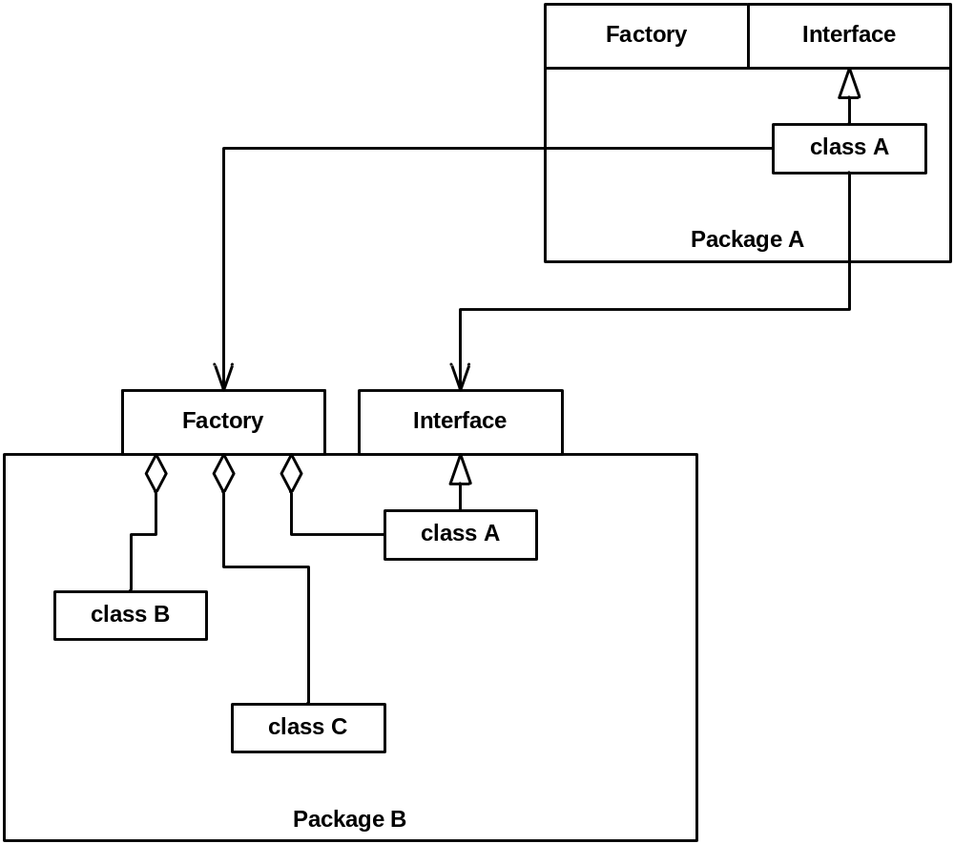
Hiding Implementation Details

Slide 29
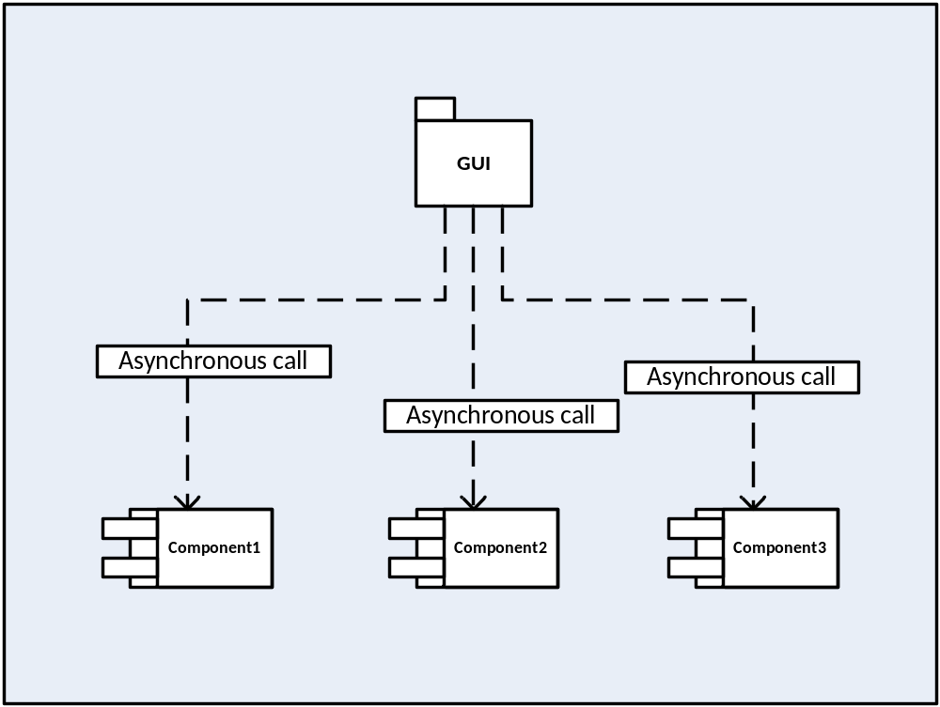
Example Componentized System
Separate presentation from application logic

Slide 30
Service Layered Structure
Provides a structure based on:
  System Services – things the user doesn’t think about
    Communication, storage, security, file caching, …
  User Services – things the user manipulates as part of the use of the system
    Input, Display, Check-in/Check-out, …
  Ancillary – Things that are not part of the system mission but are necessary
    Logging, extension hooks, test hooks, …

Slide 31
Distributed Services
Structure:
  Service oriented systems are simply client server.
  Usually the server is implemented with a web service or operating system service.
    Web service is a web application that provides an interface for client software to access.
    OS service is a system application that provides an interface for requests and an administration interface for setting service startup and shutdown policies.
  Windows Communication Foundation (WCF) has extended that model to support hosting in:
    desktop application
    windows service hosted with Windows Service Control Manager (SCM)
    web service hosted by Internet Information Server (IIS).

Slide 32
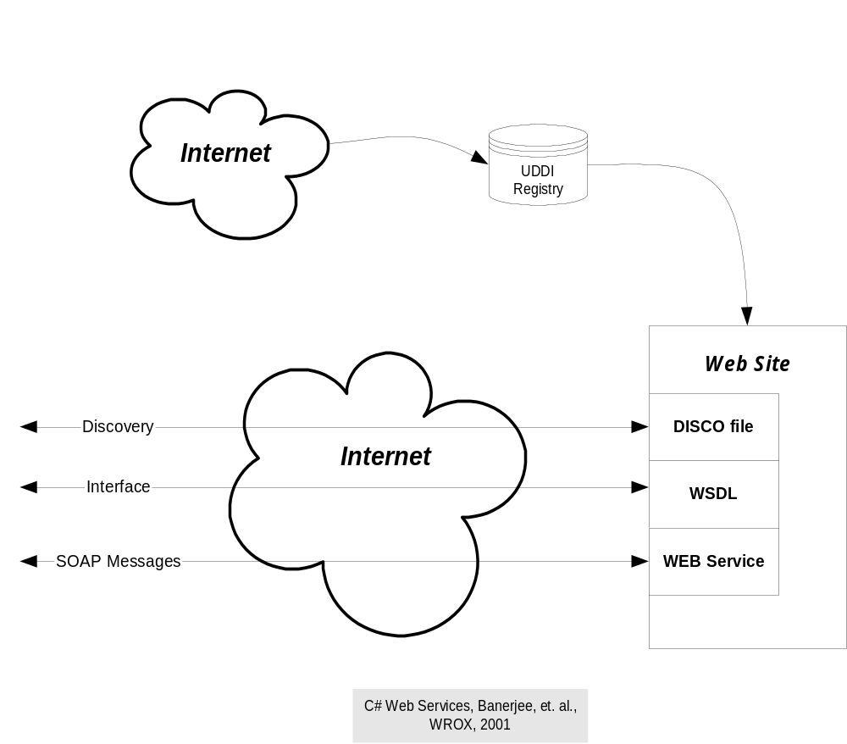

Slide 33
WCF Protocols
WCF supports:
  Http – SOAP over Http in clear text - BasicHttp
  Http – SOAP with security extensions – WsHttp
  NetTcp, SOAP over TCP
SOAP – Simple Object Access Protocol
  An XML body for HTTP or TCP messages
  Usually contains a message body in XML defined by a Data Contract
WCF is a very flexible, relatively easy to use, but heavy weight communication mechanism

Slide 34
REpresentational State Transfer
REST is a message-passing communication system built on the HTTP protocol, using the Web verbs:
  Get – retrieve a resource without changing the state of the server.
  Post – send information to the server that may change its state.
  Put – place a resource on the server.
  Delete – remove a resource from the server.
Its encoding is UTF text, not SOAP or some other complex messaging format, but may use encryption, as in HTTPS.

Slide 35
Analysis Driven Structure

Slide 36
Analysis Driven Structure
Packages
  Gather working set (inputs needed for analysis)
  Execute one or more phases of analysis
  filter and interpret resulting data to provide information
  Present the analysis information

Slide 37
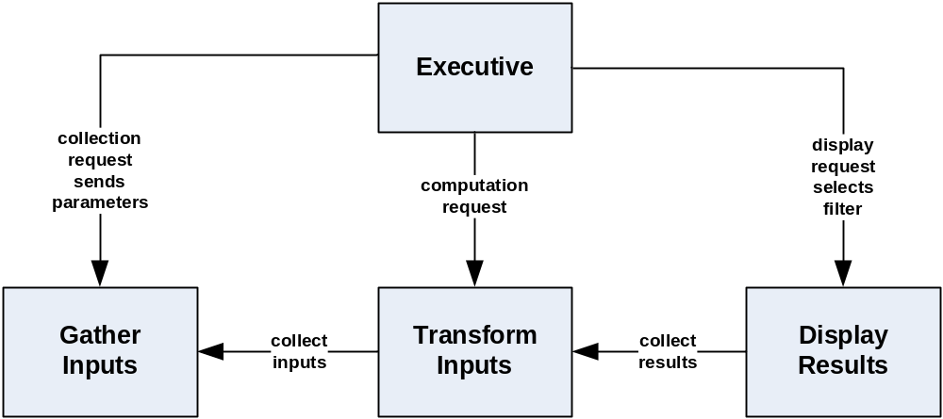
Package Structure – Analysis Driven

Slide 38
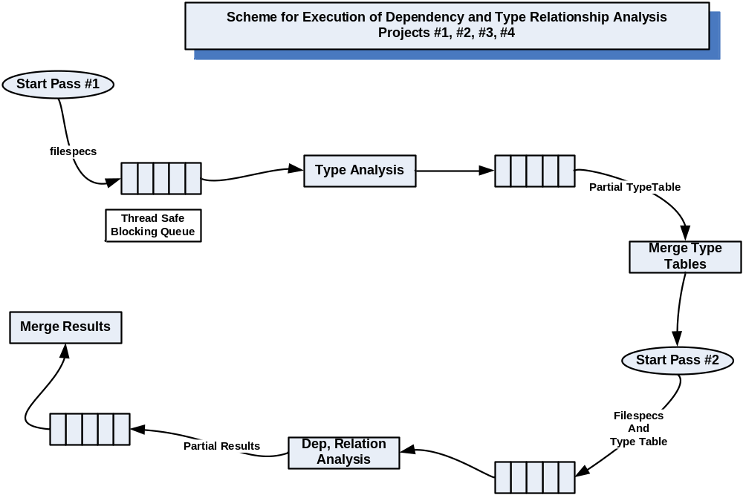
Pipelined Dependency Analysis

Slide 39
Communication Driven Structure

Slide 40
Communication Driven Structure
When users, data, and application logic are distributed across processes and machines communication becomes important:
  Client-Server
  Peer-to-peer
  Communication Middleware
    RPC (RMI)
    Message-Passing

Slide 41
Performance
Suppose that processing a request takes T units of time if requester and provider are in the same process.
Executing the same request across processes takes about 10 T units of time.
Executing the same request across a network takes about 100 T units of time.
Executing the same request across the internet takes about 1000 T units of time.

Slide 42
Structure: Client-Server
Behavior:
  Server is passive, waits for client requests
  Server handles multiple concurrent clients
  Without additional structure system may become tightly coupled and difficult to change
Example:
  Web server and browser clients

Slide 43
Structure: Peer-To-Peer
Behavior:
  Peers interact, sending and receiving messages from each other.
  Peers are sometimes identical.
  Many Peer-to-Peer models support central or distributed locater services.
Examples:
  http://www.ecs.syr.edu/faculty/fawcett/handouts/
  CoreTechnologies/SocketsAndRemoting/code/
  WCF_Fawcett_Examples/WCF_Peer_Comm/
  Bit-Torrent
  Napster

Slide 44
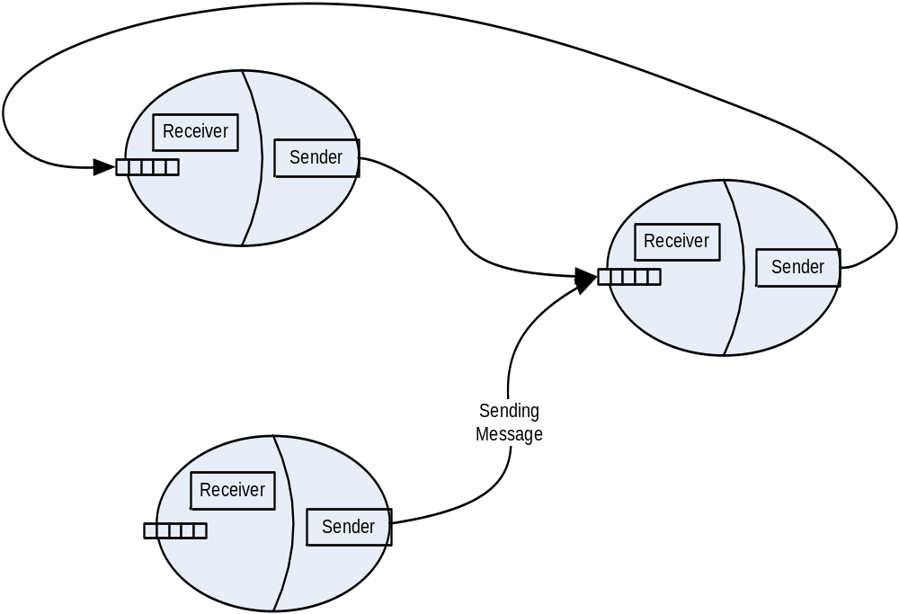
Peer-To-Peer Asynchronous Message-Passing Structure
Each Peer is a separate process possibly on separate machines

Slide 45
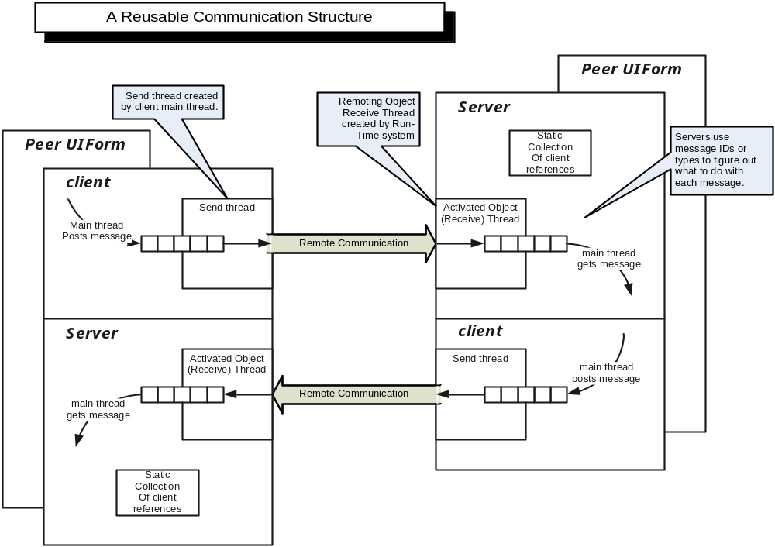
Processing
Processing

Slide 46
Communication Types
Remote Procedure Call (RPC):
  Supports function call semantics between processes and machines.
  Sends messages over wire but provides stack frames for client and server to support the function call model.
  Examples: COM, CORBA, WCF
Message Passing:
  Sends message with encoded request and/or data
  Message contains endpoint information for routing
  Directly supports asynchronous processing
  Examples: Internet, Web, SMA and OOD projects

Slide 47
Communication Patterns
TwoWay:
Synchronous Request, wait for reply
Duplex:
asynchronous request, reply sent as callback
OneWay:
Send Message and forget
  Receiver may send result back to requester as a subsequent OneWay message
Examples:
  All of the above are supported by WCF

Slide 48
Communication Style
Push Model
  Send information to a remote endpoint via a service call, perhaps via a message:
  void PostMessage(Message msg);
Pull Model
  Retrieve information from a remote endpoint via a service call, perhaps by a streaming download:
  Stream downLoad(string filename);

Slide 49
Communication Style
Pull Service and Caching
  A Software Repository could expose a WCF service that provides information about its package contents including dependencies.
  That allows a client, for example, to pull from the Repository all files in a package dependency list that are not already in its file cache.

Slide 50
Thread & Event Driven Structure

Slide 51
Structure: Publish & Subscribe
Structure:
  Many to many connection of Publishers and Subscribers.
  Each subscriber registers for notifications with a specific interface.
  Publishers send notifications to all enrolled subscribers when a publisher event occurs.
  Publishers can support multiple events.
  Publishers don’t need to know anything about the subscriber.

Slide 52
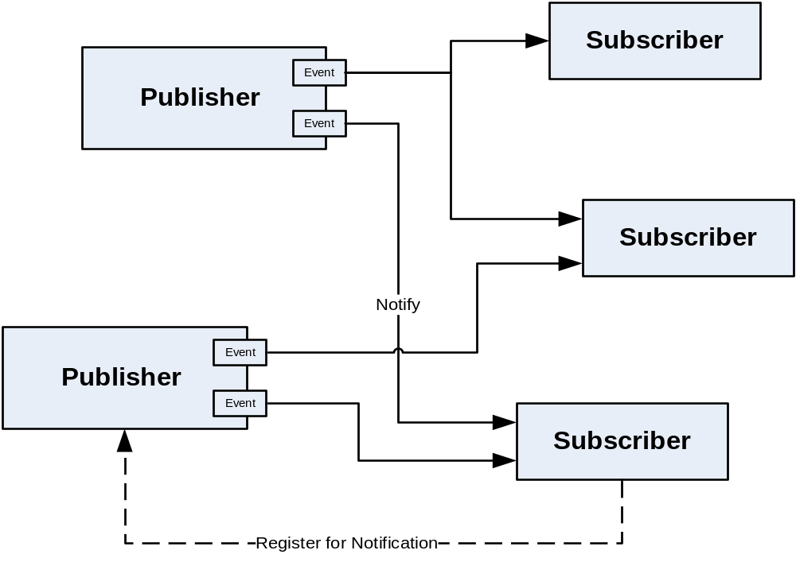

Slide 53
Threading Driven Structure
Some program structures are a consequence of specific threading models
  Event-driven and Single Threaded Apartment (STA)
  Parallel execution
  Pipelined execution

Slide 54
Structure: Event-Driven
Structure:
  Events from multiple concurrent sources generate messages which are enqueued, and typically are processed by a single handling thread.
  Messages are dispatched to event-handlers for processing.
Example:
  Windows processing

Slide 55
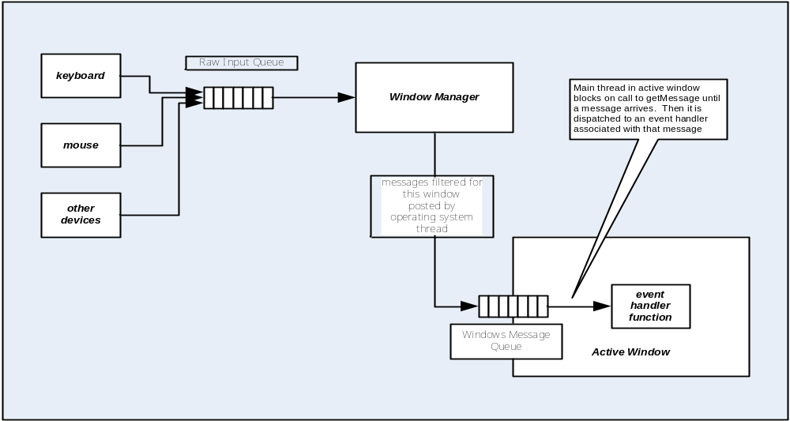
Event-Driven

Slide 56
Single Threaded Apartment
Graphical User Interfaces all use the STA model.
  Possibly concurrent clients send messages to the GUI’s message queue.
  All messages are retrieved by a single thread, the one that created the window.
  Child threads, often used to execute tasks for the GUI, are not allowed to directly interact with the window.
  Instead they must send or post messages to the window’s message queue.
  This is often done with Form.Invoke or Dispatcher.Invoke.

Slide 57
Parallel Execution
Structure:
  Often concurrent programs provide enqueued task requests.
  Threads, perhaps from a thread pool, are dispatched to handle each task.
  Tasks must be independent in order to fully realize the benefits of concurrency.
Example:
  Concurrent execution of dependency analysis tasks.

Slide 58
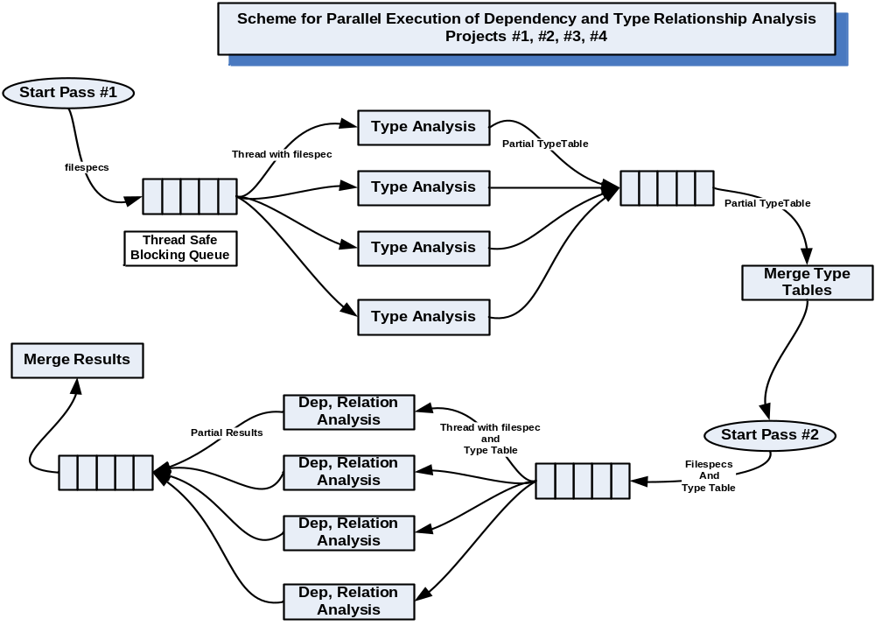

Slide 59
Pipeline Execution
Structure:
  Composed of cells.
  Each cell has a message queue and a child thread that processes messages.
  Result messages may be sent on to another cell.
  Each cell type is defined by the way it overrides a virtual message processing function.
Example:
  Project #4, CSE687 – OOD, Spring 2010

Slide 60
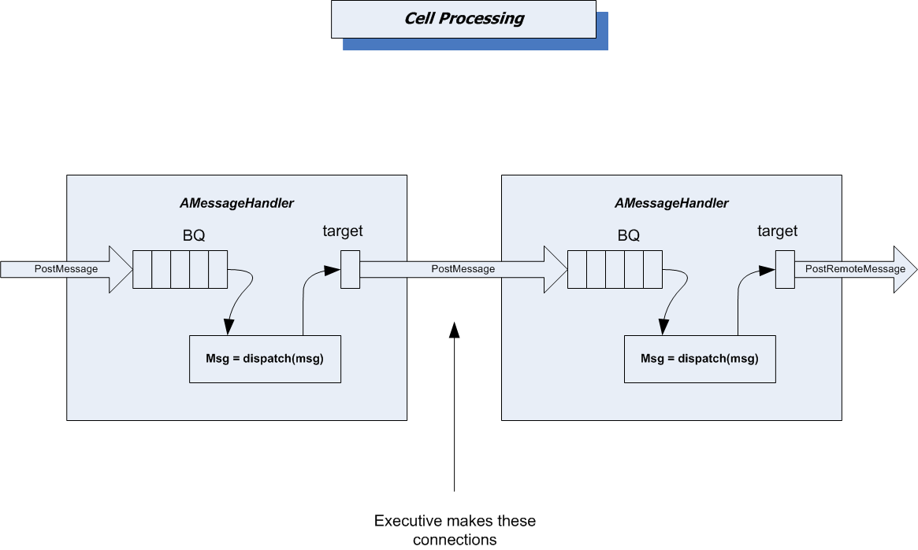

Slide 61
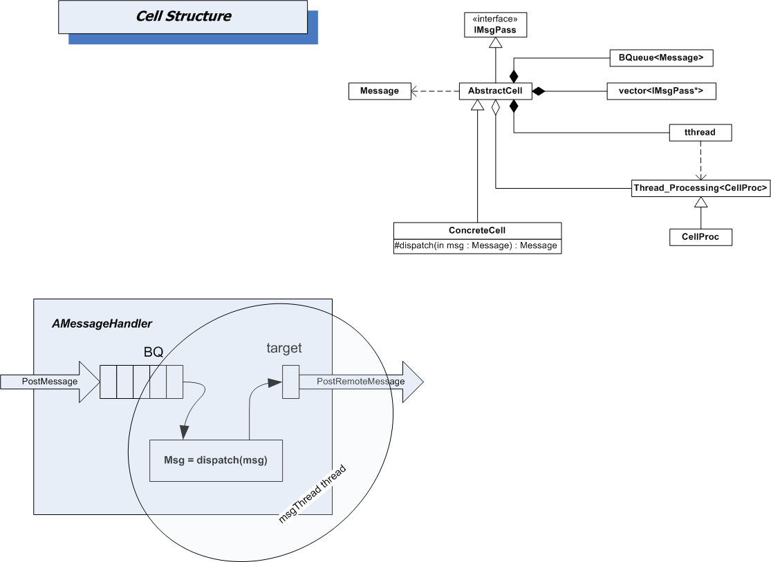

Slide 62
Pipe-lined Cell Communicators
Document Vault (Project #4 – Fall 2013)
  Uses pipe-lined cells as communicators
  Mediator (dispatcher) controls routing of messages
  Each cell has capability to send and receive messages
  Makes very flexible configuration of client and server capabilities

Slide 63
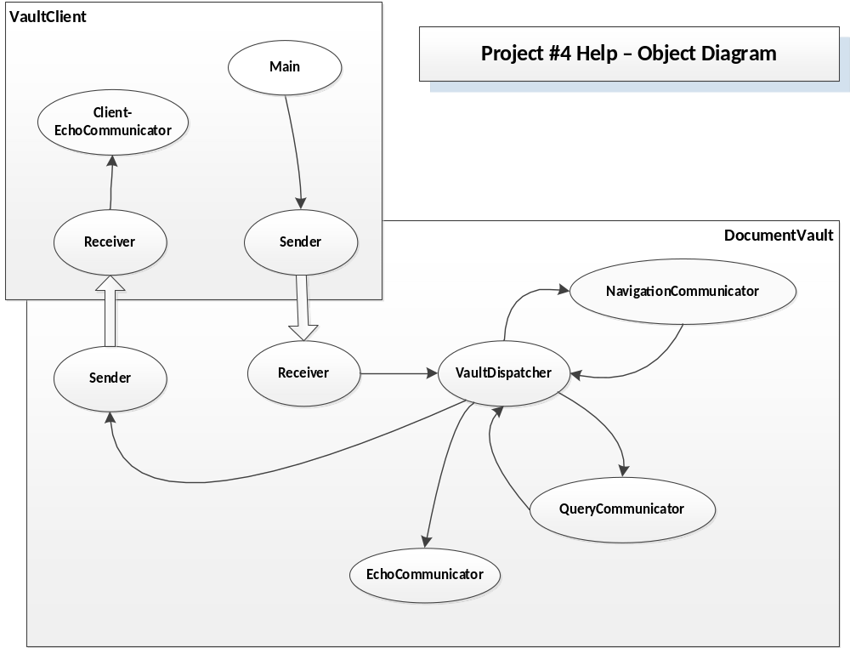

Slide 64
Enterprise Computing

Slide 65
Enterprise Computing
Large Enterprise Applications are usually constructed as a federation of lower level systems and subsystems.
  The federation is glued together with network based middleware, or more commonly now, with web services.
Example: PeopleSoft, used by S.U.
  Payroll and accounting
  Academic planning and record keeping
  Employee services
  A variety of web applications, like mySlice.

Slide 66
Enterprise App: Project Center
Federation of tools supporting Software Development
  Open source tools with integrating wrappers:
    CVS – configuration managment
    Nant – sofware builds
    Nunit – software testing
  Newly developed and legacy tools:
    Bug tracker, change tracker, project scheduler
http://www.ecs.syr.edu/faculty/fawcett/
handouts/webpages/ProjectCenter.htm

Slide 67
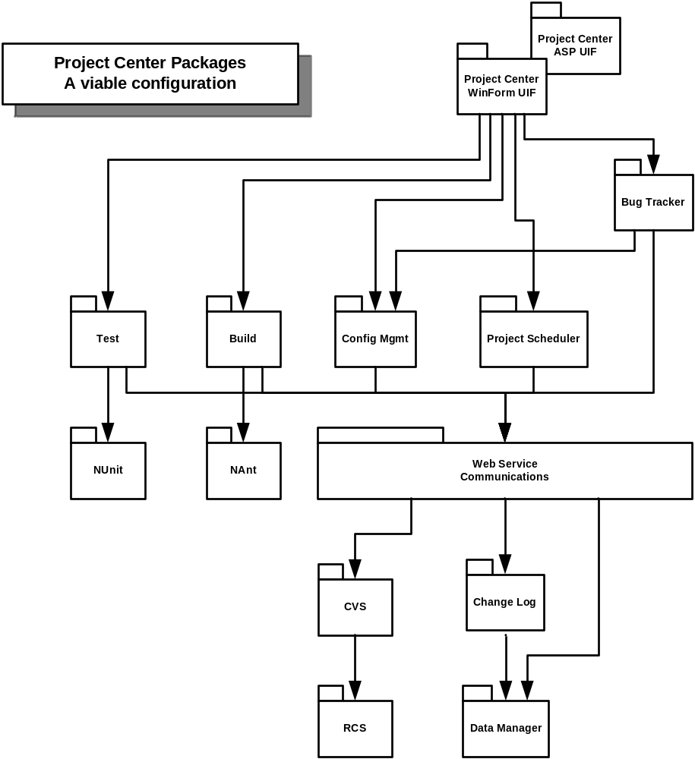

Slide 68
Federation Structure
Federated Systems often are based on one of two design patterns:
  Façade provides an integrating interface that consolidates a, possibly large, set of system interfaces into a single application interface in an attempt to make the system easier to use than working directly with its individual parts.
  Mediator serves as a communication hub so that all the various subsystems need know only one interface, that of the mediator.

Slide 69
Collaboration System
System that focuses on sharing of processes and products among peers with a common set of goals.
  Primary focus is organizing and maintaining some complex, usually evolving, state:
    Software development baseline
    Set of work plans and schedules
    Documentation and model of obligations
    Communication of events
Example:
  Collab – CSE784, Fall 2007, http://www.ecs.syr.edu/faculty/fawcett/handouts/webpages/CServ.htm

Slide 70
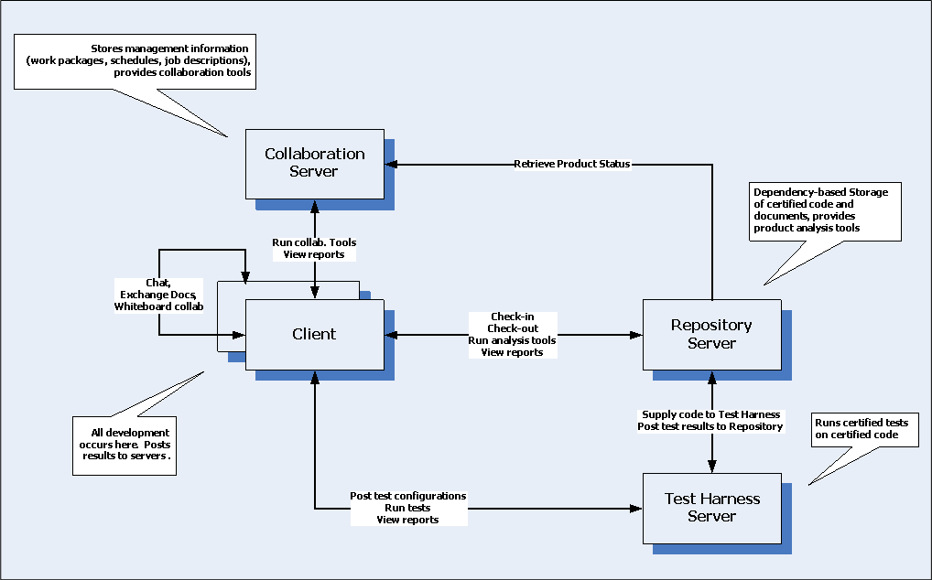
Example Collaboration System

Slide 71
Other System Structures

Slide 72
Agent-Based
System uses Software Agents
  Semi-autonomous, mobile, task oriented software entities. Crawl web, or network, or data structure
  May be scheduled
  Provide scriptable user specific services
    Collect information from a large set of data
    Perform analyses on changing baseline and report
    Conduct specific tests
    Make narrowly specified modifications to baseline
Example:
  CSE681 Project #5, summer 2009, http://www.ecs.syr.edu/faculty/fawcett/handouts/CSE681/Projects/Pr5Su09.doc

Slide 73
Master’s Thesis Research Examples
The following are all based on Software Matrix structure – Autonomous cells often used with mediator
  Software Matrix – Gosh, 2004
  Self Healing Systems – Anirudha, 2005
  Cross Platform Development – Appadurai, 2007
  Model-Driven Development – Patel, 2007
http://www.ecs.syr.edu/faculty/fawcett/handouts/webpages/research.htm

Slide 74
Other Structures
TeraScale computing:
  Term defined by Intel to describe parallel execution on a many core processor.
    Expectations are chips with scores of processors
Cloud Computing
  Term adopted by many to describe remote execution and storage of applications. The cloud provides a stable endpoint that may map onto any one of a large set of computing resources.
  Example:
    Microsoft’s Azure platform
    Amazon Web Services
    Google Cloud

Slide 75
SMA Projects - 2015
Project #2 – Fall 2015
  NoSql Database
    Key/Value store
    Provides cloning, persistence, querying, views
Project #4 – Fall 2015
  Client-Server
    Focus on NoSqlDb performance testing
    May have multiple concurrent clients
    Both client and server may use DLLs for significant processing
Project #5 – Fall 2015
  Federation of clients and servers
    Focuses on data service layer
    May have a dedicated virtual server with child services on each of the Federation servers

Slide 76
SMA Projects – Before 2015
Project #2 – Fall 2013
  Cooperating monolithic processes
    Composite Text analyzer
    Metadata generator
Project #4 – Fall 2014
  Client-Server
    May have multiple concurrent clients
    Both client and server use DLLs for significant processing
Project #5 – Fall 2013
  Federation of clients and servers
    Focuses on Software Repository server
    May wish to use virtual servers

Slide 77
The End

