Slide 1
Syracuse University Department of Electrical and Computer Engineering
Identifying Extract Class and Extract Method Refactoring Opportunities Through Analysis of Variable Declarations and Uses
Mehmet Kaya
PhD Dissertation
5/30/2014
Notes:
Good afternoon everyone! My dissertation is entitled as “ ” as my dissertation. I would like to thank you in advance for being a part of my committee and your evaluations.

Slide 2
Outline
Introduction and Problem Presentation
Overview of contributions
Cohesion and Refactoring
Extract Method - Placement Tree
Extract Method - Hammock Graph
Conclusion and Future Work
Notes:
Here is the outline of my presentation. Firstly I am going to talk about the problem that this research addresses in general. I will briefly discuss our contributions and summarize the prior work. Then following the order in my dissertation, I will cover the details of each main contributions. I will finish my presentation with concluding remarks and the future direction of this research.

Slide 3
Maintenance Phase
Changes usually degrade quality of software.
Supports the software product from its inception to its retirement and ends with product’s retirement [50]
Lasts for 10 to 20 years [3]
Increases the cost of production dramatically
Maintenance effort = 2|3 x Creating new software [2]
Comprising 60-75% of the overall cost [3, 72, 51]
Notes:
Software development is a process that proceeds in stages. After the delivery or release of a software product, software development enters what is known as the maintenance phase. The focus in this phase is on the modification of the code “to correct faults, to improve performance or other attributes, or to adapt the product to a modified environment” During the Maintenance Phase, Software programs may be modified by people who are not the original authors. This means that, changes are sometimes made by people who may not thoroughly understand the original design concept and this almost always causes the quality or design of the programs to degrade. Research shows that, over time, after many such changes, software quality decays in a way that no one understands the code any more, not even the original authors of the program. Software that has evolved in this way, at some point, becomes very costly to modify or improve and detecting and fixing the bugs in such code, likewise turns into a very challenging task due to the complexity of the code. Research shows that Maintenance Phase supports the software product from its inception to its retirement and ends with product’s retirement and for successful system this phase lasts for 10 to 20 years. Maintenance operations impact the production cost dramatically especially for large complex systems. Some studies show that developers spend 2 to 3 times more time and effort with maintaining software than creating new software and maintenance operations comprise 60-75% of the overall production cost

Slide 4
Software Quality vs. Cost
Developing a large system requires a team.
Each component will be read and used by other developers.
Software may be modified/maintained by developers who are not original authors.
Some quality aspects:
Cohesion
Comprehensibility/ Cyclomatic Complexity
Readability
Reusability
Notes:
Software development is a social endeavor that requires collaboration between team members. One component written by someone is going to be used by other developers. For this reason the quality of code affects the speed of development a lot. Therefore maintenance for a software program with poor quality will be costly So To reduce the maintenance cost, The goal should be to develop software units with a cohesive design or implementation, a clear intention with small size. If code fails to meet these goals, refactoring is one strategy to improve its quality.

Slide 5
Quality vs. Bad Smells in Code
Duplicated Code – identical or very similar code exists in more than one location
Long Method –method that has grown too large
Large Class – class that has grown too large
Long Parameter List – hard to understand/read
Feature Envy – a class that uses methods of another class excessively
Notes:
The term bad smell has been coined by Kent Beck and Fowler. Code smell is any symptom in the source code of a program that possibly indicates a deeper problem. Code smells are usually not bugs—they are not technically incorrect and do not currently prevent the program from functioning. Instead, they indicate weaknesses in design that may be slowing down development or increasing the risk of bugs or failures in the future. Once you see one of these bad smalls in your code, you need to fix it. It is not fixing a bug, yet it improves the quality of the cost which is a contributing factor to the cost of development. This modification of the code to improve the structure is known as refactoring.

Slide 6
Software Refactoring
Refactoring is defined by Fowler et al. as "the exact reverse of the normal notion of software decay" [5]
Example:
Renaming an attribute
Extraction of new units
Goal: to make the software easier to understand and modify.
Result: better understandable/readable/reusable code or reduced cost of maintenance/production
Notes:
As software quality degrades over time, refactoring helps to improve the quality.

Slide 7
Steps to Refactoring
Error messages (Eclipse) [58]
Selected block references a local type declared outside the selection: A local type declaration is not part of the selection but is referenced by one of the statements selected for extraction.
A local type declared in the selected block is referenced outside the selection: The selection covers a local type declaration but the type is also referenced outside the selected statements.
Error messages are non-specific and unhelpful in diagnosing problems [73]
Discouraging programmers from refactoring at all [73]
1. Selection of Code Fragments
a) Read the software code to get familiar
b) Inspect the code to find code regions
2. Extraction of Code Fragments
a) Determine the feasibility of refactoring
b) Perform Refactoring / Create method – replace with method call
Manual!
Eclipse, Visual Studio, Resharper, Refactor Pro
Notes:
All tools I have come across support only the extraction part. The selection which is the harder part is manual with these tools. The refactoring selection needs to fulfill some refactoring preconditions, this tools warn the users with messages to help them with the selection process. Furthermore they do not support all programming languages.

Slide 8
What people are saying!
Does anybody know a fully featured refactoring tool for C++ that works reliably with large code bases (some 100.000 lines)? I tried whatever i can find again and again over the last years. They all were not at all usable.
SUMMARY: I took time and evaluated "Visual Assist X" as well as "Refactor for C++". Both have some impressing features, but both as well are far from perfect. Extracting a large block of code usually is not done satisfying without manual modifications - and therefore does not pay off.
"Visual Assist X" has nice features such as much more complete autocompletition etc. But it leads to so much flickering and slows down much at certain points.
By my opinion therefore the answer is: "No, there is no production ready refactoring tool for C++"
Notes:
These are some discussions that you will find when you google a refactoring tools for C++.

Slide 9
What people are saying!
The problem with C++ is its very complex, context-sensitive syntax. Without actually parsing the full source, you cannot be sure what an identifier means
See also: stackoverflow.com/questions/249827/… but it doesn't have much to offer
Unfortunately, Refactor for C++ doesn't work well (if at all) with large codebases
@IraBaxter It simply is broken. The refactoring options either don't show up or don't complete. There are strange error messages or none at all.
Refactor for C++ doesn't work well even for small codebases, it is broken and unusable at all.
VA does not seem to understand C++ at all.
Currently I can't recommend any refactoring tool for C++, certainly not for large code bases of 100k lines and above.

Slide 10
Identifying Refactoring Opportunities
Refactoring is based on human intuition [5]
Although Fowler introduces many different kinds of refactoring, the identification of location where to apply these re-factorings is ambiguous [5]
Developer is the last authority to decide where to apply the refactoring [46]
Although refactoring is practiced very frequently, 90 percent of refactoring is applied manually and refactoring tools need further improvements [64,65]
Notes:
Fowler introduces many bad smells and suggests possible solutions to them. He states that refactoring is based on human intuition. You have to know if your program includes bad smell or needs refactoring. But when you are working with a large foreign code base this is going to be a very challenging task. You have to read and analyze the code to find bad smells and refactor the code. Because, the identification of location where or when to apply these re-factorings is ambiguous. It is accepted developer is the last authority to decide where exactly to apply the refactoring. Research shows that although refactoring is practiced very frequently, 90 percent of refactoring is applied manually and refactoring tools need further improvements.

Slide 11
Goal of Our Research
Refactoring is acknowledged to be a subjective ambiguous process
Our contribution turns that into an objective quantitative process
Find techniques for suggesting refactoring
Implement the techniques in tools
Produce result that can be represented visually
No need to inspect code to detect refactoring
Developer is still the last authority
Notes:
Refactoring is acknowledged to be a subjective ambiguous process. In this research we are trying to find out ways of suggesting refactoring that turns this ambiguous process into an objective quantitative process. We also want to be able to represent our results visually for a more effective refactoring process.

Slide 12
Overview of Contribution 1
Large Class Code Defect
Fowler suggests based on number of data member [5]
Simple and cohesive, understandable, and readable
Cohesion is simply the degree to which the elements of a module belong together
Higher quality=better reuse and maintainability
“Should capture one and only one key abstraction” [78]
Remedy: Extract Class Refactoring
Extract each distinct task as a separate unit
Notes:
We are addressing three different code defects in this research. The first one is Large Class Code defect. Classes are the key units of object oriented programming. To reduce maintenance cost, therefore, developers aim to design classes with high quality so that they can be understood, reused, and maintained. Our main concern is the cohesiveness of the class. A cohesive class “Should capture one and only one key abstraction” if not Extract Class Refactoring is the remedy where Extract each distinct task is extracted as separate unit.

Slide 13
Some Results of Contribution 1
Extract Class Refactoring Before and After
 | # of Methods | # of Data Members | # of Lines
Original Class | 13 | 9 | 150
Class After Refactoring | 13 | 3 | 72
Extracted Class 1 | 6 | 2 | 49
Extracted Class 2 | 12 | 3 | 105
Extracted Class 3 | 5 | 4 | 35
Notes:
Each class has one abstraction

Slide 14
Overview of Contribution 2
Long Method Code Defect
The source of many other code defects [1]
Smaller methods are easier to read, comprehend, and maintain [1]
Is this a subjective measure?
Should be shorter with one clear intention
Remedy: Extract Method Refactoring
Extract appropriate code fragments as separate methods
Notes:
Rather than trying to accomplish many subtasks together, methods should be shorter with one clear intention for better comprehensibility, readability and simplicity. When this is achieved, maintenance of such methods will be a lot less costly. Long Methods with higher complexity and length should be restructured to produce smaller, more cohesive and comprehensible methods. We have used methods with 4000 lines of code for our experiment and some methods from our own analysis tools had some 100 lines of code. We could apply the same technique to them both the same way.

Slide 15
Some Results of Contribution 2
Extract Method with Placement Tree Before and After
Method: W_Calculate Domain: Medical # of Extraction: 9
 | LOC | Cyclomatic Complexity
Before Refactoring | 379 | 46
After Refactoring | 39 | 4
Extracted Method 1 | 13 | 3
Extracted Method 2 | 13 | 3
Extracted Method 3 | 13 | 3
Extracted Method 4 | 13 | 3
Extracted Method 5 | 19 | 5
Extracted Method 6 | 33 | 9
Extracted Method 7 | 16 | 5
Extracted Method 8 | 45 | 9
Extracted Method 9 | 62 | 11
Method: doAction Domain: Analyzer # of Extraction: 3
 | LOC | Cyclomatic Complexity
Before Refactoring | 101 | 44
After Refactoring | 21 | 3
Extracted Method 1 | 52 | 27
Extracted Method 2 | 20 | 11
Extracted Method 3 | 21 | 6
Notes:
The method before refactoring had several pages of code.

Slide 16
Overview of Contribution 3
Long Parameter List Code Defect
Impact the quality of software programs dramatically
“Difficult to understand and test ” [5]
Maintenance phase requires more time and effort
Extract Method may result in long parameter lists
We do not identify existing long parameter lists.
Provide an opportunity to observe extract method refactoring opportunities based on the desired length of parameter list
Notes:
Research shows that Long Parameter List code defect can impact the quality of software programs dramatically, as such methods are typically difficult to understand and test. As a result, the maintenance phase requires more time and effort increasing overall production cost. Therefore, it is very important to generate methods with fewer arguments during refactoring long methods. We have experienced that extract method refactoring may result in method with long parameter lists. This contribution introduces another refactoring technique and a tool to observe extract method refactoring suggestion with a constraint on the number of parameters extracted methods will take.

Slide 17
Some Results of Contribution 3
Extract Method with Hammock Before and After
Method: run_dlgProc Domain: Notepad++ # of Extraction: 25
 | LOC | Cyclomatic Complexity | # of Parameters
Before Refactoring | 560 | 54 | 3
After Refactoring | 269 | 35 | 3
Extracted Method 1 | 19 | 1 | 0
Extracted Method 2 | 9 | 2 | 0
Extracted Method 3 | 13 | 3 | 0
Extracted Method 4 | 28 | 5 | 0
Extracted Method 5 | 5 | 1 | 0
Extracted Method 6 | 6 | 1 | 0
Extracted Method 7 | 8 | 1 | 0
Extracted Method 8 | 6 | 1 | 0
Extracted Method 9 | 6 | 1 | 0
Extracted Method 10 | 15 | 2 | 0
Extracted Method 11 | 6 | 1 | 0
Extracted Method 12 | 14 | 2 | 0
Extracted Method 13 | 7 | 1 | 0
Extracted Method 14 | 7 | 1 | 0
Extracted Method 15 | 7 | 1 | 0
Extracted Method 16 | 6 | 1 | 0
Extracted Method 17 | 5 | 1 | 0
Extracted Method 18 | 8 | 2 | 0
Extracted Method 19 | 4 | 1 | 0
Extracted Method 20 | 5 | 1 | 0
Extracted Method 21 | 20 | 3 | 1
Extracted Method 22 | 21 | 4 | 1
Extracted Method 23 | 19 | 3 | 1
Extracted Method 24 | 17 | 2 | 1
Extracted Method 25 | 17 | 3 | 2
Notes:
Notepad++ is an open source code editor and Notepad replacement that supports several programming languages and natural languages

Slide 18
Tools and Techniques
Rule Based Parser (Dr Fawcett)
Developed a rule based ad-hoc parser
Analyzes source code to extract information
Results we seek depend on only a small part of the language grammar
Simple design and very flexible to extend
Designed on an Actions and Rules based approach
Notes:
Before I go to the details of my contributions, I would like to talk about tools and techniques that we use in our research. Our analysis tools use a parser that developed by Dr. Fawcett. It is very convenient to use when the information we need depends on a small part of language grammar.

Slide 19
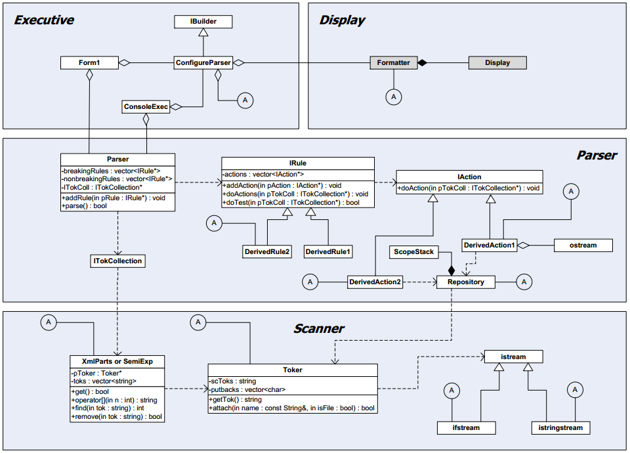
Notes:
It is very flexible to extent to extract more information by simply defining new rules that translate the part of language grammar we would like to detect and actions that describe what to do upon detecting that particular grammar.

Slide 20
Tools and Techniques (cont'd.)
Program Slicing
“The method of automatically decomposing programs by analyzing their relationships between statements based on data and control flow” [9]
Slicing criterion: C= (9, sum).
1 2 3 4 5 6 7 8 9 10 | int i; int sum = 0; int product = 1; for(i = 0; i < N; ++i) { sum = sum + i; product = product *i; } cout<< sum; cout<< product; | int i; int sum = 0; for(i = 0; i < N; ++i) { sum = sum + i; } cout<< sum;
Notes:
Program slicing is a technique we inspired from to suggest class refactoring. Originally, it is the process of tracing backwards from a particular variable in a particular statement to identify all possible sources of influence on the value of that variable. We see the slice on the given program fragment with respect to the criterion. It has been used as a tool for debugging and determining the complete computation of a variable.

Slide 21
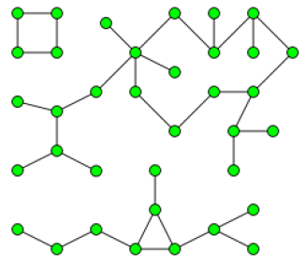
Tools and Techniques (cont'd.)
Graph Theory - Connected Components
A sub-graph in which there exists a path between every pair of nodes.
Construct a cluster of objects with at least one common attribute
To address some design flaws and quality issues in software programs.

Slide 22
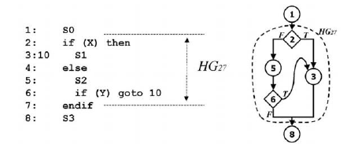
Tools and Techniques (cont'd.)
Graph Theory - Hammock Graphs
Definition: Let G be a control flow graph for program P. A hammock H is an induced sub-graph of G with a distinguished node V in H called the entry node and a distinguished node W not in H called the exit node such that
All edges from (G - H) to H go to V.
All edges from H to (G - H) go to W.
Notes:
Hammock graph is a special kind of graph that is usually defined on the control flow graph of a program. It is defined as a sub graph with two distinguished nodes. All the edges from outside of the sub graph to the sub graph go to the distinguished node V, and all edges from the sub graph to outside of it go to the distinguished node W. Hammock graphs have been defined on control flow graphs and used to eliminate unstructured branches such as goto and jumps.

Slide 23
Tools and Techniques (cont'd.)
Placement Trees
Methods can be represented with a placement tree
Each node represents a different scope
The root is method itself
Can be used to create effective refactoring and visualization tools
Tree-maps
An effective way of presenting hierarchical information
Nodes are represented by nested boxes

Slide 24
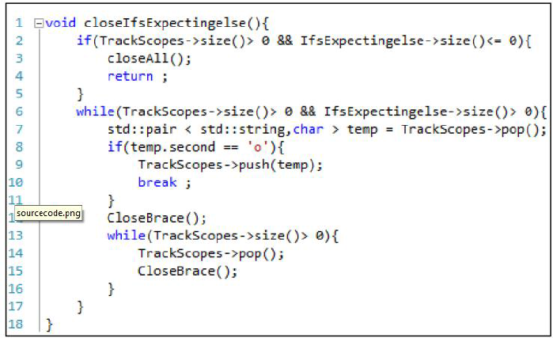
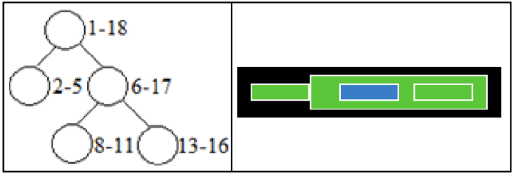
Tools and Techniques (cont'd.)

Slide 25
Tools and Techniques (cont'd.)
Tools we developed - Analysis
Brace Insertion: detects scopes, inserts missing braces, indents statements: enhanced readability and easier analysis
Tree Generator: for each scope detects; source code, line numbers, variable references and produces an XML representation
Hammock Graph Constructor: detects variable spans for each local variable, control blocks and interactions and produces an XML representation

Slide 26
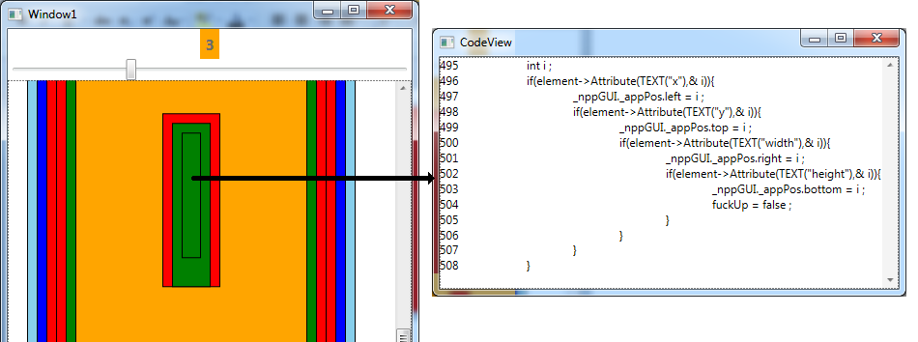
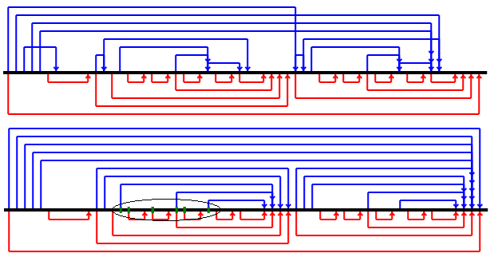
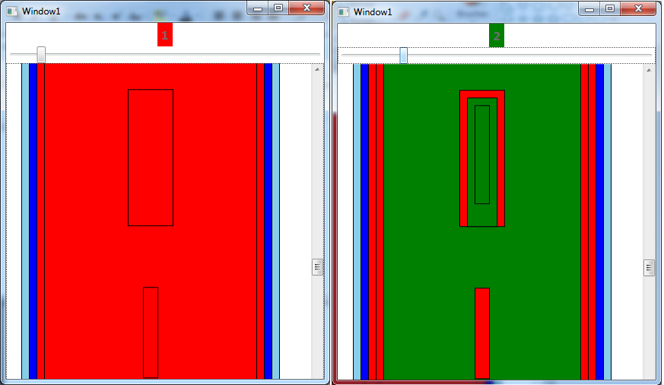
Tools and Techniques (cont'd.)
Tools we developed – Visualization
Each box is a scope – this code is complex
Notes:
Add bullet

Slide 27
Overview of Contributions
Contribution 1: Extract Class Refactoring
Introduced a new cohesion metric
Can be used to indicate the need for refactoring for the class
Indentify statements that possibly constitute the same abstraction
Introduced an extract class refactoring technique
Slices are always extractable and slicing criteria is defined

Slide 28
Overview of Contributions (cont'd.)
Contribution 2: Extract Method Refactoring with Placement Tree
Introduces a novel technique to identify refactoring opportunities
Indentifies code regions suitable for extraction
No need for inspecting the code manually
Implemented the require analysis tool
Introduced tree-map visualization for our result

Slide 29
Overview of Contributions (cont'd.)
Extract Method Refactoring with Hammock
Introduces a novel technique to identify refactoring opportunities based on hammock
Indentifies code regions suitable for extraction depending on desired number of parameters
Supported by analysis tools
Results can effectively be visualized as tree-map

Slide 30
Literature Survey
Program Slicing:
Used for debugging [Wieser]
Used in method refactoring and functional cohesion [Beimen et al]
Extract the complete computation of a variable [Tsantalis et al]
Traditionally, Program slicing seeks program statements that affect value of a certain variable
We aim to find program statements that should be in the same abstraction
We extend the slice based on relationship conditions
Notes:
Showed in a study program slicing can be used effectively with experiment: When debugging unfamiliar programs programmers use program pieces called slices which are sets of statements related by their flow of data. automatic slicer could be used interactively by a programmer to ask for statements which could be the source of erroneous behavior.
Each debugging task was on a program of from 75 to 150 lines of Algol-W [26], with at least one major subroutine that performed most of the computation. In this subroutine, a single statement was changed to cause a bug (see Table I).
Beimen computes a data slice for each output of a procedure. An “output” is any single value explicitly output to a file (or user output), an output parameter, or an assignment to a global variable Our analysis identifies the data tokens that lie on more than one slice as the “glue” that binds
separate components together. Cohesion is measured in terms of the relative number of glue tokens, tokens that lie on more than one data slice,
Nikolaos Tsantalis, Alexander Chatzigeorgiou one of the first suggested automating the selection. The suggested refactorings adhere to
three principles: the extracted code should contain the complete computation of a given variable declared in the original method, the behavior of the program should be preserved after the application of the refactoring, and the extracted code should not be excessively duplicated in the original method. We argue that you do not have to include the entire computation of a variable as it may be split across multiple methods.

Slide 31
Literature Survey
Comparison Of Slices
Line# | Original Program | Program Slicing Result | Our Result
1 2 3 4 5 6 7 8 9 10 | int i; int sum = 0; int product = 1; for(i = 0; i < N; ++i) { sum = sum + i; product = product *i; } cout<< sum; cout<< product; | int i; int sum = 0; for(i = 0; i < N; ++i) { sum = sum + i; } cout<< sum; | int i; int sum = 0; int product = 1; for(i = 0; i < N; ++i) { sum = sum + i; product = product *i; } cout<< sum; cout<< product;
Notes:
Slices are generally not contiguous pieces, but contain statements scattered throughout the code. Weiser

Slide 32
Literature Survey
Cohesion Metrics:
“Different cohesion metrics aim to detect different aspects of the software units to evaluate their cohesiveness”
“Some do not satisfactorily capture the concept of cohesion”
In a class, it is usually measured by data member-method interactions
We want a metric that serves as a tool to indicate when a class needs refactoring and how to apply the refactoring

Slide 33
Literature Survey
Clustering Techniques:
A preferred technique for class extraction
Group entities in a system: data members, methods, classes
Based on moving existing attributes between classes!
Our evaluation is at the statement level and preserves the interface of the class

Slide 34
Literature Survey
Extract Method Techniques:
A program slicing technique is proposed to extract code fragments related to the computation of a given variable [Tsantalis et al]
A Technique based on an input CFG of a method and a set of pre-selected nodes is introduced [Komondoor et al]
Another area where extract method refactoring is used is eliminating code duplicates [O’Connnor et al]
Notes:
Tools and techniques address the extraction step. Provides an algorithm for semantic preserving procedure extraction given an arbitrary set of selected statements in an arbitrary control flow graph. Moving selected statements together so that they become extractable. It changes the order of statements execution must have a valid proof of sematic preserve

Slide 35
Literature Survey
Hammock Graphs:
Used for Compiler optimization by eliminating unstructured branches
Used for a compiler to analyze performance differences between different GPU programming models
For software comprehension, hammock is defined on call graphs
Hammock graphs have been used for comparing two versions of a program
We generate hammock graphs based on variable declarations and uses as well as control blocks in a method for method extraction

Slide 36
Literature Survey
Visualization and Refactoring Tools
No tool support for identification of refactoring!
Eclipse, Visual Studio, Refactor Pro, Resharper support extraction
Error messages are non-specific and unhelpful in diagnosing problems
Discouraging programmers from refactoring at all
A tool to help with selection!
Selection assist
Box view
Refactoring annotation

Slide 37
Contribution 1: Class Cohesion and Refactoring
Started to explore refactoring through variable declaration and uses
Published in conference proceedings
Goal: to quantitatively measure the cohesiveness of a class
Should be able to help with suggesting refactoring
Contribution 2
Contribution 3
Computer Software and Applications Conference Proceedings
Notes:
We started this research with exploring refactoring through variable declarations and references. Detecting variable declarations and references is straightforward to implement an analysis tool with our parser to do this. Our goal is to quantitatively measure the cohesiveness of a class in a way that once it is determined that the class is not cohesive, we should be able to suggest how to improve this aspect of the quality for the class.

Slide 38
Construction of Slices
Page 36 of Dissertation
Slicing Criteria
Existing approaches require user-selected criteria
Slicing Criteria defined as:
DMC is the union of all private data members defined in class C.
STdxC is the set of all program statements using data member d in C where d Є DMC.
Notes:
For each data member in the class we have a set of statements that represent the slicing criteria.

Slide 39
Relationships Between Statements
Line# | Original Program | Program Slicing Result | Our Result
1 2 3 4 5 6 7 8 9 10 | int i; int sum = 0; int product = 1; for(i = 0; i < N; ++i) { sum = sum + i; product = product *i; } cout<< sum; cout<< product; | int i; int sum = 0; for(i = 0; i < N; ++i) { sum = sum + i; } cout<< sum; | int i; int sum = 0; int product = 1; for(i = 0; i < N; ++i) { sum = sum + i; product = product *i; } cout<< sum; cout<< product;
Relationships

Slide 40
Conditions 1,5 and 6
Condition 1, 5 and 6
16 17 18 19 20 21 | void ErrorInSize() { cout<<"Index out of range!\n"; cout<<"The Array has "<<top <<" elements.\n"; }
129 130 131 132 133 134 135 136 137 138 139 | if (top > 0) { top--; int temp_int=stk[top]; return temp_int; } else { ErrorInSize(); return -1; }
S4
S1
S2
S3

Slide 41
Conditions 2 and 3
Conditions 2 and 3
64 65 66 67 | int w=x2-x1; int h=y2-y1; int a=w*h; return a;
S1
S2
S3
s4

Slide 42
Condition 4
Condition 4
111 112 113 | string temp="Push invoked: "; temp+=t; PushFunInvok(temp);
S1
S2
S3

Slide 43
Condition 7
Condition 7
29 30 31 | string temp="Class1 invoked: "; temp+=t; PushFunInvok(temp);
97 98 99 100 101 102 103 104 105 106 | void PushFunInvok(std::string str) { if (topInvok < 100) { funinvokes[topInvok]=str; topInvok++; } else ErrorInSizeFunInvok(); }
S1
S2

Slide 44
Determination of Our Slices
Page 41 of Dissertation
SLstxC is the set of all program statements which are related to the statement st based on the conditions
SLdxC is the union of all SLstxC where st Є STdxC and d Є DMC.
SL_{dxC}=
Notes:
SLST gives the slice with respect to the statement st. For each slicing criterion for a data member d, we compute the slice. SLd represents the final slice of data member which is the union of all slices for the criteria of data member d.

Slide 45
Data Slice Graph
We generate a Data-Slice-Graph (DSG) to evaluate cohesiveness of the class
It provides information for evaluating cohesion and suggesting refactoring
Each node represents a data member of the class
Edges are due to the relationship between slices
Notes:
To represent the relationships between data members we construct a graph that we call data slice graph. We evaluate the cohesiveness of the class based on its data slice graph. The graph not only provides information about the cohesiveness of the class, it also helps to suggest refactoring to improve the class.

Slide 46
Data Slice Graph
DSG= (V, E) is a undirected graph such that V is the finite set of data members representing vertices in the graph and E is the finite set of relationships between data members representing edges in the graph.
|V| is the number of data members of the class
v1v2 Є E iff SLv1xC ∩ SLv2xC ≠Ø
Notes:
The description of DSG suggests that two data members, d1 and d2, are related if there is at least one program statement in the class that affects at least one occurrence of both data member d1 and data member d2 based on the dependency conditions given in section 3.1.2.

Slide 47
Cohesion Metric
Quantitative and Constructive
It is defined as the number of connected components, NC in its DSG
The bigger NC, less cohesive our class is
Each connected component in DSG refers to one abstraction
Notes:
We define the cohesion metric based on the number of connected components in the class. The bigger number of connected component less cohesive our class is. We argue that each connected component refers to a distinct abstraction and needs to be extracted as a separate class.

Slide 48
Possible Cohesion Values
NC = 0 means class does not have any data members.
NC = 1 occurs when the class has only one abstraction
NC > 1 occurs when the class has more than one abstraction.

Slide 49
Suggesting Extract Class Refactoring
C1 and C2 represent two different abstractions
C1 = v1-v5 with slices
C2= v6-v8 with their slices
Each consecutive set of statements in the slice of any data member constructs a method
v1
v2
v6
v7
C2
C1
v3
v4
v5
v8
Notes:
This is an hypothetical example where we have two connected components in the graph. We suggest to create a class out of each connected component. Each consecutive set of statements will construct a method within the extracted class.

Slide 50
Edge Cases
Edge Case 1: Method call in a control block
Our technique always guarantees that the method definition and the method call in this case are in the same slice.
We suggest changing that method call in the control block with a method call to the corresponding method created in the new class. That will eliminate a call-back to the original class.

Slide 51
Edge Cases
Edge Case 2: Method call without an argument
Our technique always guarantees that the method call in this case will not reside in any of the slices defined by our technique
No special action needs to be taken for this case. This case does not cause any call back to the original class.

Slide 52
Edge Cases
Edge Case 3: Method call with an argument
Our technique does not guarantee that all of the statements in the definition of the method will always be in the same slice as the method call
One should verify if the definition of the method consists of statements which are fully related
Otherwise this method call should be removed from the slice and the argument in the method call should be replaced with a return value

Slide 53
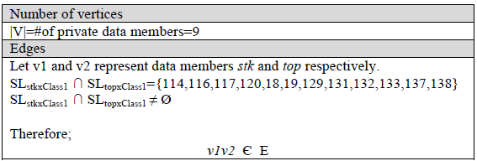
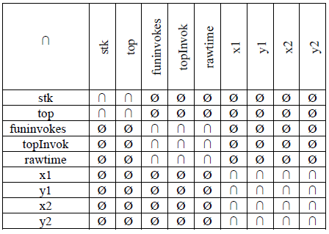
Resultant DSG
y1
top
rawtime
funinvokes
stk
x1
x2
topInvok
y2
Notes:
This shows the result for a class with 9 data members. We show the slices for two data members and their intersections. The table gives the comparisons of slices for all data members. And the final Data slice graph has three connected components. Which means it is not cohesive and should be refactored.

Slide 54
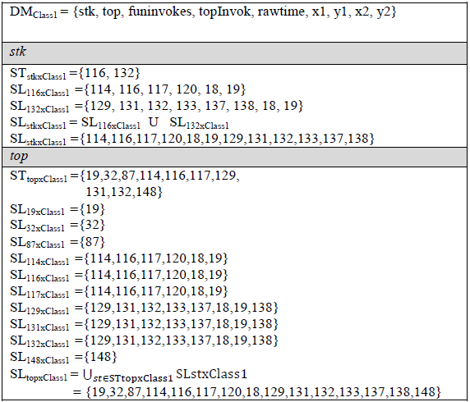
Example – Construct Slices

Slide 55
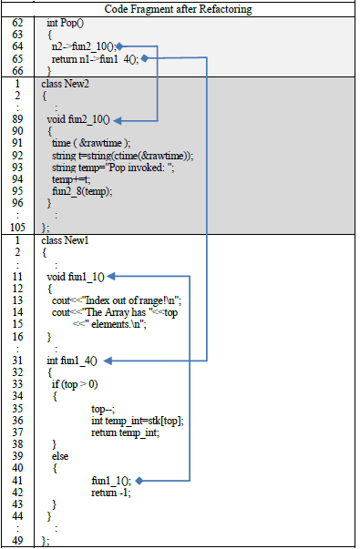
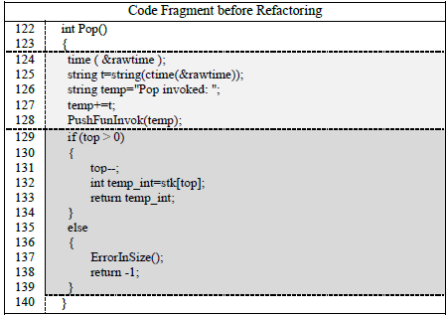
Before and After
Notes:
This shows the code before and after refactoring. One advantage of our technique over other clustering based refactoring is that we preserve the interface of the class. And do not move existing methods between classes but create new ones from statements that reside in the slices.

Slide 56
Example 2
NC=1
Notes:
This class is written by Dr. Fawcett for the parser facility that I mentioned. I used it for experiment.

Slide 57
Summary of Contribution 1
We have proposed a new cohesion metric and an extract class refactoring
Uses a technique similar to slicing
Slicing Criteria defined based on variable references
It is at the statement level
Unlike Clustering, does not suggest moving attributes between classes
We do not change the interface of the class
Cannot measure for classes with no data members.

Slide 58
Contribution 2: Identification of Extract Method Refactoring using Placement Trees
We try to build comprehensible, readable, and simple code
The refactored methods are optimal and extend the lifetime of programs [4,5]
Extract Method refactoring consists of two major activities: identification and extraction
The goal is to create methods with focus on a single task
Contribution 1
Contribution 3
SEKE – Software Engineering and Knowledge Engineering Conf Proceedings
Notes:
Long methods are usually difficult to read and comprehend due to the length and complexity of the code. As a result, maintenance can be time consuming and costly.

Slide 59
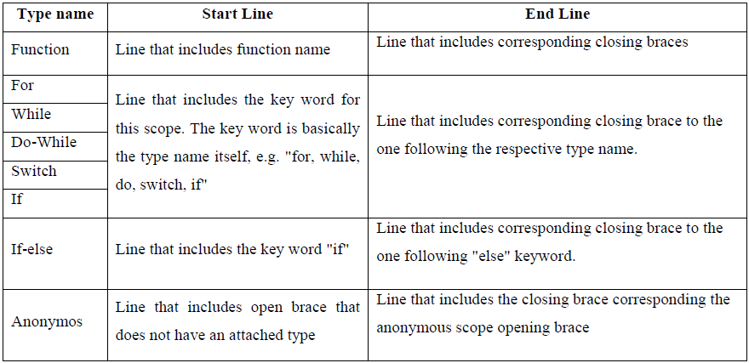
Placement Trees
Placement of scopes in a method
Notes:
Extract method refactoring activity, in this part of our research, starts with generating the placement tree for a given method to represent the hierarchically nested scopes

Slide 60
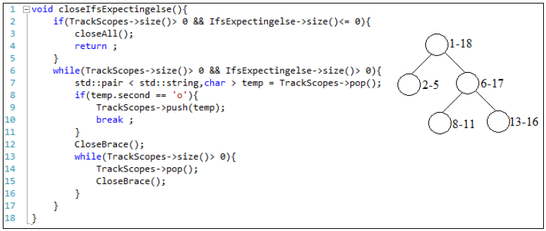
Placement Tree
Contains variable reference counts for individual scopes:
Notes:
The basic idea behind this extract method refactoring technique is that each method should have one clear task to accomplish. What this implies is that the method and all scopes subsequently will include references to some variables to accomplish this task. Using the placement tree concept, we try determine the variable which dominates the operation carried out in the method and in every node of the placement tree as well. In this sense, scopes that are dominated by different variables perform different sub-tasks in this operation and indicate possible extract method refactoring opportunities.

Slide 61
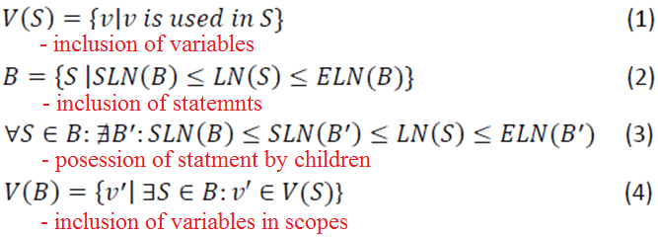
Dominant Variables
Let V(F)={ v1, v2, .., vn } represent the set of all variable names
Notes:
We expect that, a method or a scope in the given method that start with one dominant variable, continues the sub-tasks with the same dominant variable within their children scopes for better comprehension. Therefore, the hierarchical placement of scopes - the placement tree itself - helps us detect continuity of the dominant variables in a given method very effectively.

Slide 62
Dominant Variables
Heuristic: Variable with highest reference count is the dominant variable
Let D(B) represent the dominant variables in scope B,
Notes:
Although this heuristic gives promising results and works effectively, improvements for selection of dominant variables remain as a future work of our study to consider the effect of multiple variables on the determination of cohesion.

Slide 63
Dominant Variables
Parent Protection:
Let dB and dBP represent the dominant variables of the nodes B and BP respectively.

Slide 64
Dominant Variables
Sibling Collaboration
Let dB, dSB and dSA represent the dominant variables of the nodes B, SB and SA respectively.

Slide 65
Identifying Refactoring
Each method should have one clear task to accomplish.
Method and all scopes subsequently will include references to some variables
Start with one dominant variable, continue with the same dominant variable
Scopes that are dominated by different variables are possible extract method refactoring opportunities.

Slide 66
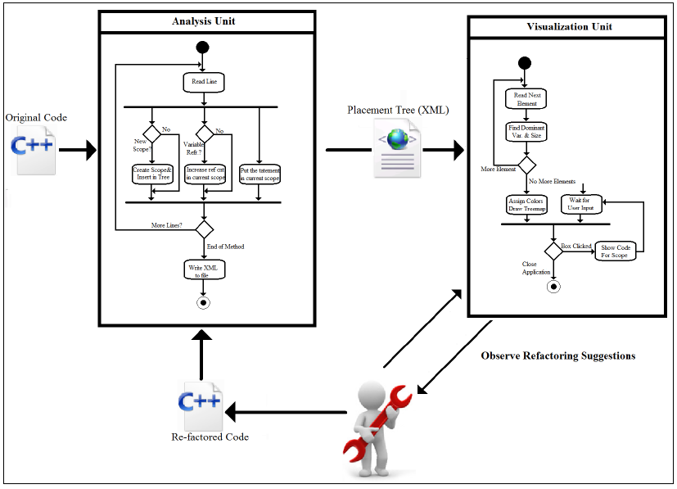
Overall Refactoring Process
Notes:
Together, many small refactorings can be applied to create a significant design change in the system.

Slide 67
Refactoring Suggestion
Large code fragments with a color different from parent's color.
Consecutive sibling nodes with the same color.
Notes:
The parent is doing a specific operation only through these nodes. So they should be refactored.

Slide 68
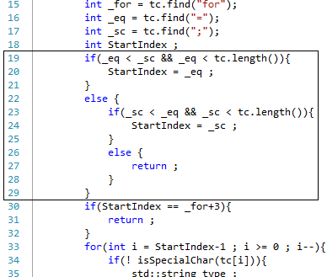
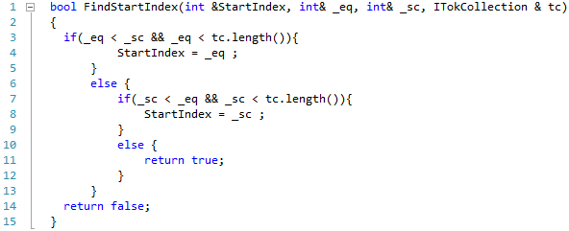
Extraction of Code Fragments
Return without a Value

Slide 69
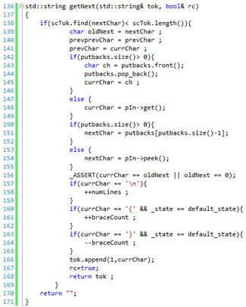
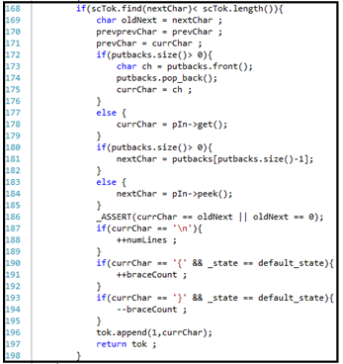
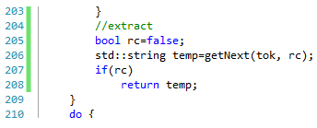
Extraction of Code Fragments
Return with a Value

Slide 70
Extraction of Code Fragments
Return with a Value

Slide 71
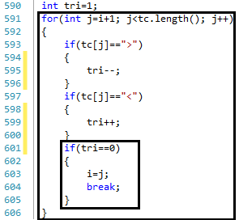
Extraction of Code Fragments
Bound Blocks

Slide 72
Experiments
Analyzer – Our Tool

Slide 73
Experiments
Medical Imaging Research Code -> from 400 to 40
Notes:
Originally we did not expect to detect duplicated code with our technique. Same patterns show duplicated code.

Slide 74
Experiments
Medical Imaging Research Code -> 4000
Notepad++ - > 800

Slide 75
Summary of Contribution 2
Main focus is on identification of code fragments
Introduced techniques and tools based on placement trees and variable reference counts
Works effectively in real software systems
Current heuristic works well, future improvements are planned
Visual representation helps user observe refactoring suggestion easily
Do not consider goto statements!
May result in long parameter lists!

Slide 76
Contribution 3 Refactoring using Hammock Graphs
This contribution focuses on managing the number of arguments in an extracted method’s parameter list
In contribution 2, length of parameter lists is omitted
A long parameter list increases the complexity of a method and makes it difficult to maintain and to comprehend
Contribution 1
Contribution 2
Under Review: IEEE Transactions on Software Engineering

Slide 77
Identification of Code Fragments
A method has a single entry and single exit point
A method usually starts with one or more variable declarations and carries out a set of operations around these variables and ends with or without returning one of the variables
Hammock graph is used to select appropriate code regions that do not violate any refactoring pre-conditions

Slide 78
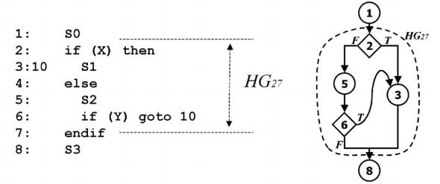
Hammock Graph

Slide 79
Constructing of Hammocks
Our technique proceeds in following steps:
Generate the initial graph of variable declarations and references together with control blocks
Convert all variable span into hammocks
For each hammock, determine the number of variables referenced in the hammock
Visualize the candidates based on a selected number of parameters dynamically
Observe refactoring opportunities, re-factor the code and continue if necessary

Slide 80
Initial Graph
Page 86 of Dissertation
G= (V, E) is a directed graph such that V is the set of program statements and E represents variable relationships
L is the set of all local variables
D(l) = statement where l is declared
LR(l) = statement where last reference of l appears

Slide 81
Initial Graph
Therefore:
Furthermore, let the set C, line number S(c), and line number E(c) represent the set of all control statements in the given method, the line number where the
Therefore:

Slide 82
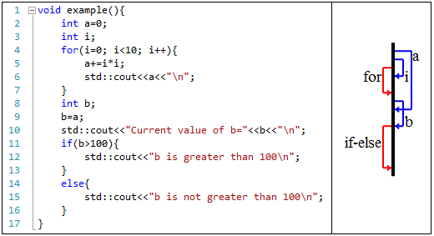
Initial Graph Example

Slide 83
Problems with the initial graph
Extraction of a variable span from the initial graph may split a control block.
Extraction of a variable span from the initial graph into a new method may move the declaration of another local variable to a new scope leaving references of that variable in the original method.

Slide 84
Generating Hammocks
Variable Spans
Control Edges and Variable Spans
Notes:
This conversion is achieved in two steps first compare variable spans with each other and variables spans with each control edge. The graph where we induce the hammocks is called the extended graph

Slide 85
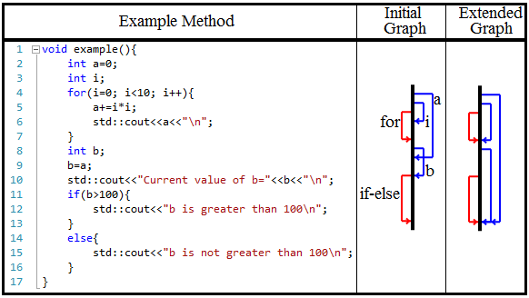
Extended Graph
Notes:
This helps in two ways: makes them extractable and turns it into a tree

Slide 86
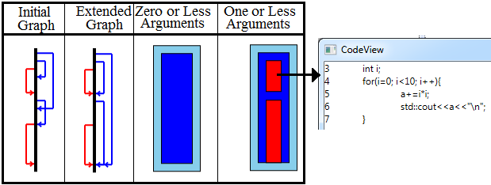
Extended Graph
Each reference edge represents a hammock
Therefore they are extractable
One can observe all possible extract method refactoring opportunities with a selected number of arguments dynamically through a visual representation

Slide 87
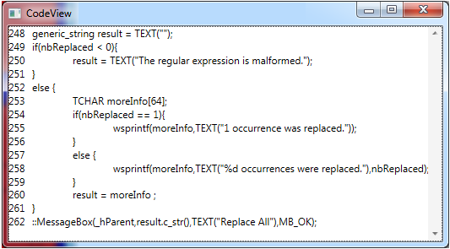
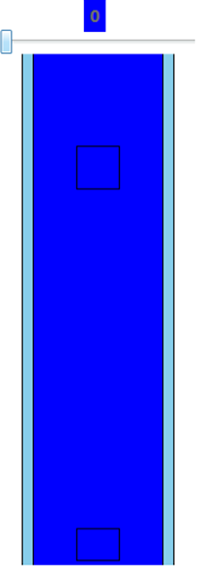
Observing Refactoring Opportunities
Notes:
This method is from notepad++

Slide 88
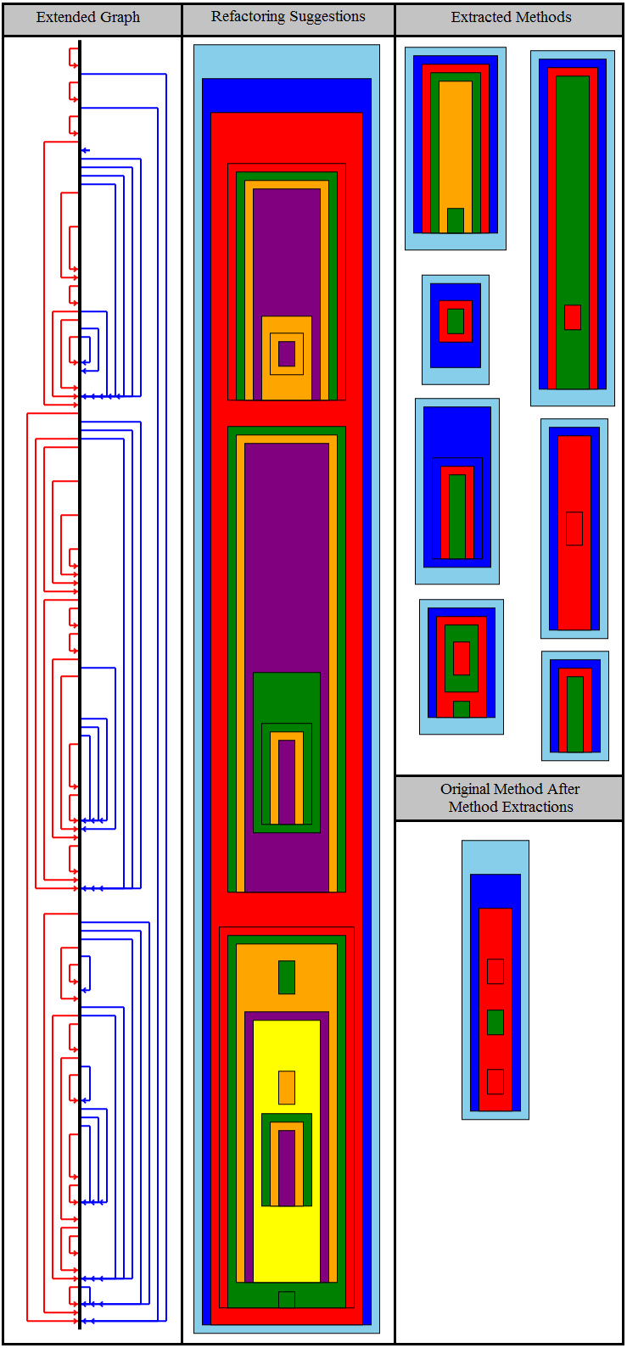
Experiments
The size of these boxes shows the length of the method or code fragment
The color is determined based on the number of arguments prospective methods will take
Notes:
This is an action that I discussed earlier that describes what to do upon detecting a grammatical construct. We gave meaningful names to the extracted methods that reflected what methods intent is.

Slide 89
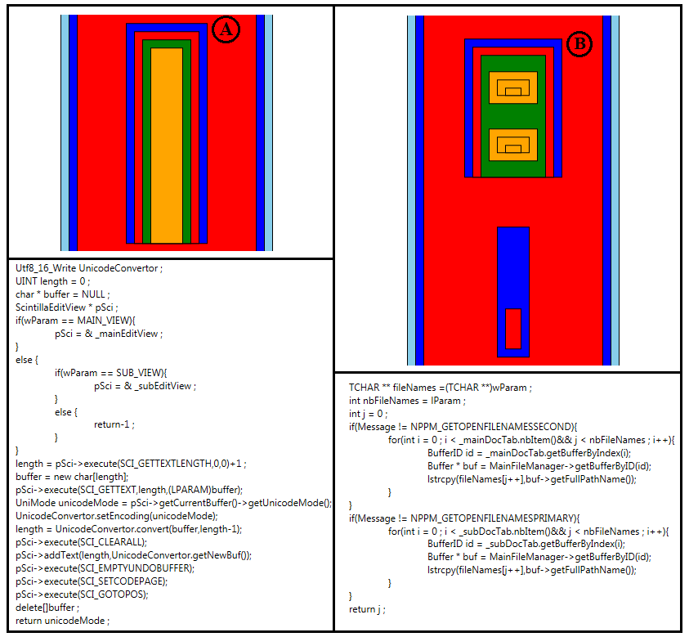
Experiments
Notes:
Notepadd++

Slide 90
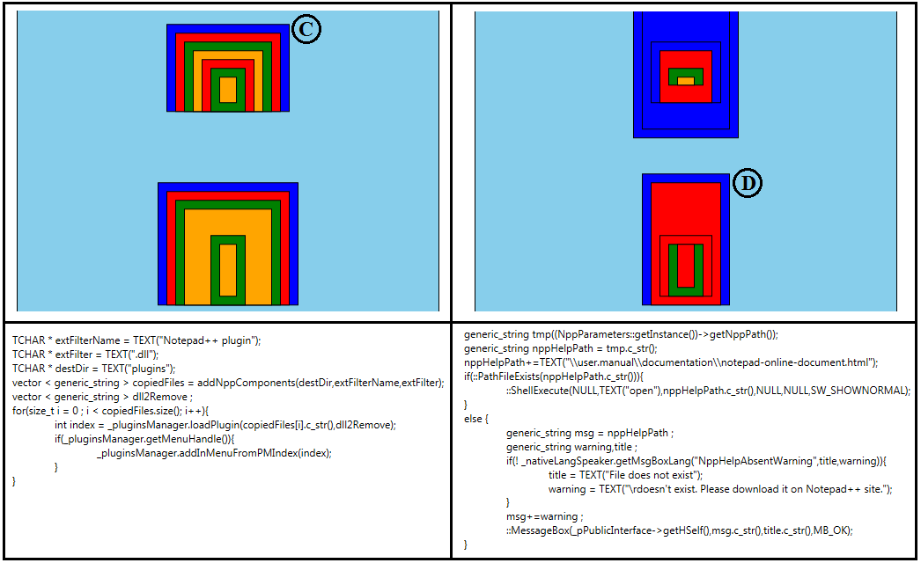
Experiments
Notes:
Notepad++

Slide 91
Summary of Contribution 3
A new technique and tool are introduced to identify code fragments for method extraction with constraints on number of parameters.
Developers have the opportunity to observe different code fragments suggested as candidates for method extraction based on a desired number of arguments.
Novel visualization and technique to observe based on desired number of parameters
Will not work effectively with methods that do not have any local variables
Extracted methods can be smaller when variables are declared as close to where they are used as possible

Slide 92
Conclusion and Future Work
Contribution 1:
A novel technique using a technique similar to slicing
Analysis at statement level
Experiments on real code demonstrate its effectiveness
Future Work:
Enhancement of the conditions that establish the relationships between statements
Improvement on the Data-Slice-Graph: convert the graph into a weighted graph

Slide 93
Conclusion and Future Work
Contribution 2:
A novel technique using scope placement trees
Eliminates any possibility of violating refactoring conditions
Does not require one to have any knowledge of code
Automates the identification phase
Visualization helps to evaluate refactoring
Final decision is up to the user
May result in long parameter lists!
Future Work:
Selection of dominant variables : Centrality analysis
Visualization: Show the effect of all variables

Slide 94
Conclusion and Future Work
Contribution 3:
A technique using hammocks in a novel way
First approach using hammock to method extraction
Eliminates any possibility of violating refactoring conditions
Does not require one to have any knowledge of code
Automates the identification phase
Visualization helps to evaluate refactoring
Final decision is up to the user with a desired number of arguments
Future Work:
May optimize by moving variable declaration before analysis

Slide 95
Bibliography
[2] Grady, Robert B, "Practical Software Metrics For Project Management and Process Improvement," Prentice Hall, Englewood Cliffs, NJ (1992)
[3] Hunt, B.; Turner, B.; McRitchie, K., "Software Maintenance Implications on Cost and Schedule," Aerospace Conference, 2008 IEEE , vol., no., pp.1,6, 1-8 March 2008
[4] Tu Honglei; Sun Wei; Zhang Yanan, "The Research on Software Metrics and Software Complexity Metrics," Computer Science-Technology and Applications, 2009. IFCSTA '09. International Forum on , vol.1, no., pp.131,136, 25-27 Dec. 2009
[5] M. Fowler, K. Beck, J. Brant, W. Opdyke, and D. Roberts, "Refactoring: Improving the Design of Existing Code," Addison Wesley, Boston, MA, 1999.
[9] M. Weiser, “Program slices: formal, psychological, and practical investigations of an automatic program abstraction method,” PhD thesis, University of Michigan, Ann Arbor, 1979.
[46] Simon, F.; Steinbruckner, F.; Lewerentz, C., "Metrics based refactoring," Software Maintenance and Reengineering, 2001. Fifth European Conference on , vol., no., pp.30,38, 2001
[50] Draft Standard for Software engineering - Software life cycle processes - maintenance," IEEE Std P14764, Nov 2004
[51] Mealy, E.; Strooper, P., "Evaluating software refactoring tool support," Software Engineering Conference, 2006. Australian , pp.10 pp.,, 18-21 April 2006
[58] http://help.eclipse.org/indigo/index.jsp?topic=%2Forg.eclipse.jdt.doc.user%2Freference%2Fref-menu-refactor.htm
[64] Zhenchang Xing; Stroulia, E., "Refactoring Practice: How it is and How it Should be Supported - An Eclipse Case Study," Software Maintenance, 2006. ICSM '06. 22nd IEEE International Conference on , vol., no., pp.458,468, 24-27 Sept. 2006
[65] Emerson Murphy-Hill, Chris Parnin, and Andrew P. Black. 2009. How we refactor, and how we know it. In Proceedings of the 31st International Conference on Software Engineering (ICSE '09). IEEE Computer Society, Washington, DC, USA, 287-297
[72] Yip, S.W.L.; Lam, T., "A software maintenance survey," Software Engineering Conference, 1994. Proceedings., 1994 First Asia-Pacific , vol., no., pp.70,79, 7-9 Dec 1994
[73] Emerson Murphy-Hill and Andrew P. Black. 2008. Breaking the barriers to successful refactoring: observations and tools for extract method. In Proceedings of the 30th international conference on Software engineering (ICSE '08). ACM, New York, NY, USA, 421-430.
[78] Riel, A. Object-Oriented Design Heuristics. Addison-Wesley Professional, 1996.

Slide 96
Thanks!

Slide 97
Relationships Between Statements
Execution of statement S1 is affected by statement S2, or vice versa.
A variable defined in S1 is being used in S2
A variable, defined in statement S' which uses a variable defined in S1, is being used in S2.
A variable defined in statement S' is being used in both S1 and S2.
Invocation of a method f() which includes the statement S1 is affected by statement S2.
Execution of both S1 and S2 is affected by the statement S'.
A variable defined in S1 is passed to a method f as an argument and the argument is being used in statement S2 of method f.
Back

