Slide 1
Chapter 12 – 3D Graphics
Jim Fawcett
Brown-Bag Seminar, December 2007

Slide 2
Drawing a House
Purpose of 3D graphics is to produce 2D image from 3D model
<Page Background="Black"
xmlns="http://schemas.microsoft.com/winfx/2006/xaml/presentation"
xmlns:x="http://schemas.microsoft.com/winfx/2006/xaml">
<Viewport3D>
<Viewport3D.Camera>
<OrthographicCamera Position="5,5,5" LookDirection="-1,-1,-1" Width="5"/>
</Viewport3D.Camera>
<Viewport3D.Children>
<ModelVisual3D x:Name="Light">
<ModelVisual3D.Content>
<AmbientLight/>
</ModelVisual3D.Content>
</ModelVisual3D>
<ModelVisual3D>
<ModelVisual3D.Content>
<Model3DGroup x:Name="House"> More Stuff Here – See House3DTransforms

Slide 3
Mapping 2D types to 3D types
Drawing
Pieces of 2D content
Geometry
2D shape
Visual
Base for 2D rendering
Transform
Position, rotate, size 2D drawings
Model3D
Pieces of 3D models
Geometry3D
3D surface
Visual3D
Base for 3D rendering
Transform3D
Position, rotate, size 3D drawings

Slide 4
Cameras
Camera provides a view of a 3D model
Position, orientation, and other properties determine view of 3D model.
<Viewport3D.Camera>
<OrthographicCamera Position="5,5,5" LookDirection="-1,-1,-1" Width="5"/>
</Viewport3D.Camera>

Slide 5
Orthographic and Perspective Cameras
Orthographic projection
Distance from viewer does not affect size
<Viewport3D.Camera>
<OrthographicCamera Position="5,5,5" LookDirection="-1,-1,-1" Width="5"/>
</Viewport3D.Camera>
Perspective projection
Distant objects appear smaller
<Viewport3D.Camera>
<PerspectiveCamera Position="6,6,6" LookDirection="-1,-1,-1" FieldOfView="45"/>
</Viewport3D.Camera>

Slide 6
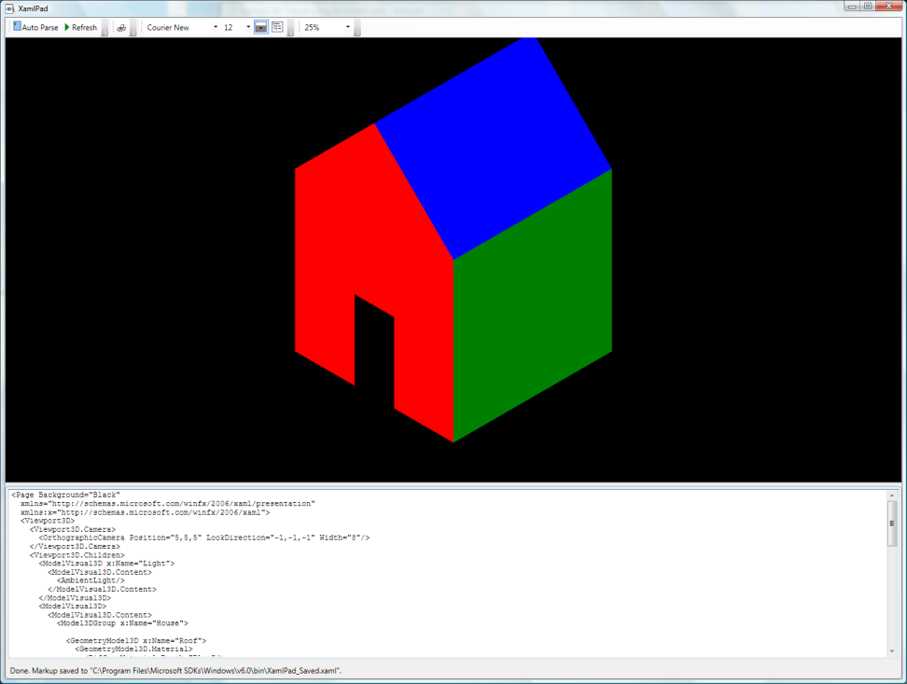
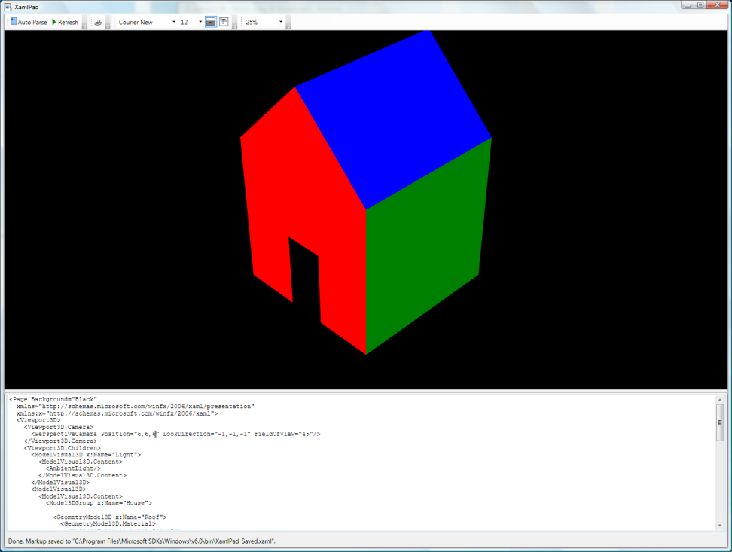
Orthographic and Perspective Cameras

Slide 7
Materials and Lights
As in 2D, you use brushes to specify appearance of filled geometry. Lights influence gradients of hue and saturation.
<ModelVisual3D x:Name="Light">
<ModelVisual3D.Content>
<AmbientLight/>
</ModelVisual3D.Content>
</ModelVisual3D>

Slide 8
Transform3Ds
TranslateTransform3D
Offset 3D object relative to its container
ScaleTransform3D
Scales object relative to its container
RotateTransform3D
You guessed it! Rotates relative to its container
MatrixTransform3D
Can combine all of the above as a matrix operation
Transform3DGroup
Contains a collection of transforms

Slide 9
Model3Ds
Model3Ds are building blocks for 3D models
Light
Place sources of light in scene
GeometryModel3D
Renders a surface with a given material
Model3DGroup
A collection of Model3Ds which is itself a Model3D

Slide 10
Light
DirectionalLight
Parallel rays from source at infinity
PointLight
Radiates light uniformly from point in scene
Appears unfocused
SpotLight
Emits cone of light from point in scene
Appears focused

Slide 11
Materials
DiffuseMaterial
Scatters light striking surface in all directions, producing a flat affect
SpecularMaterial
Reflects light at same angle as incident ray. Creates glossy highlights on smooth surfaces
EmissiveMaterial
A surface that is emitting light
MaterialGroup
Applies multiple materials to a model

Slide 12
Geometry3Ds
Positions
Defines vertices of triangles in a mesh
TriangleIndices
Describes connections between vertices to form triangles
Normals
Vector in direction normal to a surface, used for shading
TextureCoordinates
Provides 3D-to-2D mapping of positions used by materials

Slide 13
ModelVisual3Ds
<ModelVisual3D x:Name="Light">
<ModelVisual3D.Content>
<AmbientLight/>
</ModelVisual3D.Content>
</ModelVisual3D>
<ModelVisual3D>
<ModelVisual3D.Content>
<Model3DGroup x:Name="House">
<GeometryModel3D x:Name="Roof">
<GeometryModel3D.Material>
<DiffuseMaterial Brush="Blue"/>
</GeometryModel3D.Material>
<GeometryModel3D.Geometry>
<MeshGeometry3D Positions="-1,1,1 0,2,1 0,2,-1 -1,1,-1 0,2,1 1,1,1,1,1,-1 0,2,-1"
TriangleIndices="0 1 2 0 2 3 4 5 6 4 6 7"/>
</GeometryModel3D.Geometry>
</GeometryModel3D>
Node in visual tree that can render 3D content
To set content use the Content property:

Slide 14
Viewport3D
A 2D FrameworkElement that bridges 2D and 3D
Parent is always a 2D element like a Window or Grid
Children are Visual3D elements
3D scene described by the child elements is rendered inside the rectangular bounds of the Viewport
The Camera property of the Viewport controls the view of the scene

Slide 15
Nathan’s Examples
Seventeen XAML files you can open in notepad, copy to XamlPad to view, and manipulate
Two WPF projects
3D House with hit testing on its elements
Rather sophisticated photo gallery

