Slide 1
Memento Pattern Code
Jim Fawcett
CSE776 – Design Patterns
Fall 2018

Slide 2
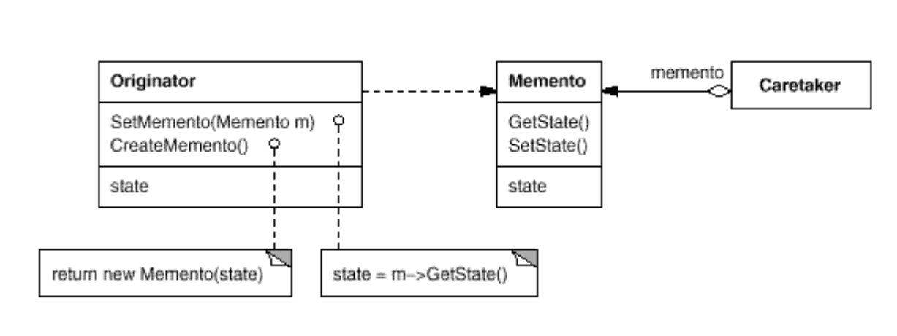
Memento Classes
Originator creates memento containing a snapshot of its current state
Uses memento to restore its internal state
Caretaker stores memento(s) without examining or altering its state
https://paginas.fe.up.pt/~aaguiar/as/gof/hires/pat5ffso.htm

Slide 3
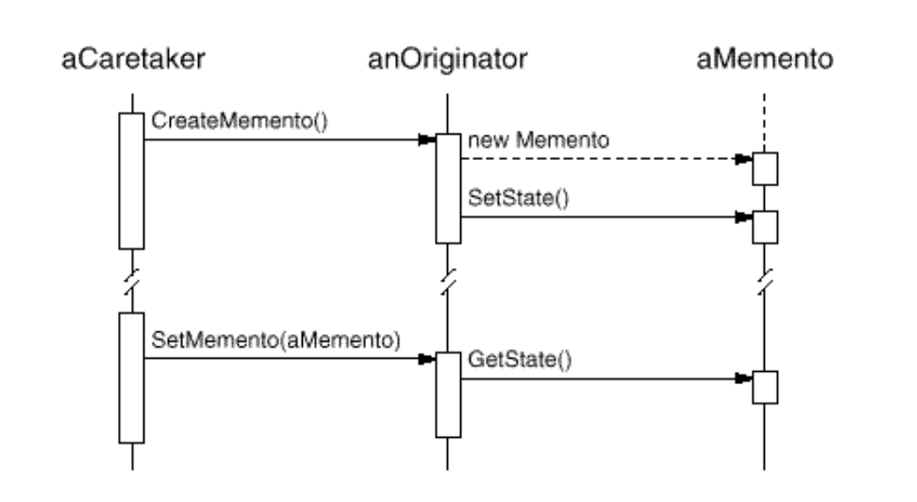
Memento Sequence Diagram
Caretaker requests memento from Originator
Holds it for a while
Passes it back to the Originator
https://paginas.fe.up.pt/~aaguiar/as/gof/hires/pat5ffso.htm

Slide 4
Memento Class
template<class state> class Originator;
template<class state> class Memento {
public:
Memento(Originator<state> *pOrig);
void GetState();
void SetState();
private:
Originator<state>* _pOrig;
state _state;
};
template<class state>
Memento<state>::Memento(Originator<state> *pOrig) : _pOrig(pOrig) { }
template<class state>
void Memento<state>::GetState() {
_state = _pOrig->_state;
}
template<class state>
void Memento<state>::SetState() {
_pOrig->_state = _state;
}

Slide 5
Originator Class
template<class state>
void Originator<state>::SetMemento(Memento<state> *m) {
m->SetState();
cout << "\n\n Originator retrieving state \"" << _state << "\"";
}
template<class state>
Memento<state>* Originator<state>::CreateMemento() {
cout << "\n Originator creating memento with state \""
<< _state << "\"";
Memento<state> *pMem = new Memento<state>(this);
pMem->GetState();
return pMem;
}
template<class state>
void Originator<state>::Operation(std::string s) {
cout << "\n\n Originator changing state to \"" << s << "\"";
_state = s;
}
template<class state> class Originator {
friend class Memento<state>;
public:
Originator(const state &s);
void Operation(std::string s);
void SetMemento(Memento<state> *m);
Memento<state>* CreateMemento();
private:
state _state;
};
template<class state>
Originator<state>::Originator(const state &s) : _state(s) { }

Slide 6
Caretaker Class
template<class state> class Caretaker {
public:
Caretaker(Originator<state> *orig);
void acceptMemento();
void returnMemento();
private:
Originator<state>* _pOrig;
std::vector< Memento<state>* > _mementos;
};
template<class state>
Caretaker<state>::Caretaker(Originator<state> *pOrig) : _pOrig(pOrig) { }
template<class state>
void Caretaker<state>::acceptMemento() {
Memento<state> *pMem = _pOrig->CreateMemento();
_mementos.push_back(pMem);
}
template<class state>
void Caretaker<state>::returnMemento() {
if(_mementos.size() > 0) {
Memento<state> *pMem = _mementos.back();
_mementos.pop_back();
_pOrig->SetMemento(pMem);
delete pMem;
}
}

Slide 7
Client
void main() {
cout << "\n Demonstrating Memento Skeleton Code "
<< "\n =====================================";
Originator<State> orig(State("first state"));
Caretaker<State> ct(&orig);
ct.acceptMemento();
orig.Operation("second state");
ct.acceptMemento();
orig.Operation("third state");
ct.acceptMemento();
ct.returnMemento();
ct.returnMemento();
ct.returnMemento();
cout << "\n\n";
}
class State {
public:
State() : _str("") { }
State(const string &s) : _str(s) { }
string str() { return _str; }
private:
std::string _str;
};
ostream& operator<<(ostream &out, State s) {
out << s.str();
return out;
}

Slide 8
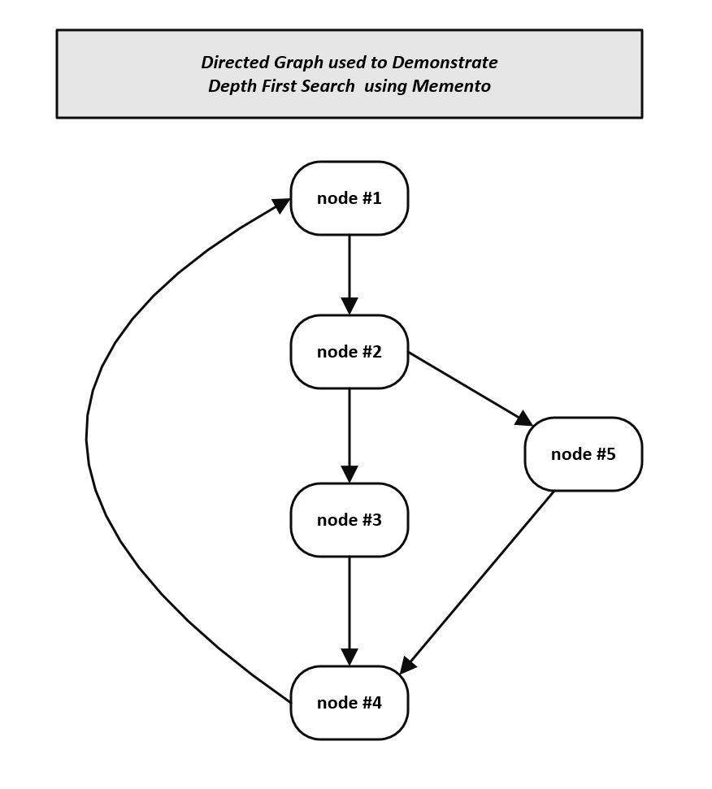
Using Memento to do non-recursive graph walk
Demonstrating Depth First Search using Memento Pattern
===============================================
starting at node 1:
---------------------
visiting node #1
visiting node #2
visiting node #3
visiting node #4
visiting node #3
visiting node #2
visiting node #5
visiting node #2
restarting at node 3:
-----------------------
visiting node #3
visiting node #4
visiting node #1
visiting node #2
visiting node #5
visiting node #2
visiting node #1
visiting node #4

Slide 9
Using Memento to do non-recursive graph walk
template<class NodeVal> class Node {
public:
Node(NodeVal v);
NodeVal& value();
bool& marked();
Node<NodeVal>* getUnmarkedChild();
void attachChild(Node<NodeVal>* pNode);
private:
std::vector< Node<NodeVal>* > _children;
NodeVal _value;
bool _visited;
};
template<class NodeVal>
Node<NodeVal>::Node(NodeVal v) : _value(v), _visited(false) { }
template<class NodeVal>
NodeVal& Node<NodeVal>::value() { return _value; }
template<class NodeVal>
bool& Node<NodeVal>::marked() { return _visited; }
template<class NodeVal>
Node<NodeVal>* Node<NodeVal>::getUnmarkedChild() {
vector< Node<NodeVal>* >::iterator it;
for(it=_children.begin(); it!=_children.end(); it++) {
if((*it)->marked() == false) {
return (*it);
}
}
return NULL;
}
template<class NodeVal>
void Node<NodeVal>::attachChild(Node<NodeVal>* pNode) {
_children.push_back(pNode);
}

Slide 10
Graph walk Caretaker
template<class NodeVal> class Memento;
template<class NodeVal> class Walker; // originator
template<class NodeVal> class Caretaker {
public:
void acceptWalker(Walker<NodeVal> *pWalk);
void acceptMemento();
int returnMemento();
int numMementos() { return _mementos.size(); }
private:
Walker<NodeVal> *_pWalk;
std::vector< Memento<NodeVal>* > _mementos;
};
template<class NodeVal>
void Caretaker<NodeVal>::acceptWalker(Walker<NodeVal> *pWalk)
{
_pWalk = pWalk;
}
template<class NodeVal>
void Caretaker<NodeVal>::acceptMemento() {
Memento<NodeVal> *pMem = _pWalk->CreateMemento();
_mementos.push_back(pMem);
}
template<class NodeVal>
int Caretaker<NodeVal>::returnMemento() {
if(_mementos.size() > 0) {
Memento<NodeVal> *pMem = _mementos.back();
_mementos.pop_back();
pMem->SetState();
delete pMem;
}
return _mementos.size();
}

Slide 11
Graph walk Originator
template<class NodeVal>
void Walker<NodeVal>::walk() {
Node<NodeVal>* pNode;
do
{
_currPos->marked() = true;
cout << "\n visiting node #" << (_currPos->value());
while((pNode = _currPos->getUnmarkedChild()) != 0)
{
_ct.acceptMemento();
_currPos = pNode;
_currPos->marked() = true;
cout << "\n visiting node #" << (_currPos->value());
}
_ct.returnMemento();
} while(_ct.numMementos() > 0);
}
template<class NodeVal>
void Walker<NodeVal>::SetMemento(Memento<NodeVal> *m) { m->GetState(); }
template<class NodeVal>
Memento<NodeVal>* Walker<NodeVal>::CreateMemento() {
Memento<NodeVal> *pMem = new Memento<NodeVal>(this);
pMem->GetState();
return pMem;
}
template<class NodeVal> class Walker {
friend class Memento<NodeVal>;
public:
Walker(Node<NodeVal> *start);
void walk();
void SetMemento(Memento<NodeVal> *m);
Memento<NodeVal>* CreateMemento();
private:
Node<NodeVal> *_currPos;
Caretaker<NodeVal> _ct;
};
template<class NodeVal>
Walker<NodeVal>::Walker(Node<NodeVal> *start) : _currPos(start) {
_ct.acceptWalker(this);
}

Slide 12
Graph walk Memento
Node<int> n1(1), n2(2), n3(3), n4(4), n5(5);
n1.attachChild(&n2);
n2.attachChild(&n3); n2.attachChild(&n5);
n3.attachChild(&n4);
n4.attachChild(&n1);
n5.attachChild(&n4);
cout << "\n starting at node 1: "
<< "\n ---------------------";
Walker<int> walker(&n1);
walker.walk();
cout << "\n\n";
cout << "\n restarting at node 3: "
<< "\n -----------------------";
n1.marked() = false;
n2.marked() = false;
n3.marked() = false;
n4.marked() = false;
n5.marked() = false;
Walker<int> walker2(&n3);
walker2.walk();
template<class NodeVal> class Memento {
public:
Memento(Walker<NodeVal> *pWalker);
void GetState();
void SetState();
private:
Walker<NodeVal> *_pWalker;
Node<NodeVal> *_pNode;
};
template<class NodeVal>
Memento<NodeVal>::Memento(Walker<NodeVal> *pWalker) : _pWalker(pWalker) { }
template<class NodeVal>
void Memento<NodeVal>::GetState() { _pNode = _pWalker->_currPos; }
template<class NodeVal>
void Memento<NodeVal>::SetState() { _pWalker->_currPos = _pNode; }

