Slide 1
Façade Code
Jim Fawcett
CSE776 – Design Patterns
Fall 2018

Slide 2
CodeAnalyzer Facade
Code Analysis tool based on parser

Slide 3
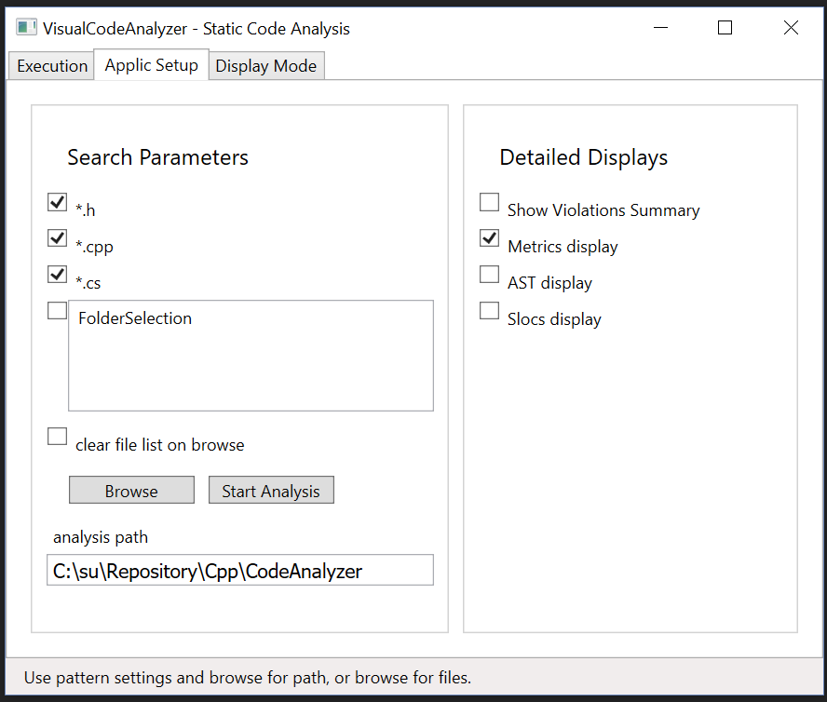
Façade Example – Code Analyzer
Analyzer
Console application with many modes and options, provided on the command line.
Need to provide path to folder containing files to analyze.
Façade – VisualCodeAnalyzer, a WPF application
Supports browsing for path
Supplies command line arguments from checkbox inputs
Spawns console analyzer, using .Net Process class and supplies it with command line arguments.

Slide 4
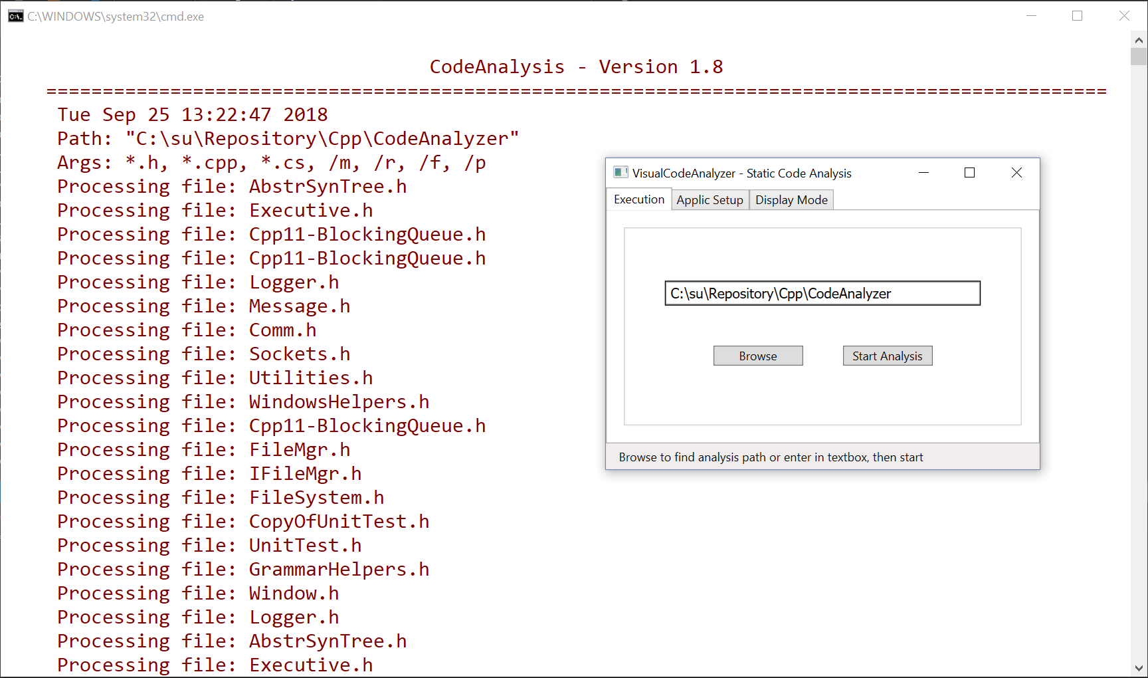
Code Analyzer Facade

Slide 5
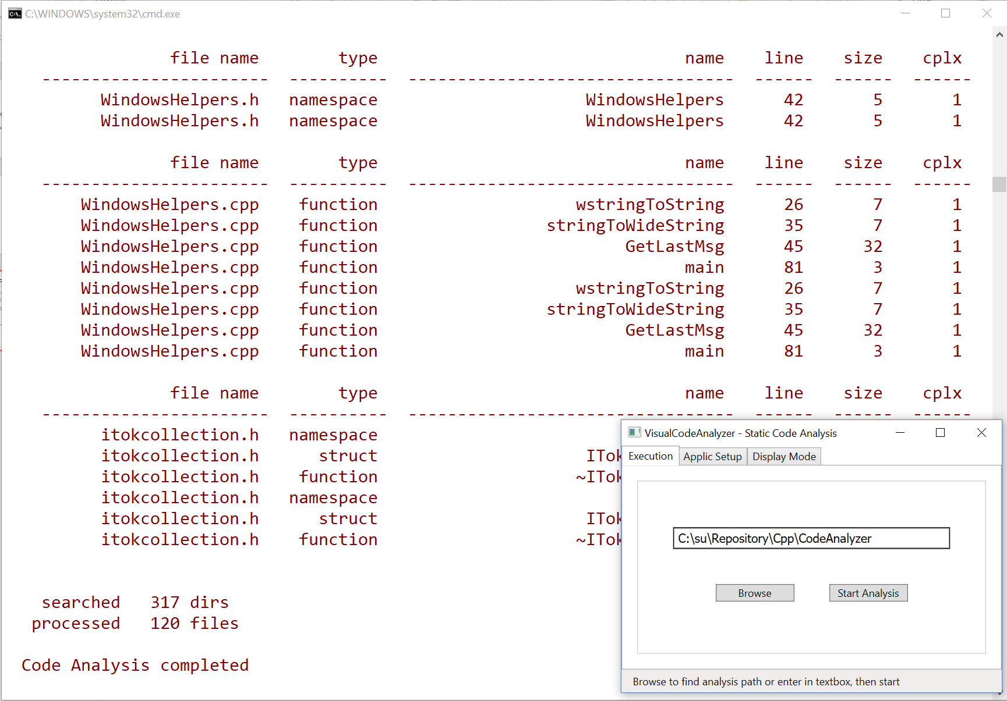
Code Analyzer Façade

Slide 6
VisualCodeAnalyzer Code to Execute Analysis
//----< execute Analyzer.exe as a separate process >----------------0
void WPFCppCliDemo::doExecute()
{
Console::Clear();
ProcessStartInfo^ psi = gcnew ProcessStartInfo();
psi->UseShellExecute = false;
/*
* Look for Analyzer executable in directory where GUI was started.
*/
String^ analyzerPath = Path::GetFullPath(Assembly::GetExecutingAssembly()->Location);
analyzerPath = Path::GetDirectoryName(analyzerPath);
if (!System::IO::Directory::Exists(analyzerPath))
{
throw gcnew Exception("invalid analyzer path");
}
analyzerPath += "\\CodeAnalyzer.exe";
try {
analyzerPath = System::IO::Path::GetFullPath(analyzerPath);
psi->FileName = analyzerPath;
setCmdLineArgs();
psi->Arguments = cmdLine_;
Process^ p = Process::Start(psi);
}
catch (Exception^ ex)
{
// we get here if file spec is invalid
Console::Write("\n{0} = {1}", ex->Message, analyzerPath);
Console::Write("\n{0}\n", "try rebuilding CodeAnalyzer");
}
saveUserSettings();
}
//----< event handler for Start Analysis Button >--------------------
void WPFCppCliDemo::execute(Object^ sender, RoutedEventArgs^ args)
{
setCmdLineArgs();
doExecute();
}

Slide 7
Code Publisher Facade
Transforms source code into web pages

Slide 8
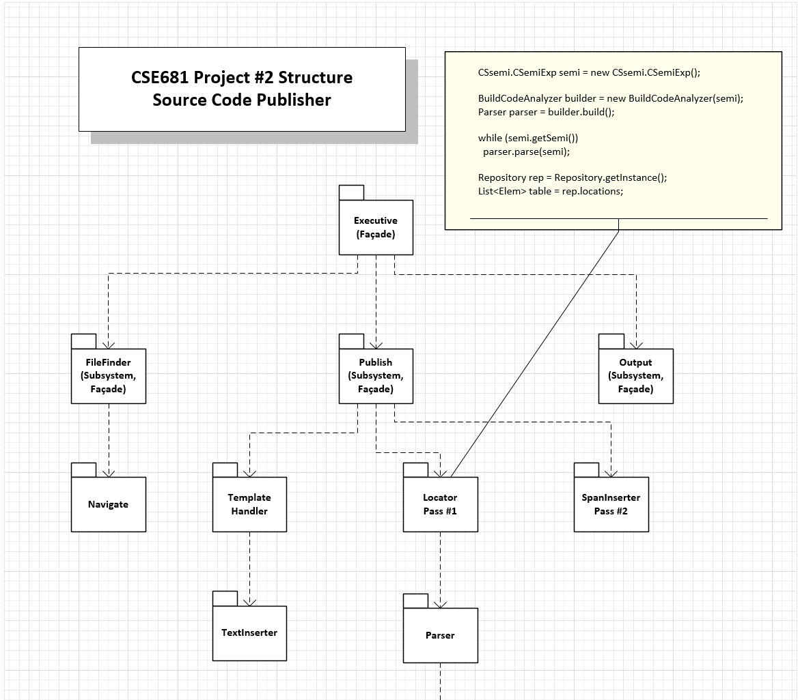
Publisher Package Diagram
Source Code Publisher
Analyzes all packages in a project folder
Converts source files to web pages:
Inserts code into HTML page between <pre> and </pre> markup.
Converts any markup characters in the code to escape sequences, e.g., converts “<“ to “&lt;”
Each top-level package:
Executive, FileFinder, Publish, and Output
are Facades.

Slide 9
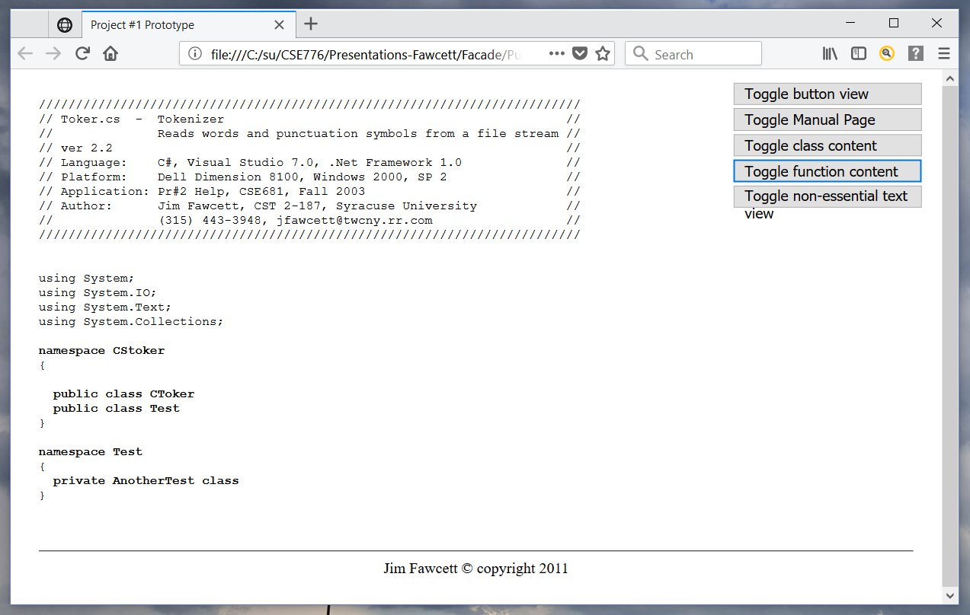
Publisher Output

Slide 10
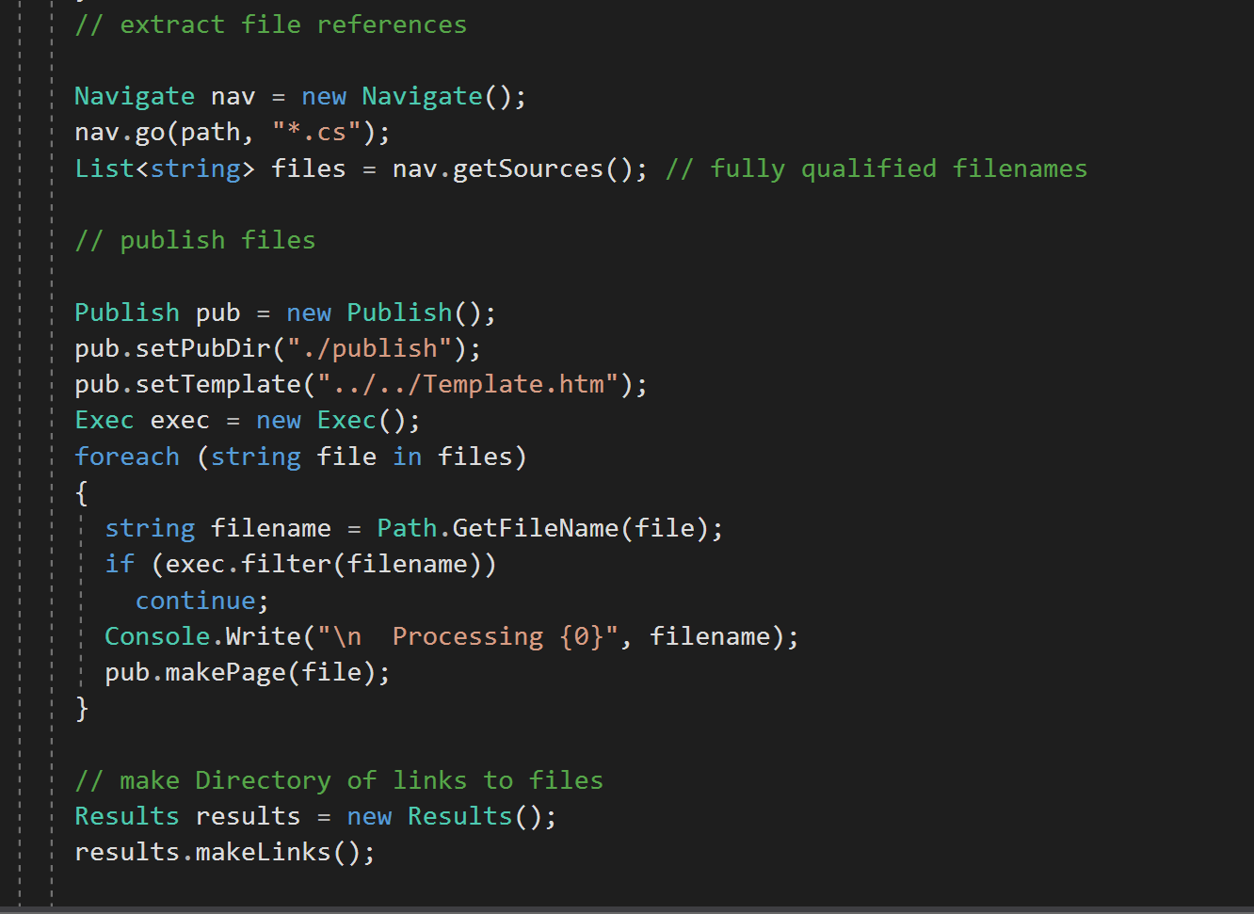
Upper-level Packages are Facades
Package Facades
Provide languages for Executive
Nav – get sources
Publish – make pages
Results – make links to dependent packages

Slide 11
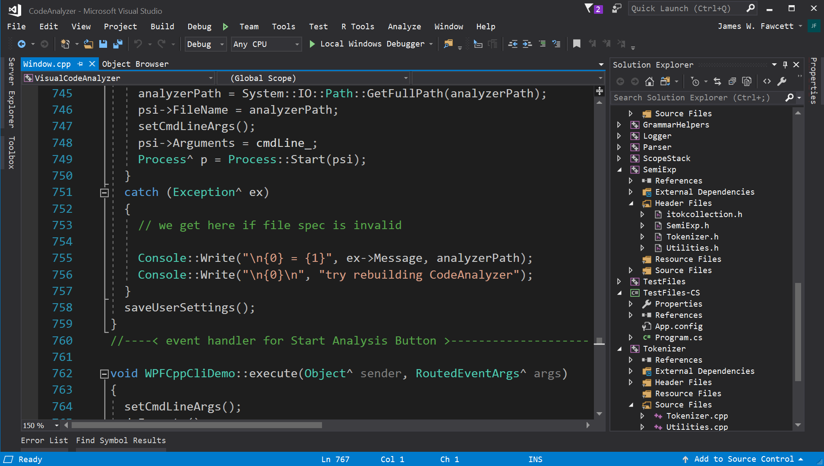
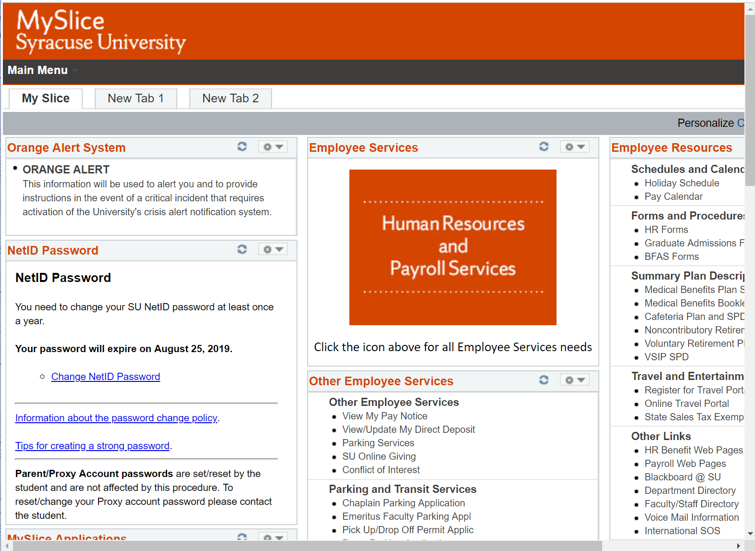
That’s all Folks!
Other Facades:
My-Slice
All Office Products
Visual Studio
Our Website

