Slide 1
FACADE PATTERN
“Any fool can write code that a computer can understand. Good programmers write code that humans can understand.” – Martin Fowler
Presented by
Dr Jim Fawcett
Sneha Sinha

Slide 2
INTENT
Question: Why Facade ?
Answer: “Simplify and Encapsulate”
Prime focus of today’s programming is to hide the complex implementation details of the object providing a simple client’s interface.
We all get perplexed when we are asked what is the best way to do that? – No BEST
There are better ways to do it.

Slide 3
Intent cont
Provide a unified interface to a set of interfaces in a subsystem.
Facade defines a higher-level interface that makes subsystems easier to use.
This can be used to simplify a number of complicated object interactions into a single interface

Slide 4
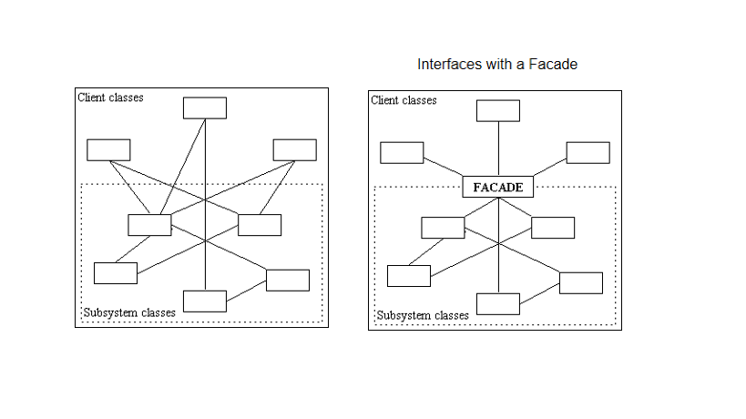
Motivation & Structure
To simplify access to the subsystem you can route everything through a facade

Slide 5
Motivation cont
Structuring a system into subsystems helps reduces complexity.
The interface exposed by the classes in a subsystem or set of subsystems can become quite complex.
To reduce this complexity, Introduce a façade object that provides a simplified and single interface to access facilities of a system.

Slide 6
Applicability
Facade Pattern provides a simple default view of the complex system which looks very clean and easy to clients.
Facade allows expert users to directly interact with its complex subsystems.

Slide 7
Applicabilty contd.
Subsystem dependencies can be minimized by making them communicate solely with facades which promotes decoupling between subsystem and client promoting portability.
To layer your subsystems. Using a Facade as an entry point to each level of sub system or subsystem of subsystem.

Slide 8
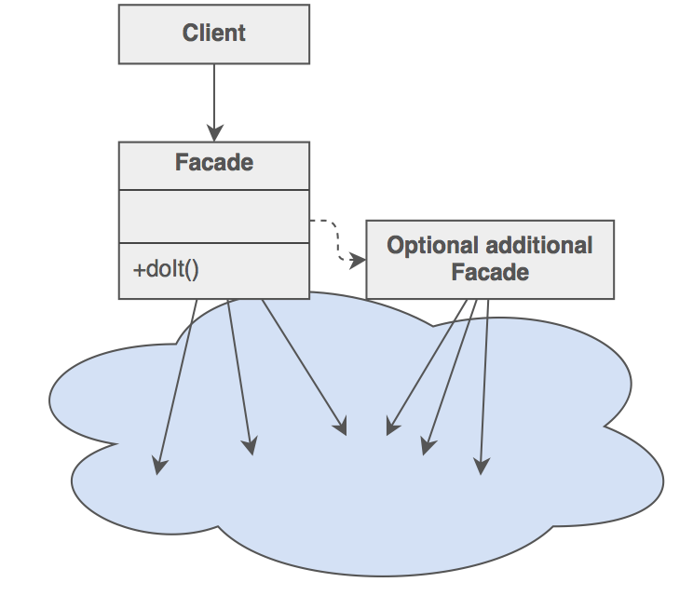
Applicability cont

Slide 9
PARTICIPANTS
Facade class
Which requests the appropriate class to deliver service.
In real world complex system, more than one facade.
Subsystem Class
implements functionality of the system.

Slide 10
Implementation
Reducing client –subsystem coupling.
Public versus private subsystem classes.
Clients could access public interface of the subsystem through façade and we can expose the private interface for subsystem extenders.

Slide 11
Collaborations
Clients requests to façade to communicate with subsystem.
Façade has its own implementation of forwarding the client’s request to the appropriate subsystem which is minimal.
Client which uses façade don’t have to access its subsystem directly.
Facade objects are often Singletons because only one Facade object is required.

Slide 12
Pros
Shields client from subsystem component, makes subsystem easier for client to use.
Promotes weak coupling between client and subsystem. This allows you to change the classes that comprise the subsystem without affecting the clients.
Reduces compilation dependencies in the large software systems.
Simplifies platform portability as more often only few more subsystem has to be build to achieve that.

Slide 13
Pros contd
Lets ambitious clients to access underlying classes.
It doesn’t add any functionality but simplifies interface.
Increases learning curve of the team.
ex: Interaction MS excel by using com object model provided by MS excel where only one team member knows the MS excel APIs.

Slide 14
Cons
Façade pattern does not limit its client to access its subsystem interface directly.
Implementation cost is worth the abstraction?

Slide 15
Why FAÇADE over ADAPTER
Facade defines a new interface, whereas Adapter uses an old interface making two existing interfaces work together as opposed to defining an entirely new one.
Well this is not the difference, it’s the definition. ;)

Slide 16
contd
Adapter and Facade are both wrappers; but they are different kinds of wrappers.
Facade routinely wraps multiple objects and Adapter wraps a single object.
So the way to tell the difference between the Adapter pattern and the Facade pattern is that the Adapter wraps one class and the Facade may represent many classes?

Slide 17
No!
While most textbook examples show the adapter adapting one class, you may need to adapt many classes to provide the interface a client is coded to.
Likewise, a Facade may provide a simplified interface to a single class with a very complex interface.
The difference between the two is not in terms of how many classes they "wrap", it is in their intent.

Slide 18
Why Abstract Factory over Facade
Abstract Factory can be used as an alternative to Facade to hide platform-specific classes.

Slide 19
Reference
Design Patterns, Elements of Reusable Object-Oriented Software, Erich Gamma, et. al., Addison-Wesley, 1994, ISBN 0-201-63361-2
Stackoverflow.com

Slide 20
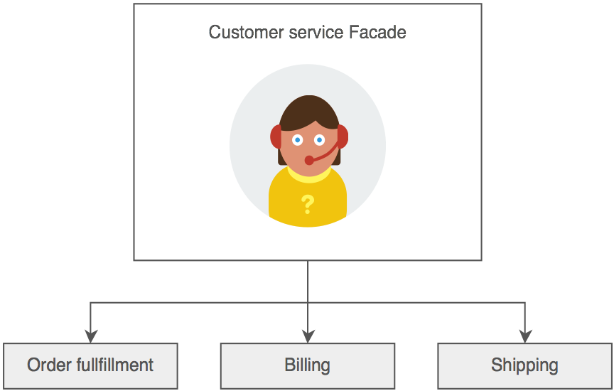
Simple example of FAÇADE (for someone who has trouble understanding without diagram)

