Slide 1
CUSTOMER INTERACTION PATTERN
CSE 776 DESIGN PATTERNS FALL 2010
Presented By
Ganpath Priya Muthukaruppan
Dr. Jim Fawcett

Slide 2
Abstract
Team members are asked to play more active role in interfacing with customers.
Pattern targets developers and service providers in their direct interaction with customers.

Slide 3
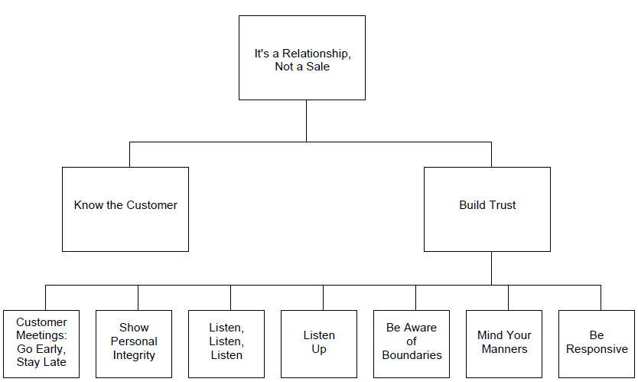
Structure

Slide 4
Structure
Pattern at each level forms context for patterns in lower levels.
Lower level is part of solution for higher level.

Slide 5
Introduction
Customer interaction is important to developers through out developments life cycle.
Many team members are involved one-on-one with a specific customer representative to coordinate flow of information from :
Customer to development team.
Resident subject matter experts on team to customer.

Slide 6
It’s a relationship, Not a sale

Slide 7
It’s a relationship, Not a sale
Problem
How should you treat customers so they’ll be satisfied with the product and services?
Context
You are a product developer or a service provider.
You may be part of a team or a single contributor.
You currently play an active role in interfacing with customers or you have been asked to take on this role.

Slide 8
It’s a relationship, Not a sale
Forces
Want to delight our customers.
Want to protect our own interests.
Solution
Know the customer: Gain an understanding of the customer
Build trust with the customer: Express understanding in product or service as part of on-going commitment.

Slide 9
It’s a relationship, Not a sale
Resulting context:
Customers will understand future success depends both on customer and the supplier.
Customer will be more dependent on you.
Rationale:
Developers need a customer contact to answer questions during development.
Need to build a relationship with trust.

Slide 10
Know the customer

Slide 11
Know the customer
Problem: What’s the best way to establish a relationship with the customer?
Context:
Customers use your products or services in their products or services.
It’s a relationship, not a sale.
Forces:
Developers feel knowing the product is enough.
Customers need results quickly.

Slide 12
Know the customer
Solution:
Learn customer’s business and the users and vendors whose product must work with yours – ensures product is integrated properly.
Get "hands on" experience in the customer environment.
Resulting Context:
A product developer becomes a service provider. When we know our customer's world, our products and services become more useful.
Understanding the customer enables a better understanding of customer priorities.

Slide 13
Know the customer
Rationale:
Understand how the customer thinks from a business point of view
Learning how users' and vendors' products work with yours will help ensure that products integrate properly for the customer.

Slide 14
Build Trust

Slide 15
Build Trust
Problem:
How do you strengthen a relationship with a customer?
Context:
You understand that It's a Relationship, Not a Sale.
Trying to Know the Customer.

Slide 16
Build Trust
Forces:
Developers need to interface with their counterparts in the customer organization – addresses issues.
Customers need contacts in your organization.
People are reluctant to spend time with people they don't know.
Solution:
Every contact with the customer is a chance to build trust.

Slide 17
Build trust
Resulting Context:
Customer interaction becomes easier.
Developers' and customers‘ questions are answered, problems solved, and progress can be made.
Don't assume that a relationship is static. It must be supported and maintained over time.
Rationale:
Clients prefer to do business with people they like, with people who seem genuinely interested in them, who deal with their concerns.
Worst customer interaction mistake for some customers is to get right down to business at the first meeting with the customer.

Slide 18
Customer Meetings: Go Early, Stay Late

Slide 19
Customer Meetings: Go Early, Stay Late
Problem:
Arriving just as the meeting begins and leaving as soon as it done – you miss opportunities to build trust with customer.
Context:
You understand It's a Relationship, Not a Sale.
You are trying to Know the Customer
You are working to Build Trust.

Slide 20
Customer Meetings: Go Early, Stay Late
Forces:
You want customers to be aware of the current status of the product.
Social interaction like meetings can seem like a waste of time.
Solution:
Arrive early enough to socialize and meet other attendees.
After meeting, talk to others with common business interests.
Make an effort to meet and greet the customer.
Should keep the meeting as short as possible if we are holding it.

Slide 21
Customer Meetings: Go Early, Stay Late
Result Context:
Routine meeting becomes a more positive experience that helps Build Trust and solve real problems.
Fine balance is required to convey the right message to our customers.
Rationale:
There are meetings whose real purpose is to get concerned parties together.
Socializing beforehand allows everyone to come to the meeting with a sense of camaraderie.

Slide 22
Listen, Listen, Listen
Problem:
Listening is important in building a customer relationship
You may not have a lot of time for customer discussions
Your customer may not communicate well

Slide 23
Listen, Listen, Listen
Solution:
Zip your lip – Let your customers say what they are trying to say
Try to pickup on unspoken information
Body language, attitude, FUD
Ask friendly but probing questions
Listen reflectively

Slide 24
Listen, Listen, Listen
Result:
Better customer relationships
Cooperative customers
Better products

Slide 25
Be Responsive
Problem:
You need to respond to customer requests quickly
What is an acceptable response time?
Immediate responses aren’t always possible (or even desirable)

Slide 26
Be Responsive
Solution:
Always return phone calls and emails the same day
Communicate the time needed for a solution
Determine the customer deadline
Do not over promise

Slide 27
Be Responsive
Result:
Customers know that what they need is getting done
Customers will be less confused, uncertain, irritated, …

Slide 28
Show Personal Integrity
Problem:
How much should you share with the customer?
We can’t tell customers every possible risk
Customers usually want to know everything
Some kinds of honest comments can be destructive

Slide 29
Show Personal Integrity
Solution:
Identify and share the impact of all major risks with the customer
Be honest and straightforward
Don’t lie, don’t deceive, and don’t over promise

Slide 30
Show Personal Integrity
Result:
The customer will learn to trust your word
Customers are calmer in the face of announced risks

Slide 31
Take your Licks
Problem:
What’s the best way to deal with an angry customer?
No one likes to be yelled at
Anger can damage the relationship with the customer
We want to diffuse the customer’s anger and protect our own interests

Slide 32
Take your Licks
Solution:
Don’t argue. Mind your manners.
An irate customer is not rational but, Listen, Listen, Listen.
Do not try to appease by making promises you cannot keep. Be Aware of Boundaries.
Ask questions and try to find the real concerns.
Your goal is to fix the problem not the blame.

Slide 33
Take your Licks
Result:
Customer will calm down quickly (if you don’t defend)
Customer will feel better that you understand the issues and will act on them.
Giving concessions will invite similar future reactions so don’t.
Promising something you can’t deliver will only weaken trust.

Slide 34
Be Aware of Boundaries
Problem:
We want to delight our customers.
Developers/Engineers love to solve problems and offer solutions.
Some technical issues can have significant commercial implications.
Customers may have unrealistic expectations and demands.
We don’t want to make promises we can’t keep.

Slide 35
Be Aware of Boundaries
Solution:
Each team member should be aware of his boundary.
Don’t discuss commercial considerations, e.g., price, cost, schedule.
Treat every conversation with the customer as part of a negotiation.
Take note of any questions outside your area.
Mind your manners.

Slide 36
Be Aware of Boundaries
Result:
The customer will feel that concerns are being heard and issues addressed.
No undue commitments are made.
Company’s and customer interests will be protected.

Slide 37
Mind Your Manners
Problem:
We don’t always think about etiquette, dress, and behavior.
Our workplace environment may be different form the customer’s.
People can react strongly to things they consider inappropriate.
They may take it personally.

Slide 38
Mind Your Manners
Solution:
Be polite. Be aware of body language.
Dress appropriately.
Show respect for everyone, including competitors.
Be careful in interaction with colleagues.

Slide 39
Mind Your Manners
Result:
Customers will feel that we are concerned about all aspects of our business interaction.
Don’t be over focused on minding your manners.

Slide 40
References
Customer Interaction Patterns – Linda Risling
PloP – 97, 98

