Slide 1
Command Pattern Code
Jim Fawcett
CSE776 Design Patterns
Fall 2018

Slide 2
Command Pattern Skeleton Code
The simplest code that implements the pattern.
Uses class names from the “Design Patterns” book.

Slide 3
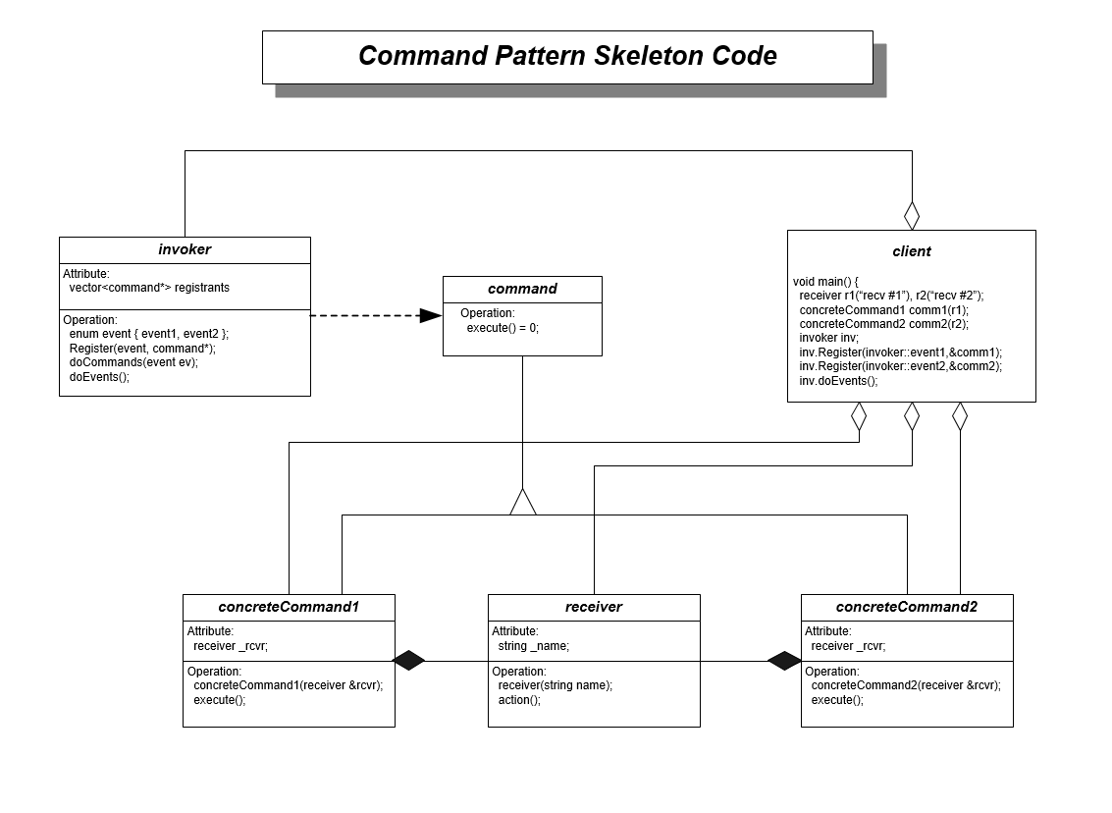

Slide 4
Library Code
class invoker {
public:
enum event { event1, event2, event3 };
void Register(event,command*);
void doCommands(event ev);
void doEvents();
private:
std::vector<command*> registrants[3];
};
class command {
public:
virtual void execute() = 0;
};

Slide 5
Application Code
class receiver {
public:
receiver(const std::string &name) : _name(name) { }
void action();
private:
std::string _name;
};
class concreteCommand2 : public command {
public:
concreteCommand2(receiver &rcvr)
: _rcvr(rcvr) { }
void execute();
private:
receiver _rcvr;
};
class concreteCommand1 : public command {
public:
concreteCommand1(receiver &rcvr)
: _rcvr(rcvr) { }
void execute();
private:
receiver _rcvr;
};

Slide 6
Event Processing
void invoker::Register(event ev, command* pComm) {
registrants[ev].push_back(pComm);
}
void invoker::doCommands(event ev) {
for(int i=0; i<(int)registrants[ev].size(); i++)
registrants[ev][i]->execute();
}
void invoker::doEvents() {
cout << "\n\n invoker processing event1";
doCommands(event1);
cout << "\n\n invoker processing event2";
doCommands(event2);
cout << "\n\n invoker processing event3";
doCommands(event3);
}

Slide 7
Client Processing
cout << "\n Demonstrate Command Pattern "
<< "\n =============================";
receiver r1("receiver r1");
receiver r2("receiver r2");
concreteCommand1 comm1(r1);
concreteCommand2 comm2(r2);
invoker inv;
inv.Register(invoker::event1,&comm1); // client #1
inv.Register(invoker::event2,&comm1); // client #1
inv.Register(invoker::event2,&comm2); // client #2
inv.Register(invoker::event3,&comm2); // client #2
inv.doEvents(); // clients get notified here

Slide 8
Client Processing
Demonstrate Command Pattern
=============================
invoker processing event1
concreteCommand1 executing
receiver r1 receiving action of command object
invoker processing event2
concreteCommand1 executing
receiver r1 receiving action of command object
concreteCommand2 executing
receiver r2 receiving action of command object
invoker processing event3
concreteCommand2 executing
receiver r2 receiving action of command object

Slide 9
Directory Navigator using Command Pattern
Demo DirectoryExplorer-Events
Handouts\Repository\Cpp\DirectoryNavigator

Slide 10
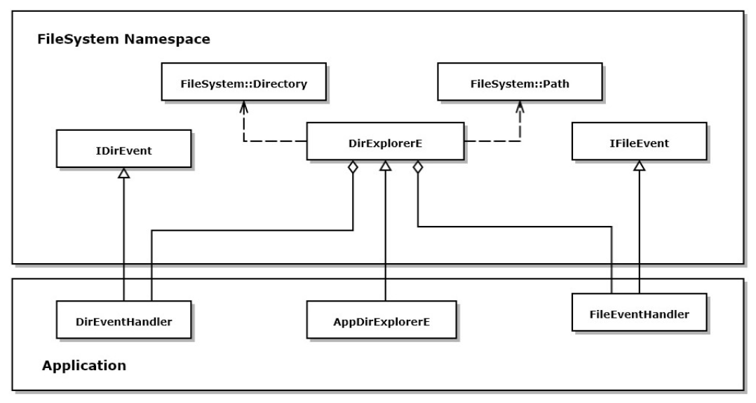
DirectoryExplorer-Events in Repository\Cpp

Slide 11
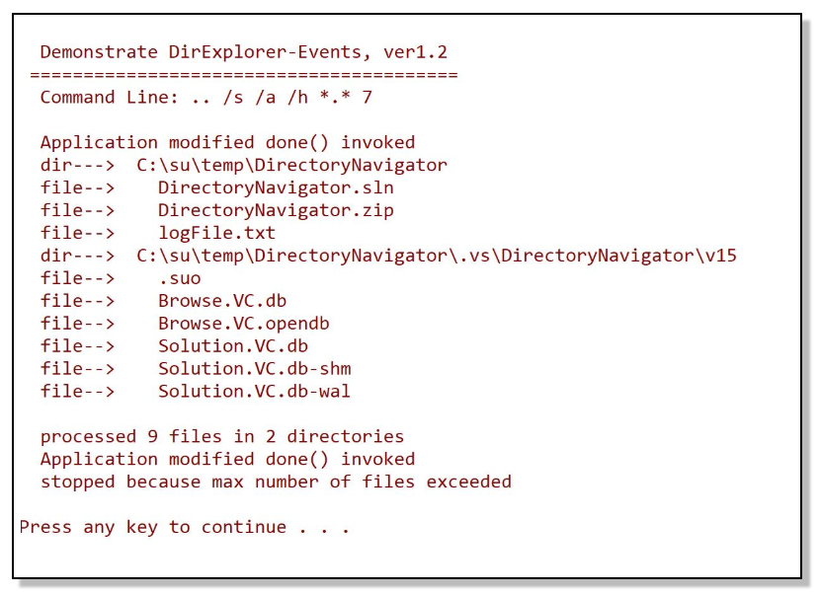
DirectoryExplorer-Events Output

