Slide 1
Adapter Application Code
Jim Fawcett
Design Patterns, Fall 2018

Slide 2
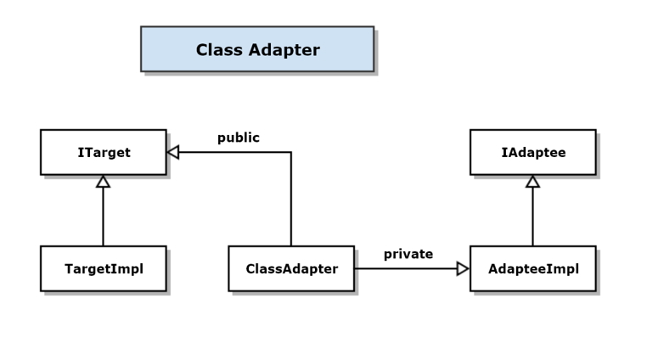
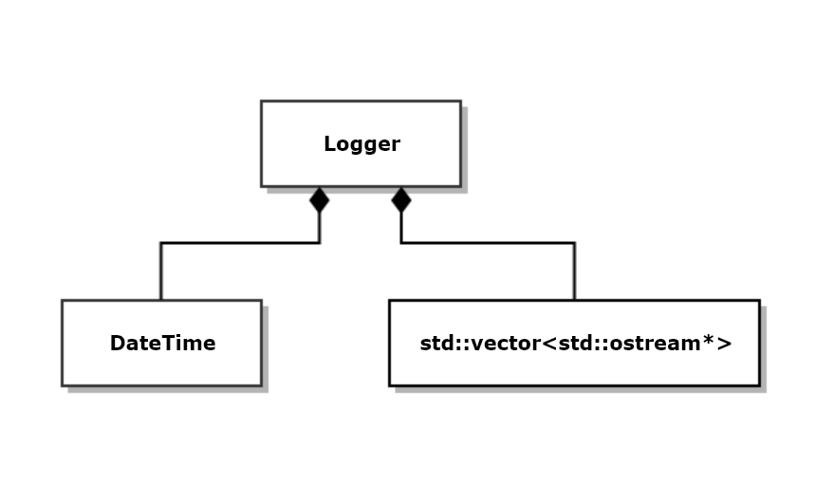
Application Specific Class Adapter
Adapts Msg-Passing Comm to std::ostream interface
Use in logger
Uses multiple streams
This adaption lets it log to other processes or machines using std::ostream interface, i.e., operator<< or write

Slide 3
Logging Application
Accepts multiple streams that implement std::ostream interface
Will adapt Msg-Passing Comm to use std::ostream interface
Can then log from one process to another

Slide 4
Singleton Logger supports multiple streams
class Logger
{
using Streams = std::vector<std::ostream*>;
using Terminator = std::string;
public:
void addStream(std::ostream* pStream)
{
streams_.push_back(pStream);
}
bool removeStream(std::ostream* pStream)
{
Streams::iterator iter = std::find(streams_.begin(), streams_.end(), pStream);
if (iter != streams_.end())
{
streams_.erase(iter);
return true;
}
return false;
}

Slide 5
Singleton Logger supports multiple streams
void writeHead(const std::string& msg)
{
for (auto pStrm_ : streams_)
{
*pStrm_ << msg.c_str() << " : ";
*pStrm_ << DateTime().now() << trm_.c_str();
}
}
void write(const std::string& text)
{
for (auto pStrm_ : streams_)
*pStrm_ << text.c_str() << trm_.c_str();
}
void writeTail(const std::string& msg = "end of log")
{
for (auto pStrm_ : streams_)
*pStrm_ << msg.c_str();
}

Slide 6
Singleton Logger
// Thread-safe singleton access:
// - Does not attempt to improve performance by double-check locking
// - That may fail occasionally, in C++, due to caching of instance_.
// - Since accesses are rare, usually only a very few times per
// execution, performance degradation is very small.
static Logger* getInstance()
{
std::lock_guard<std::mutex> lck(mtx);
if (instance_ == nullptr)
{
instance_ = new Logger;
}
return instance_;
}
Logger(const Logger&) = delete;
Logger& operator=(const Logger&) = delete;
private:
Logger()
{
addStream(&std::cout);
}
static Logger* instance_;
static std::mutex mtx;
Streams streams_;

Slide 7
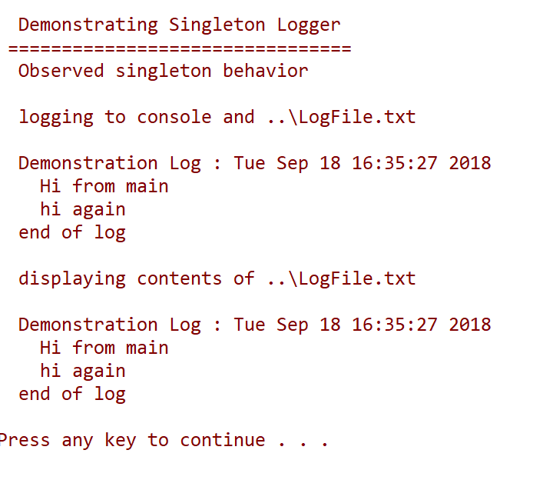
Singleton Logger Demo Output

Slide 8
Adapt Msg-Passing Comm
Adapt Comm to std::ostream
Can then log to another process, using ostream interface, but passing messages behind the curtain.
One hurdle:
std::ostream doesn’t have any virtual functions to override
std::streambuf to the rescue. It has virtual methods and std::ostream is just a wrapper that uses the std::streambuf for all the real work.
So, we adapt std::streambuf.

Slide 9
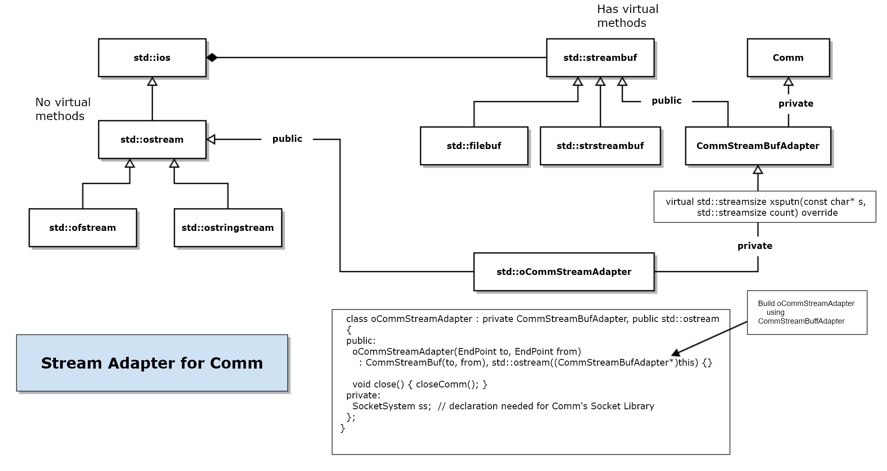

Slide 10
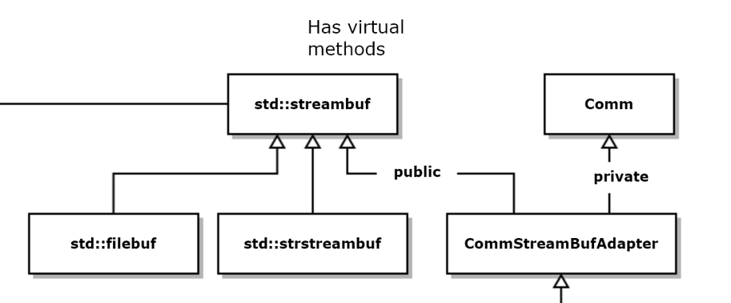
///////////////////////////////////////////////////////////////////
// CommStreamBufAdapter class
// - class adapter
// - adapts Comm to act like a std::streambuf
class CommStreamBufAdapter : public std::streambuf, private Comm
{
public:
CommStreamBufAdapter(EndPoint to, EndPoint from) : to_(to), from_(from), Comm(from)
{
start(); // start local comm running
}
virtual ~CommStreamBufAdapter() {}
virtual std::streamsize xsputn(const char* s, std::streamsize count) override
{
// xsputn accepts characters from any of the ostream (non-virtual) methods
Message msg = makeMessage(to_, from_, s); // make message using stream chars
postMessage(msg); // post it to Comm
return count;
}
void closeComm() { stop(); }
private:
EndPoint to_;
EndPoint from_;
};

Slide 11
///////////////////////////////////////////////////////////////////
// oCommStreamAdapter class
// - uses adapted streambuf in its internal inherited ostream
class oCommStreamAdapter : private CommStreamBufAdapter, public std::ostream
{
public:
oCommStreamAdapter(EndPoint to, EndPoint from)
: CommStreamBufAdapter(to, from), std::ostream((CommStreamBufAdapter*)this) {}
void close() { closeComm(); }
private:
SocketSystem ss; // declaration needed for Comm's Socket Library
};

Slide 12
That’s It!
Just a tiny bit of code to adapt Comm to std::ostream.
Comm does all the heavy TCP work.
std::ostream handles writes and insertions using our adapted std::streambuf
Piece of Cake!

Slide 13
Sender’s main
int main()
{
std::cout << "\n Demonstrating oCommStreamAdapter Sender";
std::cout << "\n =========================================";
EndPoint to("localhost", 8080);
EndPoint from("localhost", 8081);
oCommStreamAdapter sa(to, from);
// use ostream operator<<
std::string firstMsg = "hi from client";
std::cout << "\n sending 1st message \"" << firstMsg << "\" to receiver process";
sa << firstMsg;
// use ostream write method
std::string secondMsg = "hi again from client";
std::cout << "\n sending 2nd message \"" << secondMsg << "\" to receiver process";
sa.write(secondMsg.c_str(), secondMsg.length());
// tell receiver to shut down
std::string thirdMsg = "quit";
std::cout << "\n requesting receiver process to shutdown with \"" << thirdMsg << "\"";
sa << thirdMsg;
std::cout << "\n\n";
std::cout << "\n press key to quit\n";
Configure oCommStreamAdapter for a specified channel.
Using std::ostream insertion
Using std::ostream::write

Slide 14
Receiver’s main
int main()
{
std::cout << "\n Demonstrating oCommStreamAdapter Receiver";
std::cout << "\n ===========================================";
SocketSystem ss;
EndPoint ep("localhost", 8080);
Comm comm(ep, "testComm");
comm.start();
while (true)
{
Message rcvd = comm.getMessage();
//rcvd.show();
if (rcvd.containsKey("content"))
{
std::string value = rcvd.attributes()["content"];
std::cout << "\n " << value;
if (value == "quit")
{
break;
}
}
}
std::cout << "\n quitting";
comm.stop();
Receiver’s comm is started
Receiver displays text it got from comm message
comm is closed below

Slide 15
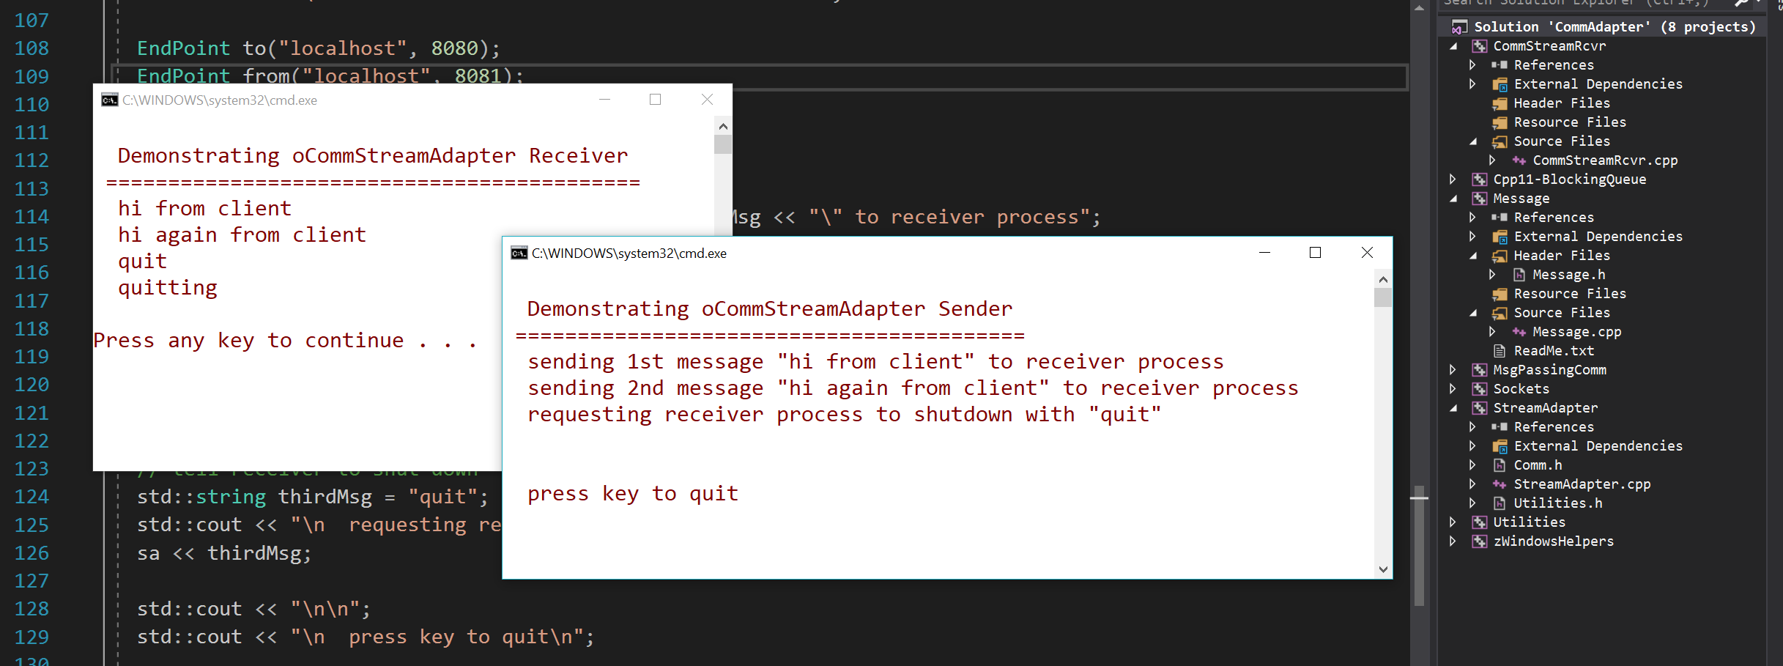
Sender process logging to Receiver process

Slide 16
That’s All Folks!

