Slide 1
Creating C++\CLI Projects
Jim Fawcett
CSE687 – Object Oriented Design
Spring 2019

Slide 2
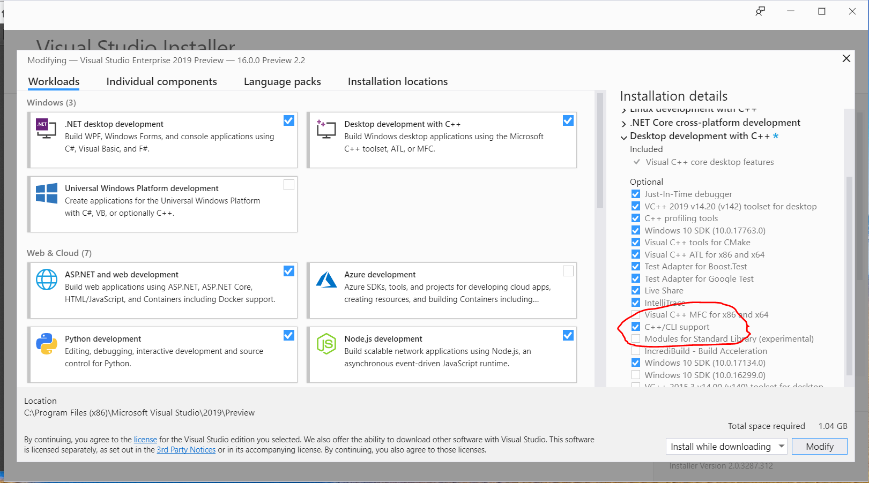
Adding Support for Creating C++\CLI Projects
To create C++\CLI projects you need to have support for that.
You can get support by using Visual Studio Installer to add it.

Slide 3
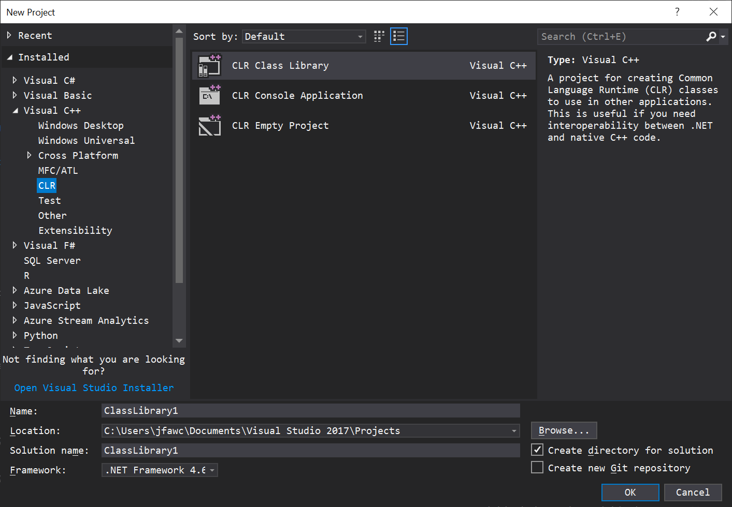
Creating C++\CLI Project
File > New > Project > C++

