Slide 1
.Net Attributes
Jim Fawcett
CSE681 – Software Modeling and Analysis
Fall 2007

Slide 2
References
Applied .Net Attributes, Bock and Barnaby, Apress, 2003
The C# Programming Lanuage, Anders Hejlsberg, et. al., Addison-Wesley, 2004
Pro C# 2005 and the .Net 2.0 Platfrom, Andrew Troelsen, Apress, 2005
COM Programming with Microsoft .Net, Templeman, Mueller, Microsoft Press, 2003
Brown Bag Seminar, Applied .Net Attributes, Mario Tayah, 2005
MSDN listing of .Net Attribute Hierarchy
MSDN: Extending Metadata with Attributes

Slide 3
Uses of Attributes in .Net
Provide custom additions to metadata for managed types
Support serialization
Support debugging and tracing
Set COM+ attributes
Activation, queuing, security, events, contexts, object pooling, synchronization, transactions
Support creation of COM objects
Support creation of .Net controls
Support creation of Web Services
Create ATL Server code – essentially builds ISAPI filters
Implement performance counters
Implement OLEDB consumers

Slide 4
Kinds of Attributes
Custom attributes
Add entries to metadata but are not used by run-time
Distinguished custom attributes
These attributes have data stored in the assembly next to the items to which it applies.
OneWay is a distinguished custom attribute that affects marshaling by the run-time
Pseudo custom attributes
Changes, does not extend existing metadata
Serializable is a pseudo custom attribute. It sets or resets the metadata flag tdSerializable

Slide 5
Defining Custom Attributes
Create a class marked with the AttributeUsage attribute [AttributeUsage(AttributeTargets::All, AllowMultiple=true)] class myAttribute : System.Attribute { … }
Targets include: Assembly, Class, Delegate, Event, Field, Method, …, All
Typically, the class provides a constructor accepting a value of some type, e.g., string, and a property to retrieve that value.
The value is stored in the metadata of the assembly that implements the attributed target.
It is retrieved using the Reflection API.

Slide 6
Using Custom Attributes
Decorate the target code with the custom attribute: [myAttribute(args)] public class decoratedClass { … } This serializes member data of the myAttribute class into metadata for the assembly holding class decoratedClass.
Now other programs can access this information from the assembly’s metadata using reflection: Type t = typeof(target); object [] obj = Attribute.GetCustomAttributes(t); Now cast the elements of the obj array to the types of the stored metadata, e.g., the member data of class myAttribute.

Slide 7
Some .Net Provided Attributes
[CLSCompliant(true)] - class fails to compile if not compliant
[Conditional(“Debug”)] - won’t get called unless Debug defined
[Assembly: AssemblyTitle(“…”)] - assembly descriptions
[Assembly: AssemblyVersion(“1.2”)]
[DllImport(“kernel32.dll”)] - accessing unmanaged global function public static extern int Beep(int freq, int dur);
[Serializable()] - enabling serialization public class myClass { … }
[OneWay()] - marshal only to remote object public void myFunc(string msg) { … }
[Synchronization()] - allow access by one thread at a time class SomeClass : ContextBoundObject { … }

Slide 8
Design-Time and Security Attributes
Attributes used with user defined controls
[Category(“Custom Properties”)] - makes property page category
[DefaultEvent(myEvent)] - double click on control to wire up
[Description(“myPropertDesc”)] - description shown when selected
[ToolBoxBitmap(“myBitMap.bmp”)] – defines bitmap used in toolbox
Declarative security settings
[FileIOPermission(SecurityAction.Deny, Read=@”c:\Windows\System32”)] public in ReadFile(string path) { … }

Slide 9
Support Creation of COM Objects

Slide 10
COM Attributes
[ coclass, // an implementing class plus COM infrastructure threading("apartment"), vi_progid("AttribATL.Test"), progid("AttribATL.Test.1"), version(1.0), uuid("CC51A06F-70D1-4113-A821-3756FC45ADF9"), helpstring("Test Class") ]
[ module // defines a COM server ( dll, uuid = "{E9944495-22AF-422F-A011-AE3FD9E17644}", name = "AttribATL", helpstring = "AttribATL 1.0 Type Library", resource_name = "IDR_ATTRIBATL“ ) ];
object attribute identifies an interface, events , IDL attributes, …

Slide 11
What they do
Metadata attributes provide data that is used at compile time and/or runtime in an assembly’s metadata.
COM attributes cause code to be generated and injected into the MSIL stream.
C++ uses two providers:
clxx.dll used for type generation and marshaling
Atlprov.dll for ATL.

Slide 12
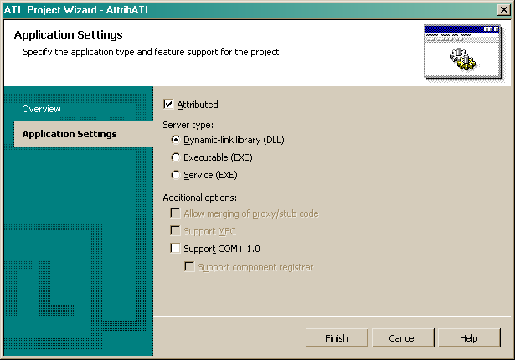
Building Attributed ATL Component

Slide 13
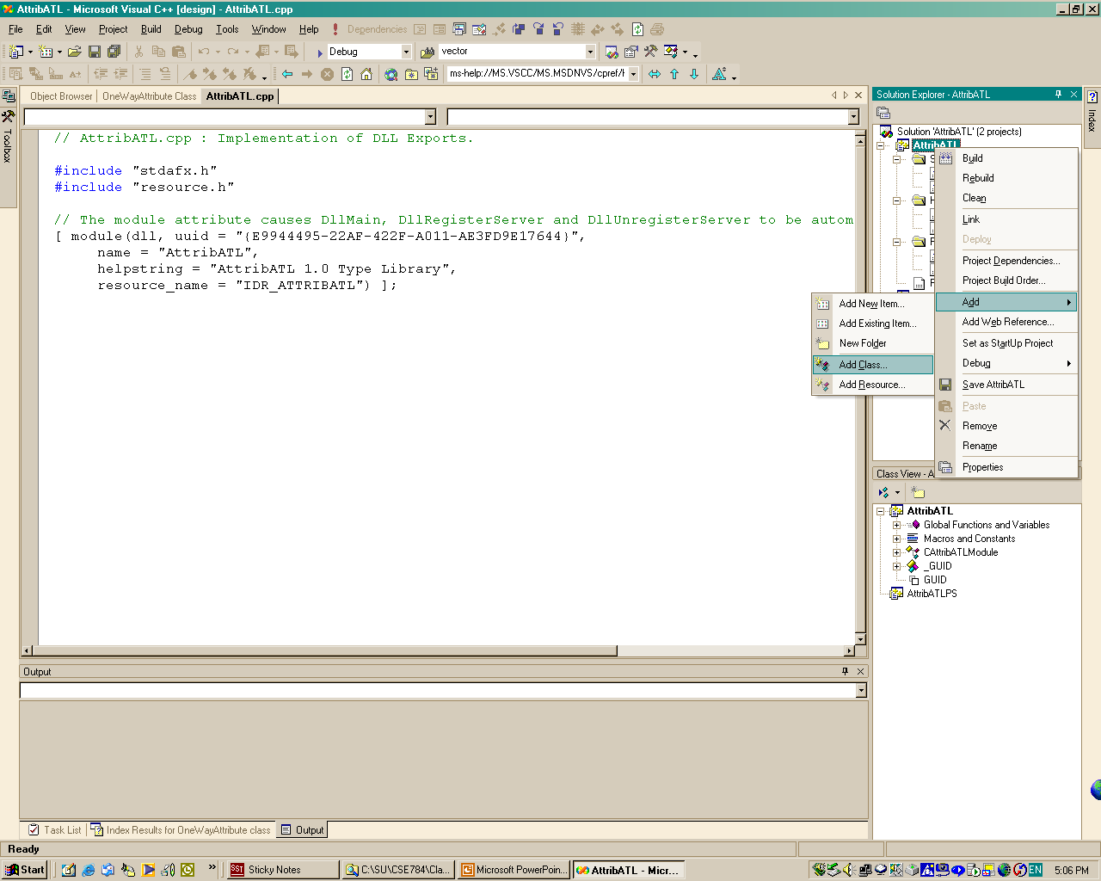
Adding a Class

Slide 14
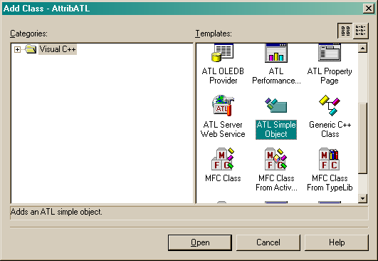
Adding Simple Object

Slide 15
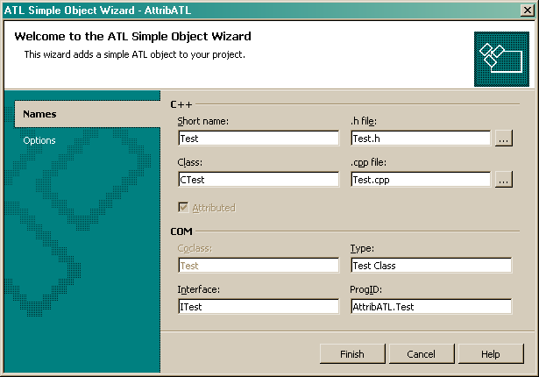
Test Class

Slide 16
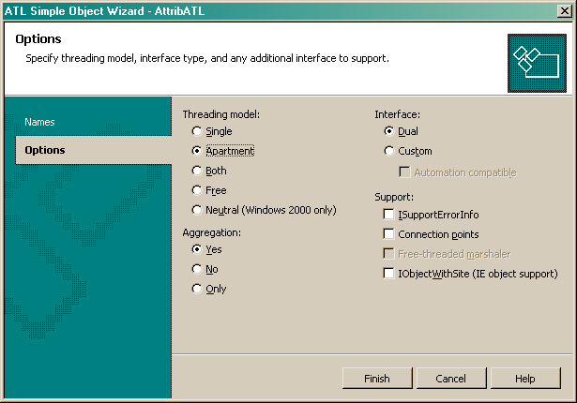
Selecting Attribute Parameters

Slide 17
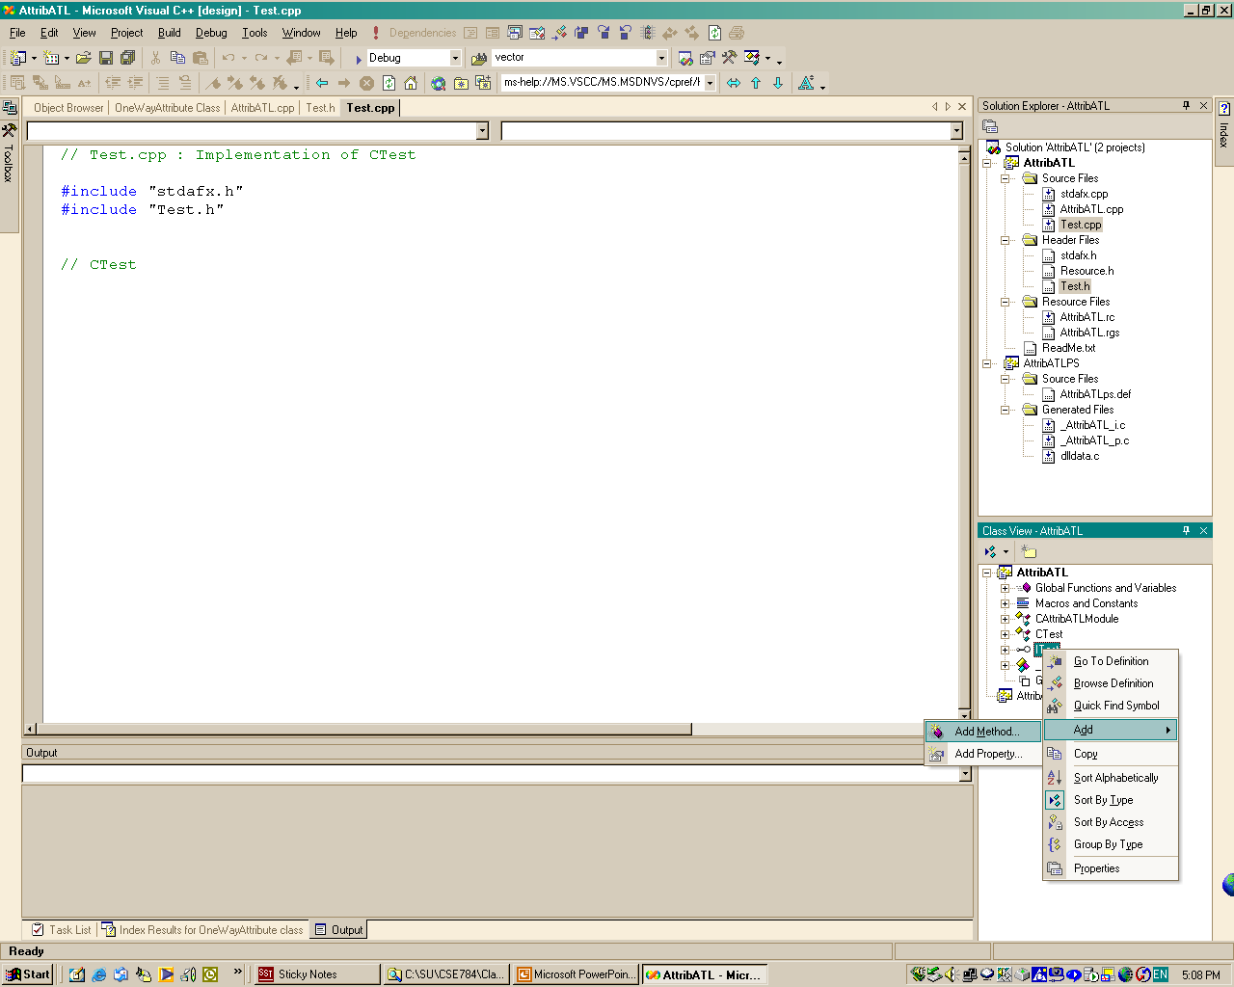
Adding Methods to Interface

Slide 18
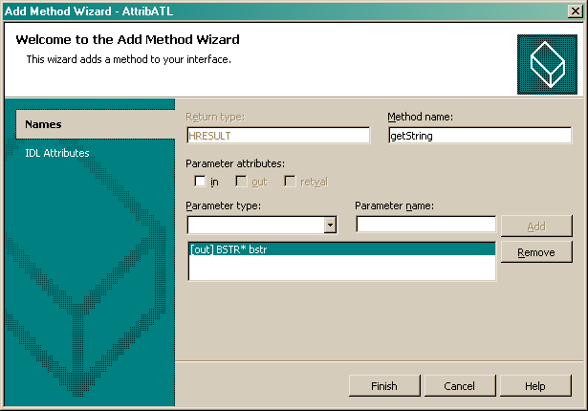
Sending and Receiving Strings

Slide 19
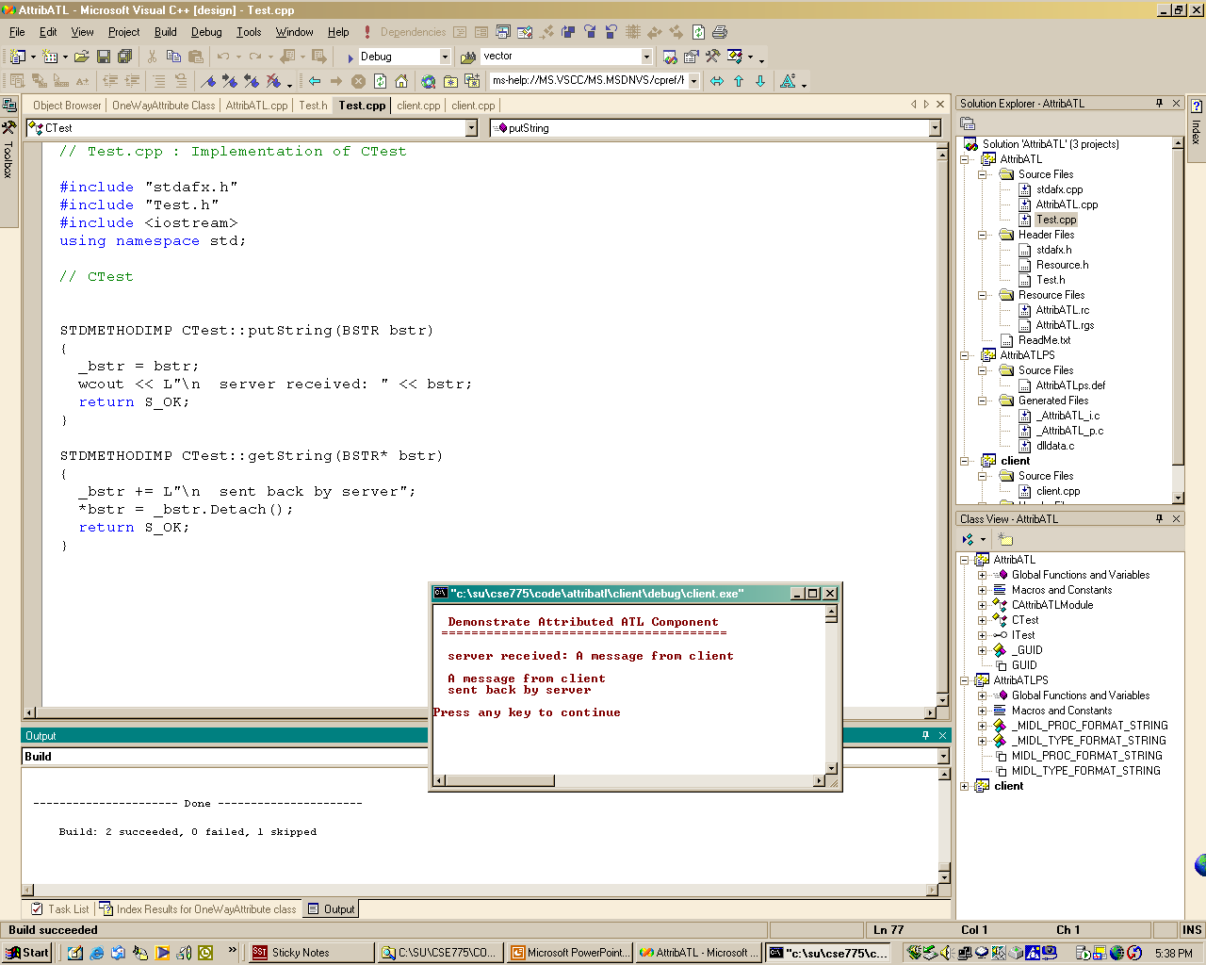
Client Running Attributed ATL Component

Slide 20
End of Presentation

