Slide 1
UML Notation
Jim Fawcett
CSE681 – Software Modeling and Analysis
Fall 2017

Slide 2
Diagrams for Architecture
Activity Diagram (high level program behavior) Shows activities a program carries out
Which activities may be executed in parallel
Which activities must be synchronized for correct operation
Package Diagram (package structure of program or system)
Enumerates all software packages
Shows calling dependencies between packages
Module Diagram (packages in a subsystem – focused on one responsibility)
Enumerates modules
Shows calling dependencies between modules

Slide 3
Design Documentation
Class Diagram
Shows classes that are used in a program along with their relationships
Sequence Diagram
Illustrates the timing of important messages (method invocations) between objects in the program.
Structure Chart (not UML)
Shows calling relationships between all the functions in a package or module.
State Diagram
Illustrates how a program navigates through its states.
Data Structure Diagram, Ad-Hoc Diagram (not UML)
Presents the layout and relationships between important pieces of data in the program.

Slide 4
Diagrams for Requirements
Context Diagram
Shows how program interacts with its environment
Data Flow Diagram
Represents requirement processing and the information flows necessary to sustain them.

Slide 5
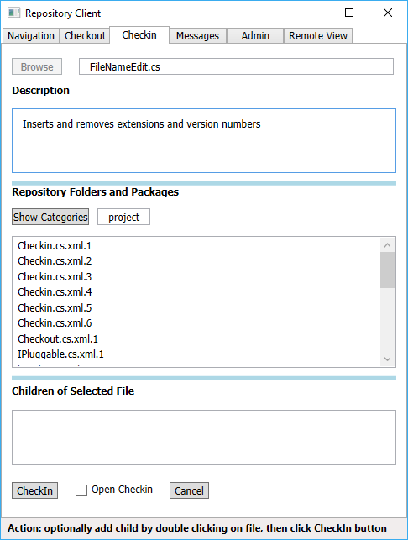
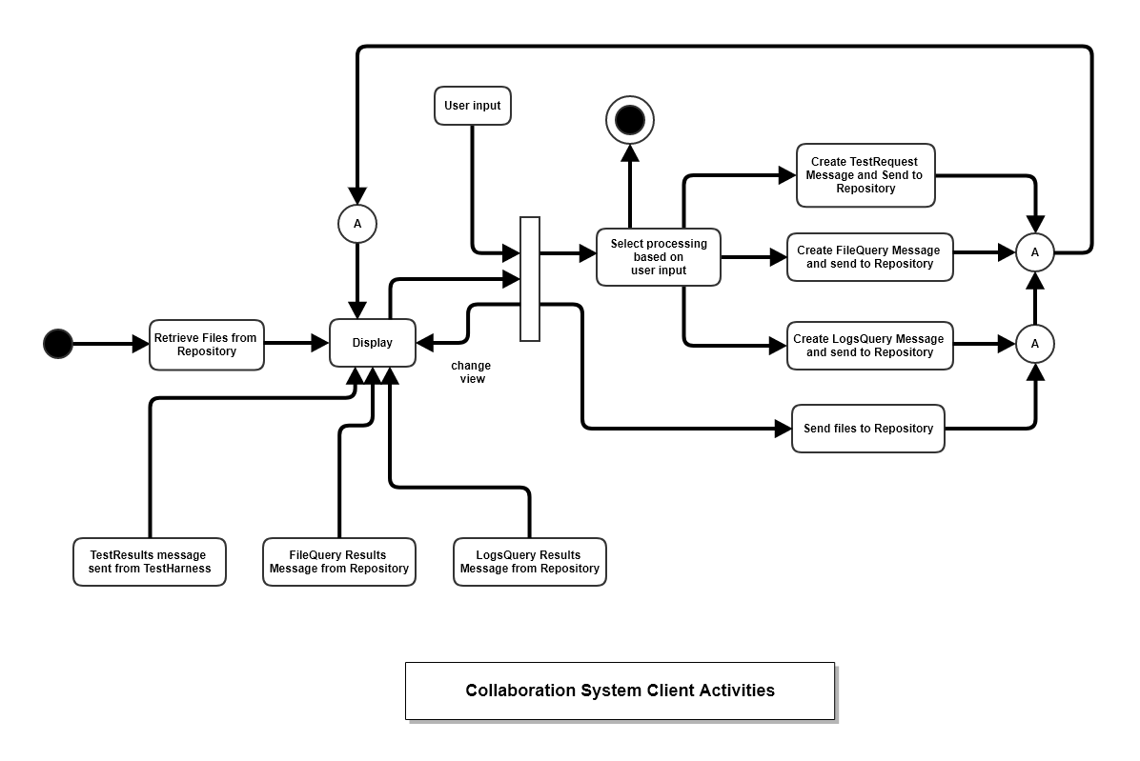
Activity Diagram
Table of Contents
Each of the blocks represents a specific processing activity.
Start and stop activities are explicitly shown
Synchronizing bars indicate timing constraints:
No output activity can start until all of the input activities have completed.
Multiple output activities indicate tasks that can run in parallel.

Slide 6
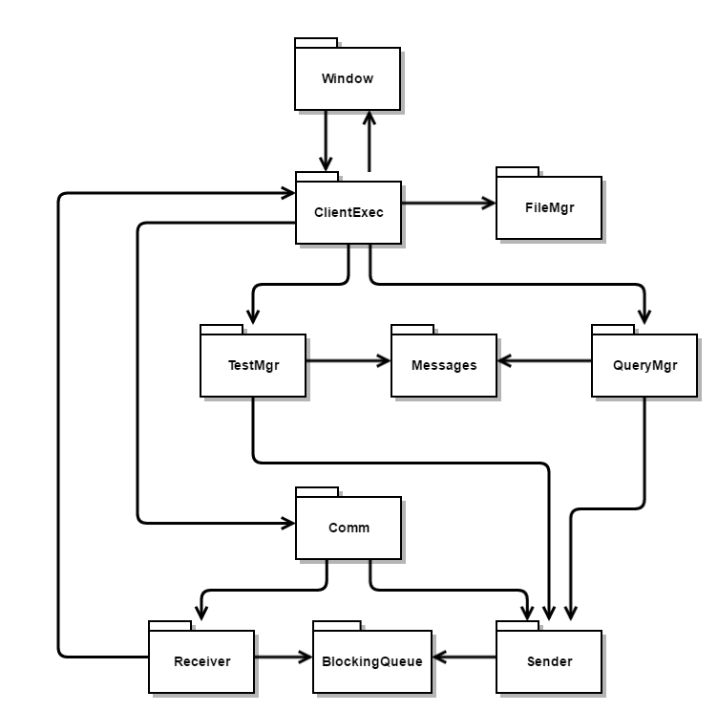
Package Diagrams
Table of Contents
Enumerate each of the packages in a program or module.
Show calling relationships with one-way directed lines.
May show module boundaries.

Slide 7
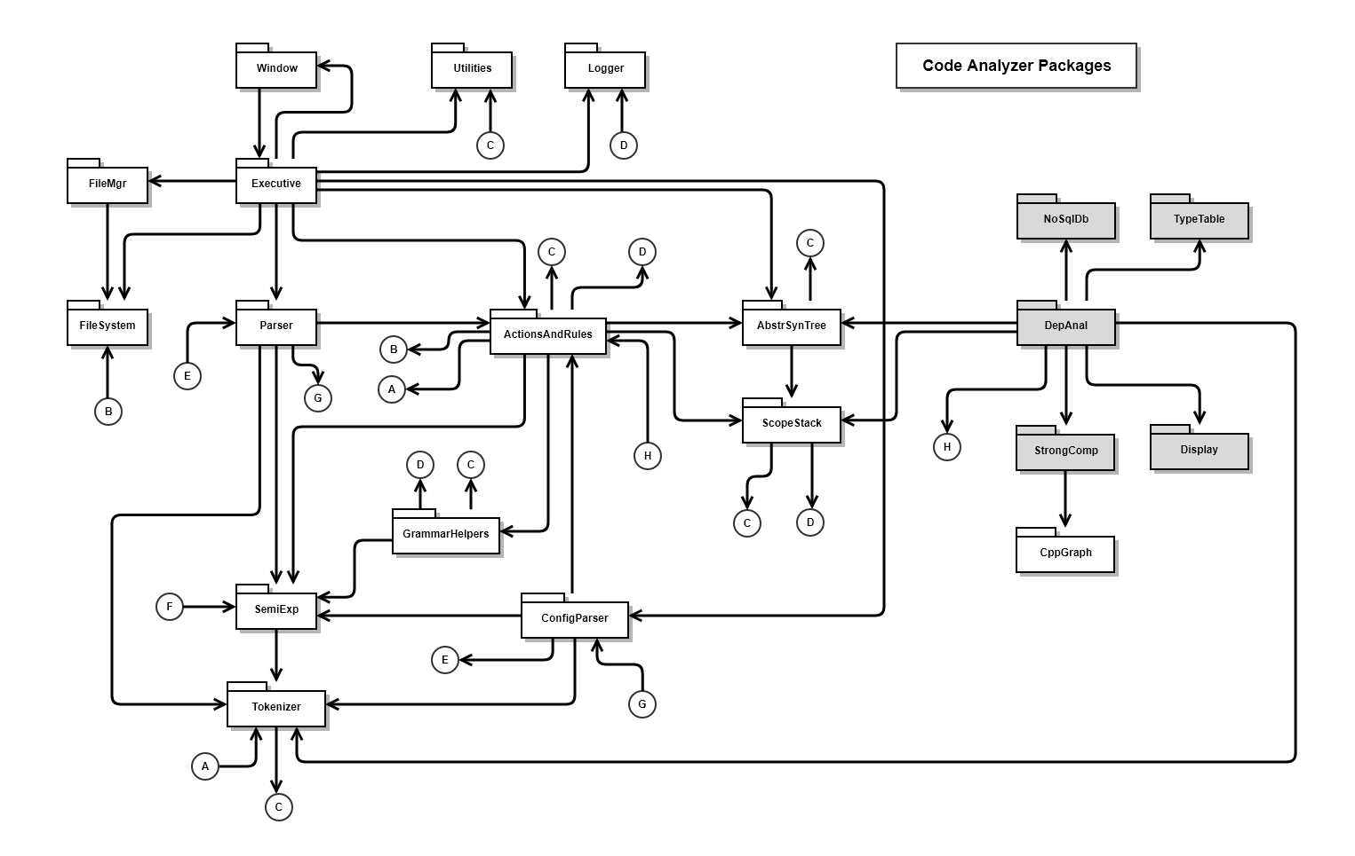
Table of Contents

Slide 8
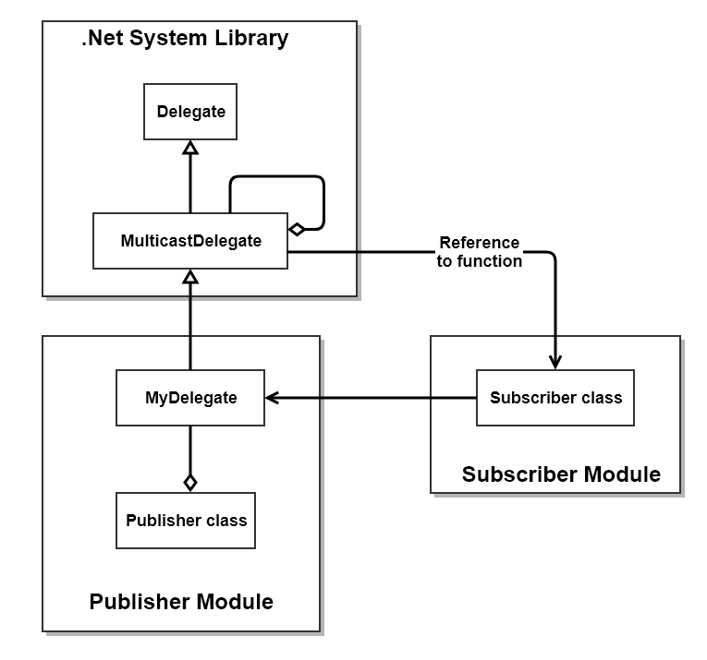
Class Diagrams
Table of Contents
Show each class with a named rectangle.
Show class relationships:
Inheritance with a line beginning with a triangle attached to the base class.
Composition with a solid diamond attached to the composer
Aggregation with a hollow diamond attached to the aggregator
Using with a directed line from the user to the used class.
May show module boundaries.
May show methods and members

Slide 9
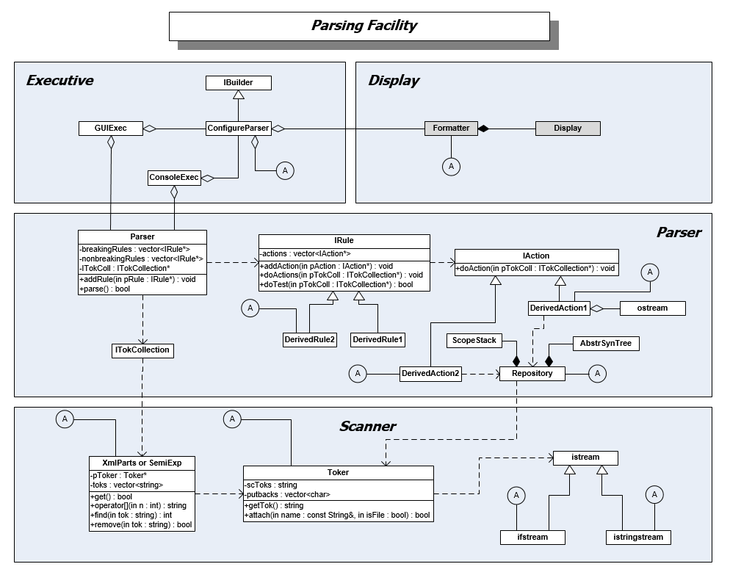
Table of Contents

Slide 10
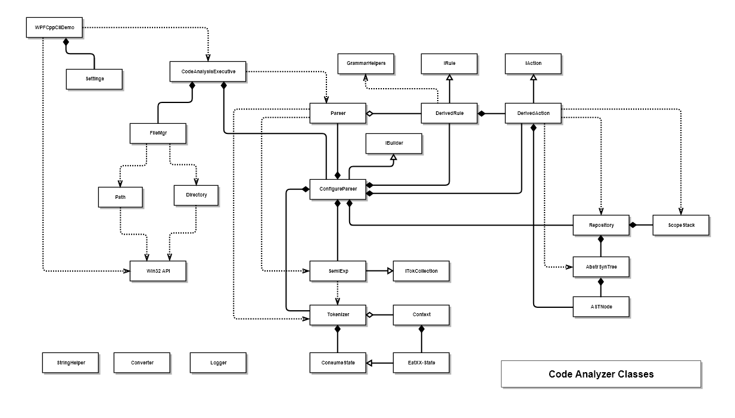
Table of Contents

Slide 11
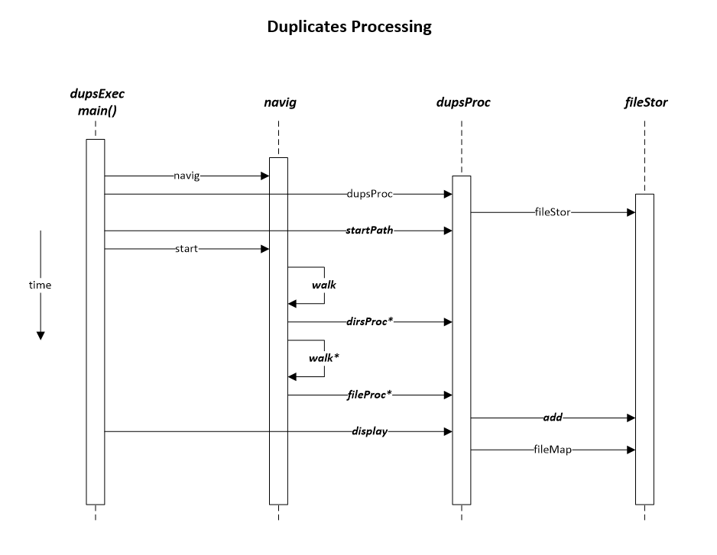
Sequence Diagram
Table of Contents
Represents conversations between objects in a program.
Each horizontal line is a method invocation. Text is the name of the method called.
Increasing time flows downward in the diagram.
Multiple calls are shown with an asterisk “*”.
Each bar represents lifetime of the named object.

Slide 12
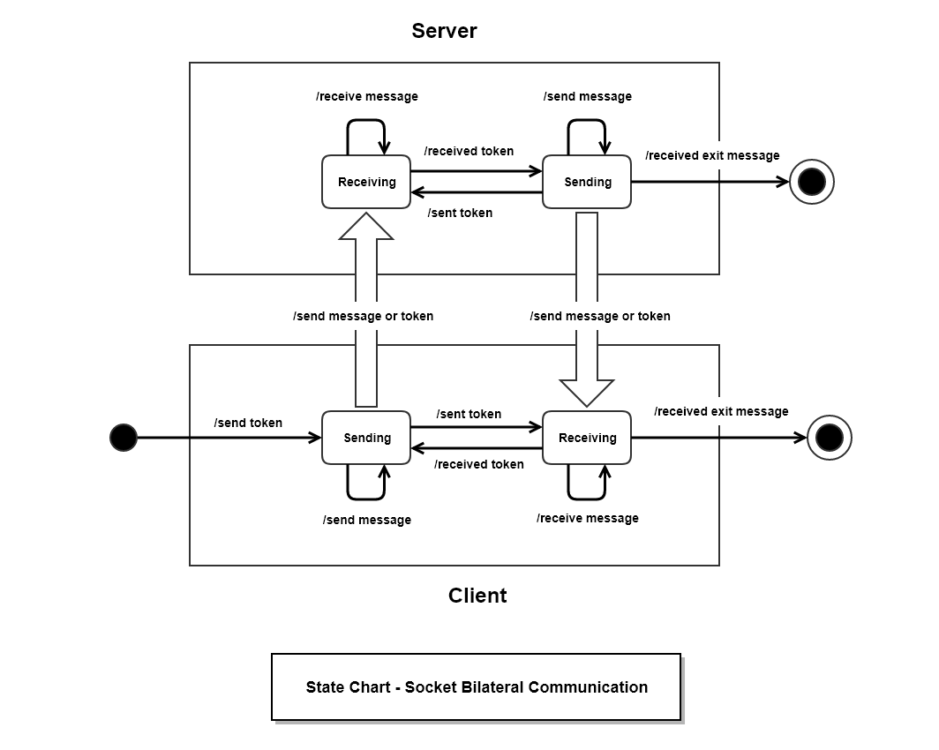
State Diagram
Table of Contents
Shows transitions between processing states.
May have entrance and exit transitions.

Slide 13
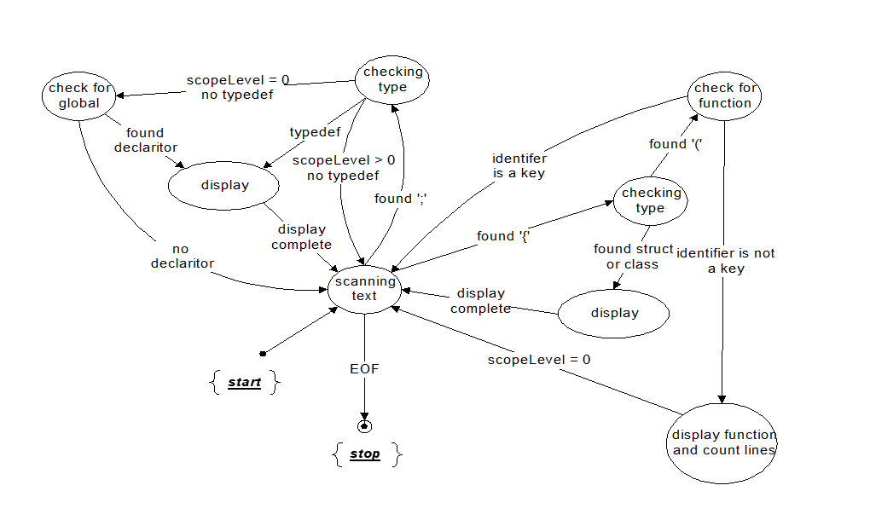
Tokenizer State Diagram
Table of Contents
This example is typical of the diagrams you will draw to illustrate states implemented in one of your programs.
It documents one of my early tokenizer designs.

Slide 14
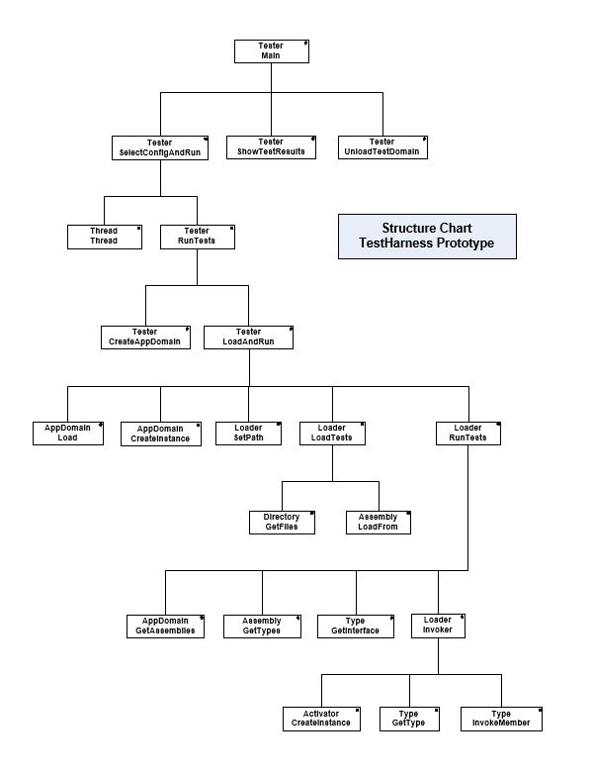
Structure Chart (not UML)
Table of Contents
Shows function calling relationships.
Used when there is a deep nesting of calling relationships.
Used infrequently, but it is the best way to understand deep calling relationships.

Slide 15
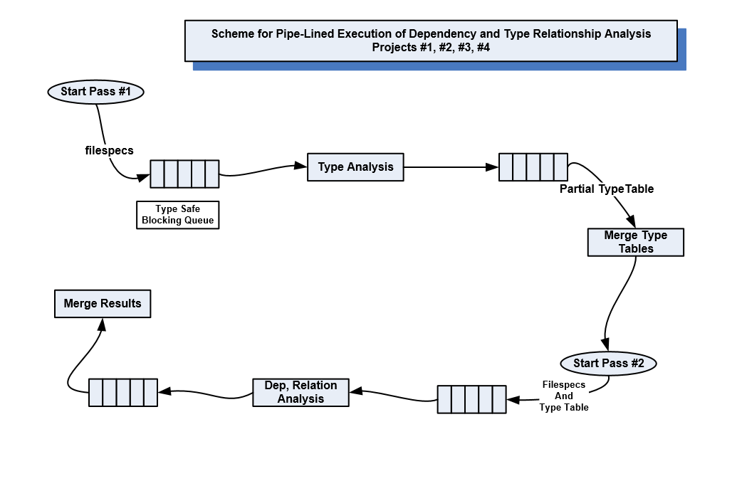
Ad-Hoc Diagram
Table of Contents
Ad-Hoc
Latin phrase “for this”
“designed for a specific problem or task”.
Both quotes from Wikipedia.
A diagram made to suit one particular purpose.
This diagram represents a parallel-pipelined software structure I used for code analysis.

Slide 16
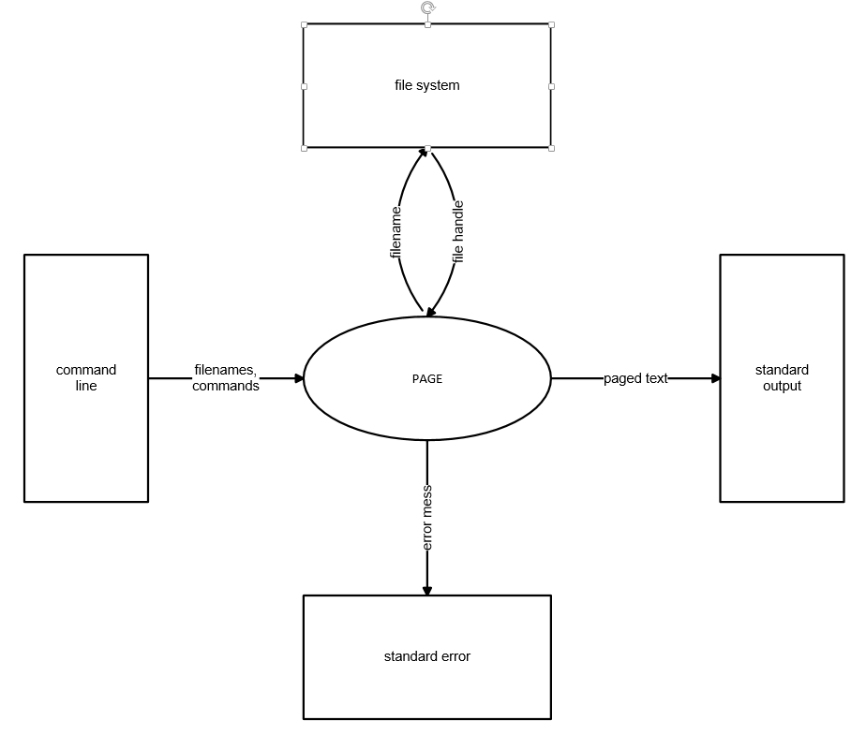
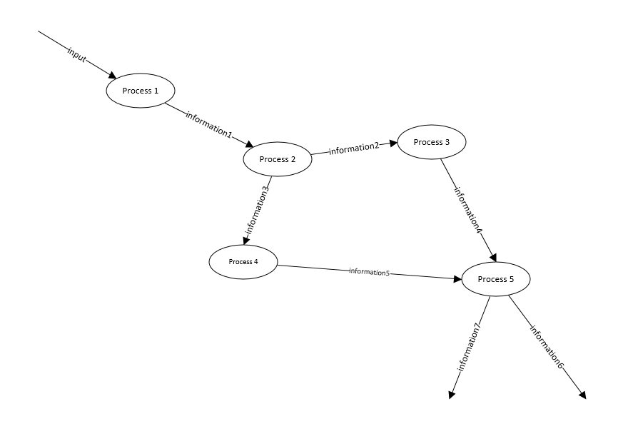
Diagrams for Requirements
Table of Contents
Context Diagram
Shows relationships of program with its environment
Data Flow Diagram
Shows information flow between processing blocks

Slide 17
The End
More discussion on a few of the diagrams here:
UML-Diagrams.htm

