Slide 1
Segments
Introduction: slides 2-6 15 minutes
Variations: 7-14, 16 20 minutes

Slide 2
Enterprise Computing Collaboration System Example
Jim Fawcett
CSE681 – Software Modeling and Analysis
Spring 2010

Slide 3
Enterprise Computing combines Structures
Enterprise computing binds together a business with its partners, suppliers, and customers.
May integrate many functions:
Inventory control, order processing, product disclosure, product design collaboration.
Likely to be peer-to-peer with “distinguished” peer that coordinates activities.
Partners work together through a collaboration subsystem.
Uses web-based service oriented architecture.

Slide 4
Collaboration System
System that focuses on sharing of processes and products among peers with a common set of goals.
Primary focus is organizing and maintaining some complex, usually evolving, state:
Software development baseline
Set of work plans and schedules
Documentation and model of obligations
Communication of events
Example:
Collab – CSE784, Fall 2007, http://www.ecs.syr.edu/faculty/fawcett/handouts/webpages/CServ.htm

Slide 5
Virtual Collaboration-Repository-Testbed Server System (VCRTS)
Servers:
Collaboration
Holds work package definitions, schedules, job descriptions, collaboration tools (white board, chat, …)
Repository
Holds the developing project baseline, e.g., code, test drivers, documentation, test results, …
Test Harness
Performs all certified tests, only on Repository products.
Clients
Code development, test development, local testing, chatting, whiteboard collaboration, …

Slide 6
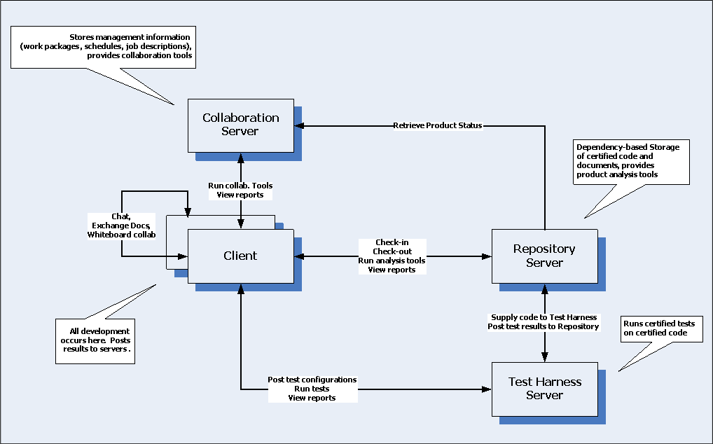
Example Collaboration System

Slide 7
Virtual Servers
Not defined by machine boundaries
May have multiple servers on one machine
May have multiple machines implementing one server, e.g., repository, testbed
Can be easily replicated
Download installer
Select desired contents from source
Create server
All servers derive from abstract virtual server
Virtual server is one of the core services.

Slide 8
Virtual Server Uses
Project has VCRTS
Manages all certified project products
Code baseline
Test code and results
Documentation
Teams have VCRTS
Local management for each team
Company has VCRTS
Manages company’s reusable code base

Slide 9
Layered Structure
Provides a structure based on:
System Services – things the user doesn’t think about
Communication, storage, security, file caching, …
User Services – things the user manipulates as part of the use of the system
Input, Display, Check-in/Check-out, …
Ancillary – Things that are not part of the system mission but are necessary
Logging, extension hooks, test hooks, …

Slide 10
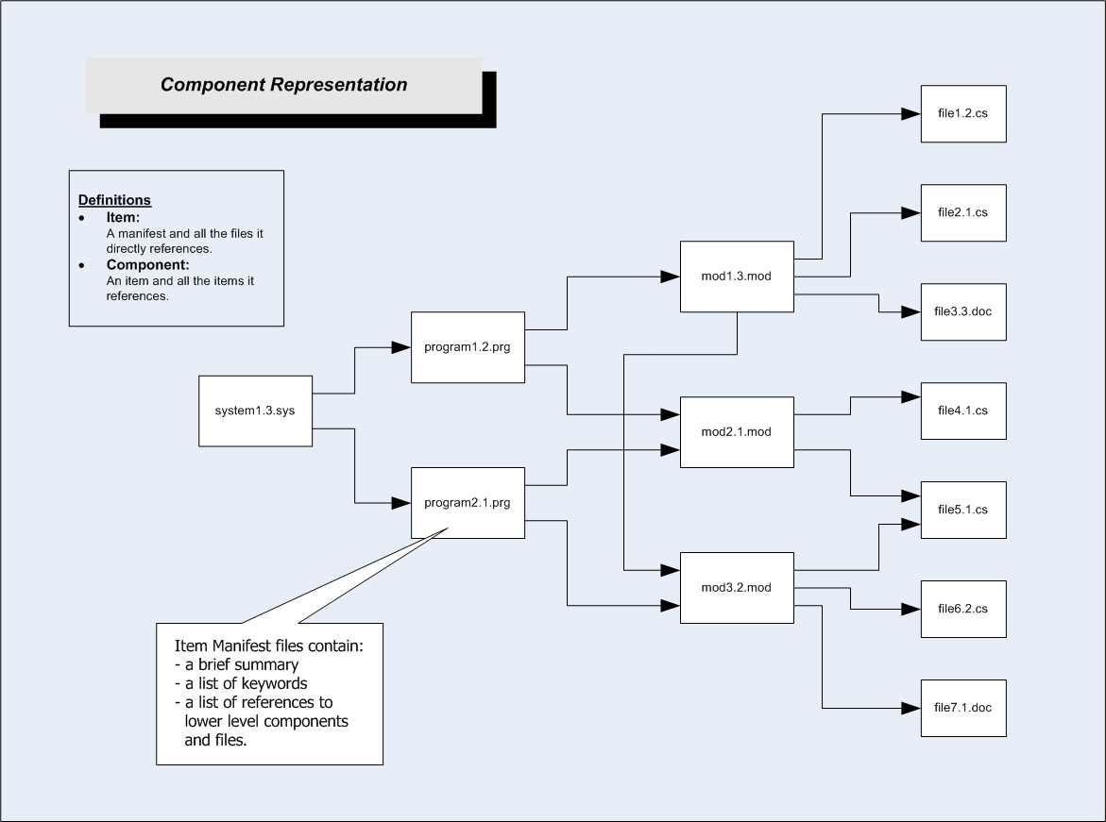
Repository Components

Slide 11
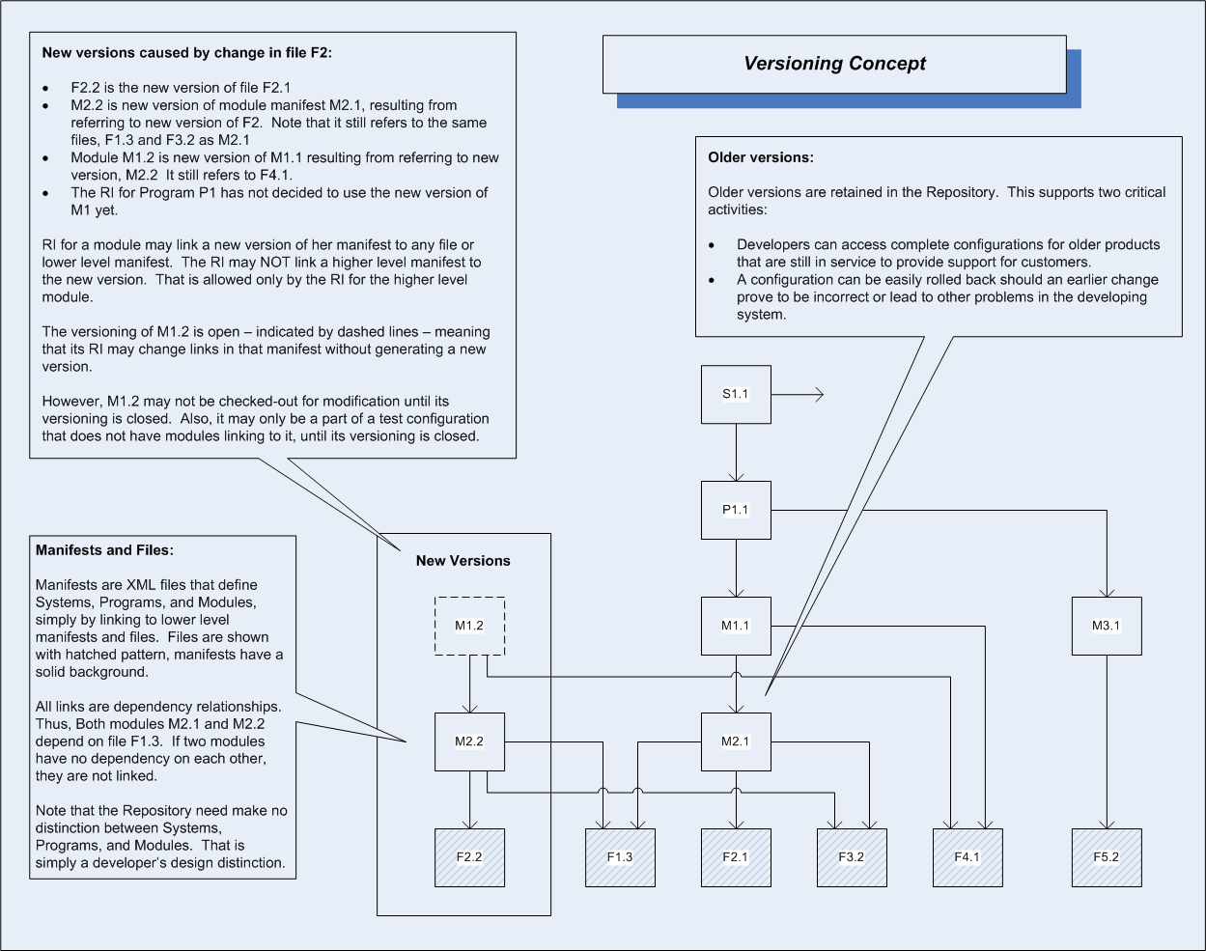
Repository Versions

Slide 12
Peer-to-Peer
Distribution of parts that cooperate on a mission by sending each other commands and messages.
Parts may or may not be identical, but probably have identical layered system services
Usually part of a collaboration system
May have a “distinguished” peer
Development attempts to provide one set of core services and build peer personalization on top of that
Example:
Software Matrix, Gosh M.S. Thesis, http://www.ecs.syr.edu/faculty/fawcett/handouts/webpages/softwarematrix.htm

Slide 13
Service Oriented
System composed of
Set of autonomous services
Software glue that binds the services together
Focus on
Reliability, availability, composability
Example:
VRTS – CSE784 Project, Fall 2008, http://www.ecs.syr.edu/faculty/fawcett/handouts/webpages/Vrts.htm

Slide 14
Agent-Based
System uses Software Agents
Semi-autonomous, mobile, task oriented software entities
May be scheduled
Provide scriptable user specific services
Collect information from a large set of data
Perform analyses on changing baseline and report
Conduct specific tests
Make narrowly specified modifications to baseline
Example:
CSE681 Project #5, summer 2009, http://www.ecs.syr.edu/faculty/fawcett/handouts/CSE681/Projects/Pr5Su09.doc

Slide 15
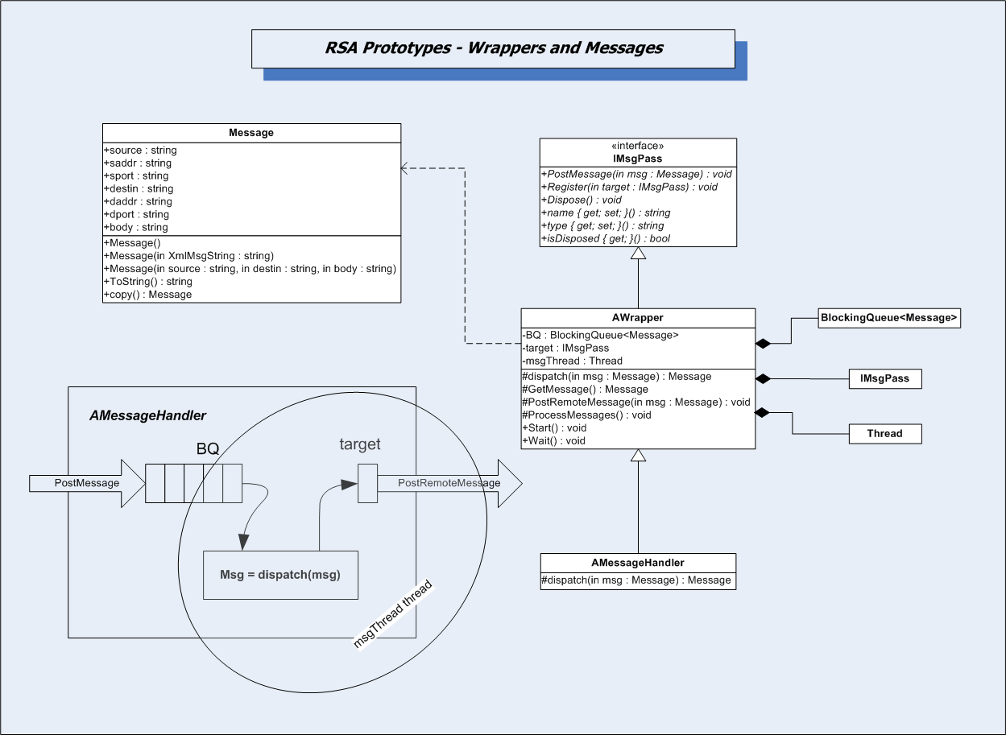
Building Blocks

Slide 16
Project #4
Peer-to-peer?
May initiate analyses from client
May schedule analyses and notify users of results
Collaborative?
QA, Management, Developers, and Architects all care about the analyses and results.
How do we overtly support collaboration?
Service Oriented?
Communication and Notification are probably service-based
Layered?
If we extend by sending libraries to remote machines to be run from tool holster, we may want to have the holster provide execution services – a sandbox – to enhance security
Agent-based?
We probably want to schedule tests, tailored to specific users, e.g. QA, team lead, architect.

Slide 17
The End

