Slide 1
Enterprise Computing
Jim Fawcett
CSE681 – Software Modeling and Analysis
Spring 2010

Slide 2
A Definition
Enterprise Computing: Automation or support of business processes. It usually involves:
Creation
Display
Manipulation
Analysis
of complex time-varying data relationships from distributed sources to many distributed destinations. Currency of information is one of the most important measures of the system.
Example systems:
Reservations, financial, supply chain, orders and inventory, repositories, decision support, customer relationship management

Slide 3
A Near-Future Scenario
You are a high-level trouble shooter for a vendor of some important products.
You are planning a trip to visit a group of customers with a mix of problems, purchase plans, and technical questions.
Your company’s enterprise system finds the 5 most important customers for you to visit in the target area and time.
It negotiates meeting times with each of the customer’s calendar services, trying to optimize your coverage and time on-site.
It schedules plane, rental car, and hotel accommodations.
One customer cancels and two more are added, requiring changes of reservations, negotiated by machine without your intervention, but notifying you quickly, by the method of your choice (email, cell phone, pager).
Just before walking into each meeting you consult with your enterprise system to discover the latest problem reports, questions, and issues this customer has discussed with your company’s staff.

Slide 4
Consequences
This scenario makes it clear that some aspect of several computational models is needed here:
Repository storage and retrieval of customer information from a dedicated data storage server.
Agent-based calendar services provided via web communications (my calendar agent negotiates with customers’ agents for date and time).
Messaging using a peer-to-peer model.
None of this works without universal standards beyond the traditional web standards for routing and information access.
W3C is trying to put that in place via the Semantic Web

Slide 5
Distributed Computing Models
Client/Server (Access to Information): A client computer initiates a service request. A server computer waits to reply.
Peer-to-peer (Collaboration): A communications model in which each party has the same capabilities and either party can initiate a communication session.
Web Services (Provide a Specialized Service):
Service-oriented, component-based, application architecture.
Discrete tasks within business processes are distributed widely throughout an internet-based web.

Slide 6
HTTP Web Protocol
HTTP has simple powerful facilities to support all three models via messaging
Get – retrieve a resource
Post – return client responses via a form
Put – send a resource
Delete – remove a resource
Put and Delete are dangerous
Resources are subject to damage through ignorance or malicious intent
Most web servers disable them
The REST model attempts to use the full HTTP model due to its power and simplicity
Developers are struggling to make it secure but keep its simplicity

Slide 7
Web Service
W3C Definition: A Web service is a software system identified by a URI (Uniform Resource Identifier), whose public interfaces and bindings are defined and described using XML. Its definition can be discovered by other software systems. These systems may then interact with the Web service in a manner prescribed by its definition, using XML based messages conveyed by Internet protocols.
This focus is on machine-to-machine interaction rather than the human-to-machine interaction of the traditional web.

Slide 8
Service Oriented Architecture
The scenario suggests a Service Oriented Architecture:
A collection of services.
The services can communicate with each other, perhaps through agents.
Communication may be simple data exchange.
It may also be a more complex coordination of some activity.
The connections need to be standardized.
Standards are essential:
Data definition: XML
Transmission: TCP/IP, HTTP, Soap
Service description: WSDL
Service discovery: UDDI

Slide 9
Pieces of the Recipe
ASP.NET and ASP.NET MVC applications: Provide a dynamic, web page based, human-to-machine interface.
HTML5 or Silverlight and WCF: Support balancing application load between server and client.
Web Services: ASP.NET based, IIS hosted, RPC machine-to-machine interface and REST message-passing.
.NET run-time supports component-oriented, secure, connectable environment.
Security, remoting, personalization through attributed programming
COM+ supports transactions, object pooling

Slide 10
References:
Semantic Web, Scientific American, May 2001, Tim Berners-Lee, James Hendler, Ora Lassila
Web Services and Service-Oriented Architectures, Douglas Barry, Morgan Kaufmann, 2003
Patterns of Enterprise Application Architecture, Martin Fowler, Addison-Wesley, 2003
Pattern-Oriented Software Architecture, Volume 2, Douglas Schmidt, et. al., Wiley, 2000
Programming .Net Web Services, Alex Ferrara, Matthew MacDonald, O’Reilly, 2002
Programming .Net Components, Juval Lowy, O’Reilly, 2003

Slide 11
Web References
www.learnthenet.com/english/html/70alan.htm
www.zakon.org/robert/internet/timeline/
www.w3.org/TR/ws-gloss/

Slide 12
Appendix A – Growth of the Web

Slide 13
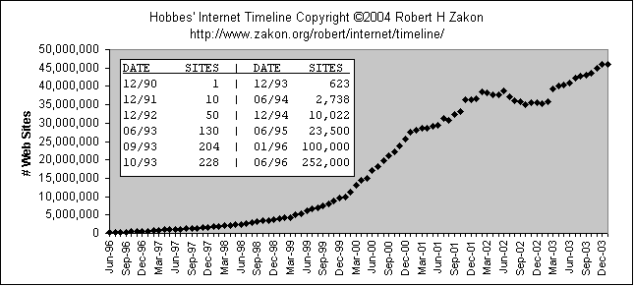
Growth of Web Sites

Slide 14
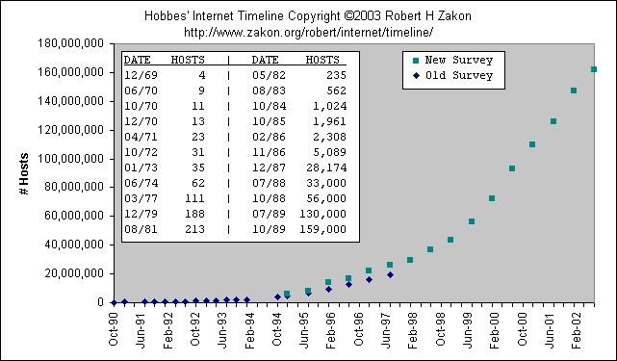
Growth of Internet Hosts

Slide 15
Appendix B - Benchmarks

Slide 16
Some Benchmarks
"There are three kinds of lies: lies, damned lies and statistics." Attributed to Disraeli in Mark Twain Autobiography (1924) vol. 1, p. 246
That reminds me of the observation that "87% of all statistics are made up on the spot".

Slide 17
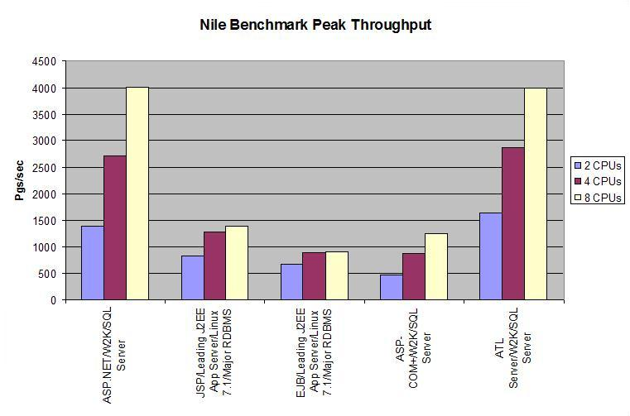
www.gotdotnet.com/team/compare/nileperf.aspx

Slide 18
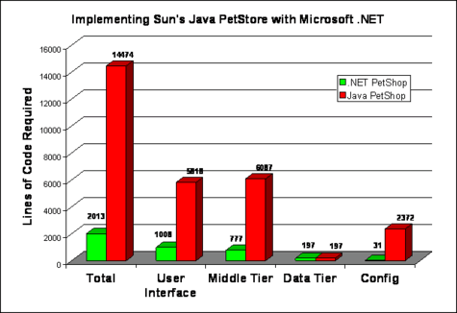
msdn.microsoft.com/library/default.asp?url=/library/
en-us/dnbda/html/psimp.asp

Slide 19
End of Presentation

