Slide 1
C++ vs. C# Presentation Notes
Segments
Introduction: slides 2–9 15 minutes
Types: slides 10–14 10 minutes
Special Types: slides 15–19 10 minutes
Assemblies: slides 20–23 12 minutes
Interfaces and libs: slides 24–35 10 minutes

Slide 2
Comparison of C++ and C#
Jim Fawcett
Software Modeling
Copyright © 1999–2017

Slide 3
Both Are Important
C++ has a huge installed base.
C++ provides almost complete control over the allocation of resources and execution behavior of programs.
C# is the dominant .Net language.
C#, a managed language, is simpler than C++, takes over control of memory resources and manages the execution of programs.
CSE681—Software Modeling and Analysis
Focuses almost exclusively on C# and .Net.
CSE687—Object-Oriented Design:
Focuses almost exclusively on C++ and the Standard Library.

Slide 4
C# Language
Looks a lot like Java
A strong similarity between:
Java Virtual Machine and .Net CLR
Java bytecodes and .Net Intermediate Language
Java packages and CRL components and assemblies
Both have just-in-time (JIT) compilers
Both support reflection, used to obtain class information at run time
Both languages support generics (not as useful as C++ templates)
Differences:
Java and C# do have significant differences
C# has most of the operators and keywords of C++
C# code supports attributes—tagged metadata, Java uses annotations
C# provides deep access to the Windows platform through FCL
Java supports network programming and GUI development on many platforms

Slide 5
C# Hello World Program
using System;
namespace HelloWorld
{
class Chello
{
string Title(string s)
{
int len = s.Length;
string underline = new string('=',len+2);
string temp = "\n " + s + "\n" + underline;
return temp;
}
string SayHello()
{
return "Hello World!";
}
[STAThread]
static void Main(string[] args)
{
Chello ch = new Chello();
Console.Write(ch.Title("HelloWorld Demonstration"));
Console.Write("\n\n {0}\n\n",ch.SayHello());
}
}
}

Slide 6
Differences between C# and C++
In C# there are no global functions. Everything is a class.
Main(string args[]) is a static member function of a class.
The C# class libraries are like Java Packages, not like the C and C++ Standard Libraries.
System, System.Drawing, System.Runtime.Remoting, System.Text, System.Web
C# class hierarchy is rooted in a single “Object” class
C# does not separate class declaration and member function definitions.
Every function definition is inline in the class declaration—like the Java structure.
There are no header files.
Instead of #include, C# uses using statements:
using System;
using System.ComponentModel;

Slide 7
Differences between C++ and C#
The C# object model is very different from the C++ object model.
Illustrated on the next slide
C# supports only single inheritance of implementation but multiple inheritance of interfaces
C# does not support use of pointers, only references, except in “unsafe” code.
Use of a C# variable before initialization is a compile-time error.

Slide 8
C# Object Model

Slide 9
Comparison of Object Models
C++ Object Model
All objects share a rich memory model:
Static, stack, and heap
Rich object life-time model:
Static objects live for the duration of the program.
Objects on stack live within a scope defined by { and }.
Objects on heap live at the designer’s discretion.
Semantics based on a deep copy model.
That’s the good news.
That’s the bad news.
For compilation, clients carry their server’s type information via headers.
That’s definitely bad news.
But it has a work-around, e.g., design to interface not implementation. Use object factories.
.Net Object Model
More Spartan memory model:
Value types are static and stack based only.
Reference types (all user-defined types and library types) live on the managed heap.
Nondeterministic lifetime model:
All reference types are garbage collected.
That’s the good news.
That’s the bad news.
Semantics based on a shallow reference model.
For compilation, clients use their server’s metadata.
That is great news.
It is this property that makes .Net components so simple.

Slide 10
C# Primitive Types
.Net Base Class
System.Byte
System.SByte
System.Int16
System.Int32
System.Int64
System.UInt16
System.UInt32
System.UInt64
System.Single
System.Double
System.Object
System.Char
System.String
System.Decimal
System.Boolean
C# Types
byte
sbyte
short
int
long
ushort
uint
ulong
float
double
object
char
string
decimal
bool

Slide 11
C# Object Type
Object is the root class of the C# library
Object’s members:
Public Object();
Public virtual Boolean Equals(Object obj);
Returns true if obj and invoker handles point to the same body.
Public virtual Int32 GetHashCode();
Return value identifies object instance.
Public Type GetType();
Type object supports RTTI – see next page
Public virtual String ToString();
Returns namespace.name
Protected virtual void Finalize();
Called to free allocated resources before object is garbage collected.
Protected Object MemberwiseClone();
Performs shallow copy
To have your class instances perform deep copies you need to implement the ICloneable interface.

Slide 12
Common Type System
Reference types
Classes
Methods
Fields
Properties
Events
Member adornments: public, protected, private, abstract, static
Interfaces
Class can inherit more than one
Must implement each base interface
Delegates
Instances used for notifications

Slide 13
Common Type System
Value types
Primitive types
See page 13
Structures
Methods
Fields
Properties
Events
Member adornments: public, protected, private, abstract, static
Enumerations

Slide 14
Type Class
You get type object this way:
Type t = myObj.GetType();
Type t = Type.GetType(“myObj”);
Some of Type’s members:
IsAbstract
IsArray
IsClass
IsComObject
IsEnum
IsInterface
IsPrimitive
IsSealed
IsValueType
InvokeMember()
GetType() returns Type Object
FindMembers() returns MemberInfo array
GetEvents() returns EventInfo array
GetFields() :
GetMethods() :
GetInterfaces() :
GetMembers() :
GetProperties() :
An instance of Type is a container for reflection information, and has many methods to use that information.

Slide 15
More Differences
The CLR defines a new delegate type, used for callbacks.
Event is a keyword in all CLR languages.
Events modify the delegate interface, eliminating actions by a subscriber that might affect other subscribers.
All memory allocations are subject to garbage collection—you don’t call delete.
There are no #includes in C#. There are in both managed and unmanaged C++.
In C# all class data members are primitive types or C# references. In managed C++ all class data members are either primitive value types, C++ references, or C++ pointers. Nothing else is allowed.
The CLR provides directory services, and remoting. The Standard C++ Library provides neither of these, although they are relatively easy to provide yourself.

Slide 16
Delegates
Delegates are used for callbacks:
In response to some event they invoke one or more functions supplied to them.
Library code that generates an event will define a delegate for application developers to use—the developer defines application-specific processing that needs to occur in response to an event generated by the library code.
A delegate defines one specific function signature to use: public delegate rtnType delFun(args…);
This declares a new type, delFun whose instances can invoke functions with that signature.
The developer supplies functions this way: libClass.delFun myDel = new libClass.delFun(myFun);
This declares a new instance, myDel, of the delFun type.

Slide 17
Events
Events are specialized delegates that are declared and invoked by a class that wants to publish notifications. The event handlers are functions created by an event subscriber and given to the delegate.
Many C# events use the specialized delegate event handler of the form: public delegate void evDelegate( object sender, userEventArgs eArgs );
userEventArgs is a subscriber-defined class, derived from System.EventArgs. You usually provide it with a constructor to allow you to specify information for the event to use.
The event is then declared by the publisher as: public event evDelegate evt;
Either publisher or subscriber has to create a delegate object, eveDel, and pass it to the other participant.
The event is invoked by the publisher this way: evDel( this, new userEventArgs(arg) );
The subscriber adds an event handler function, myOnEvent, to the event delegate this way: Publisher.evDelegate evDel += new Publisher.evDelegate(myOnEvent);

Slide 18
Threads
A C# thread is created with the statement: Thread thrd = new Thread();
System.Threading declares a delegate, named ThreadStart, used to define the thread’s processing.
ThreadStart accepts functions that take no arguments and have void return type.
You define a processing class, MyProc that uses constructor arguments or member functions to supply whatever parameters the thread processing needs.
To start the thread you simply do this: MyProc myProc = new myProc(args, …); Thread thrd = new Thread(); ThreadStart thrdProc = new ThreadStart(myProc); thrd.Start(thrdProc);

Slide 19
Thread Synchronization
The simplest way to provide mutually exclusive access to an object shared between threads is to use lock: lock(someObject) { // do some processing on // someObject } While a thread is processing the code inside the lock statement no other thread is allowed to enter the lock.

Slide 20
Assemblies
An assembly is a versioned, self-describing binary (dll or exe)
An assembly is the unit of deployment in .Net
An assembly is one or more files that contain:
A manifest
Documents each file in the assembly
Establishes the assembly version
Documents external assemblies referenced
Type metadata
Describes all the methods, properties, fields, and events in each module in the assembly
MSIL code
Platform-independent intermediate code
JIT transforms IL into platform-specific code
Optional resources
Bitmaps, string resources, …

Slide 21
Assembly Structure
Visual Studio does most of the work in configuring an assembly for you.

Slide 22
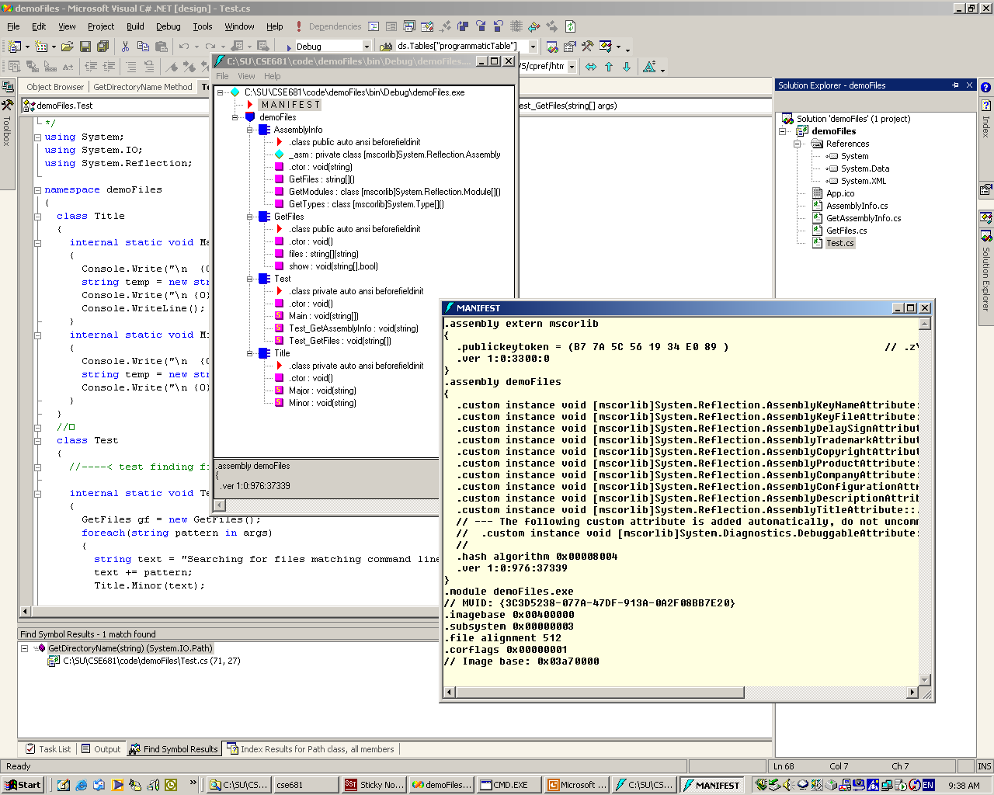
Metadata in demoFiles.exe

Slide 23
Versioning
Assemblies can be public or private:
A private assembly is used only by one executable, and no version information is checked at load time.
Private assemblies are contained in the project directory or, if there is a config file, in a subdirectory of the project directory.
A shared assembly is used by more than one executable, and is loaded only if the version number is compatible with the using executable.
Shared assemblies reside in the Global Assembly Cache (GAC), a specific directory.
Version compatibility rules can be configured by the user.
Since no registry entries are made for the assembly, each user executable can attach to its own version of the assembly. This is called side-by-side execution by Microsoft.
A shared assembly is created from a private assembly, using one of Microsoft’s utilities provided for that purpose.

Slide 24
Useful Interfaces
IComparable—method
Int CompareTo(object obj);
Return:
Negative => less
Zero => equal
Positive => greater
ICloneable—method
object clone();
ICollection—properties and method
int count { get; }
bool IsSynchronized { get; }
object SyncRoot { get; }
void CopyTo(Array array, int index);

Slide 25
Useful Interfaces
IEnumerable—method
System.Collections.IEnumerator GetEnumerator();
IEnumerator—property and methods
object Current { get; }
bool MoveNext();
void Reset();

Slide 26
Useful Interfaces
IDictionary
bool IsFixedSize { get; }
bool IsReadOnly { get; }
object this[ object key ] { get; set; }
ICollection keys { get; }
ICollection values { get; }
void Add(object key, object value);
void Clear();
bool Contains(object key);
System.Collections.IDictionaryEnumerator GetEnumerator();
void Remove(object key);
IList
bool IsFixedSize { get; }
bool IsReadOnly { get; }
object this[ object key ] { get; set; }
void Add(object key, object value);
void Clear();
bool Contains(object key);
int IndexOf(object value);
void Insert(int index, object value);
void Remove(object value);
void RemoveAt(int index);

Slide 27
C# Libraries
System
Array, Attribute, Console, Convert, Delegate, Enum, Environment, EventArgs, EventHandler, Exception, Math, MTAThreadAttribute, Object, Random, STAThreadAttribute, String, Type
System.Collections
ArrayList, HashTable, Queue, SortedList, Stack
System.Collections.Specialized
ListDictionary, StringCollection, StringDictionary
System.ComponentModel
Used to create components and controls
Used by WinForms
System.ComponentModel.Design.Serialization
Used to make state of an object persistant
System.Data
Encapsulates use of ADO.NET

Slide 28
More C# Libraries
System.Drawing—GDI+ support
System.Drawing.Drawing2D—special effects
System.Drawing.Imaging—support for .jpg, .gif files
System.Drawing.Printing—settings like margins, resolution
System.Net—support for HTTP, DNS, basic sockets
System.Net.sockets—sockets details
System.Reflection
View application’s metadata including RTTI
System.Runtime.InteropServices
Access COM objects and Win32 API

Slide 29
Remoting Libraries
System.Runtime.Remoting
System.Runtime.Remoting.Activation
Activate remote objects
System.Runtime.Remoting.Channels
Sets up channel sinks and sources for remote objects
System.Runtime.Remoting.Channels.HTTP
Uses SOAP protocol to communicate with remote objects
System.Runtime.Remoting.Channels.TCP
Uses binary transmission over sockets
System.Runtime.Remoting.Contexts
Set threading and security contexts for remoting
System.Runtime.Remoting.Messaging
Classes to handle message passing through message sinks
System.Runtime.Remoting.Meta data
Customize HTTP SoapAction type output and XML Namespace URL
System.Runtime.Remoting.Proxies
System.Runtime.Remoting.Services

Slide 30
You Must Be Joking—More Libraries!
System.Runtime.Serialization
System.Runtime.Serialization.Formatters
System.Runtime.Serialization.Formatters.Soap
System.Security
System.ServiceProcess
Create windows services that run as Daemons
System.Text.RegularExpressions
System.Threading
AutoResetEvent, Monitor, Mutex, ReaderWriterLock, Thread, Timeout, Timer, WaitHandle
Delegates: ThreadStart, TimerCallBack, WaitCallBack
System.Timers
Fire events at timed intervals, day, week, or month

Slide 31
Web Libraries
System.Web
System.Web.Hosting
Communicate with IIS and ISAPI run-time
System.Web.Mail
System.Web.Security
cookies, web authentication, Passport
System.Web.Services—close ties to ASP.NET
System.Web.Services.Description
System.Web.Services.Discovery
System.Web.Services.Protocol—raw HTTP and SOAP requests
System.Web.SessionState—maintain state between page requests
System.Web.UI—access to WebForms

Slide 32
WinForms and XML Libraries
System.Windows.Forms—Forms-based GUI design
System.Xml—XML DOM
System.Xml.Schema
Authenticate XML structure
System.Xml.Serialization
Serialize to XML
System.Xml.XPath
Navigate XSL
System.Xml.Xsl
Support for XSL – XML stylesheets

Slide 33
So How Do We Learn All This Stuff!
ClassView -> Class Browser -> Help to the rescue!

Slide 34
Language Comparison
Standard C++
Is an ANSI and ISO standard.
Has a standard library.
Universally available:
Windows, UNIX, MAC
Well-known:
Large developer base.
Lots of books and articles.
Programming models supported:
Objects
Procedural
Generic
Separation of interface from implementation:
Syntactically excellent
Implementation is separate from class declaration.
Semantically poor
See object model comparison.
.Net C#
Is an ECMA and ISO standard.
Has defined an ECMA library.
Mono project porting to UNIX
Relatively new, but popular in Windows ecosystem
Large developer base.
Lots of books and articles.
Programming models supported:
Objects
Generic
Separation of Interface from Implementation:
Syntactically poor
Implementation forced in class declaration.
Semantically excellent
See object model comparison.

Slide 36
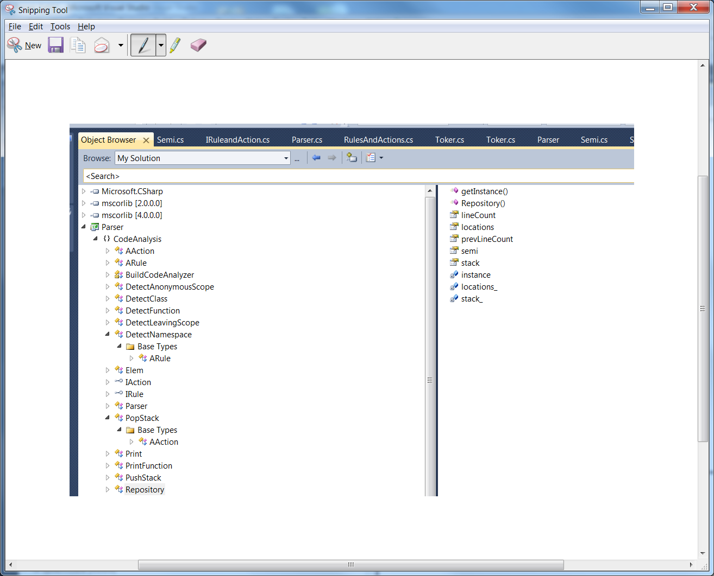
Class Browser in IDE

Slide 37
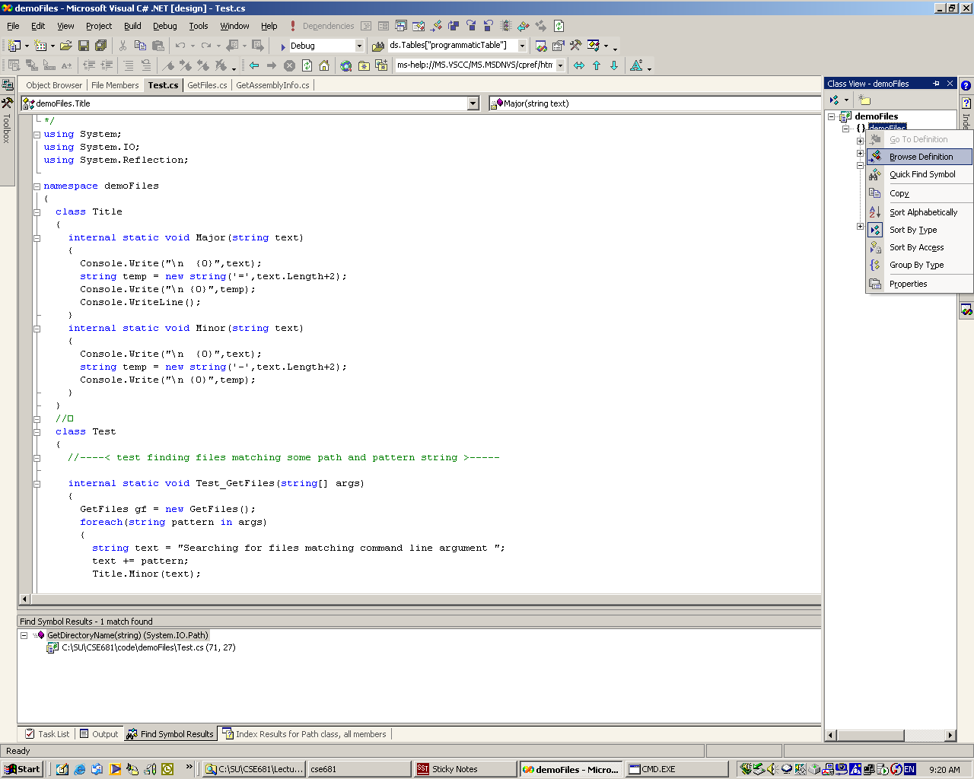
Access Class Browser from Class View

Slide 38
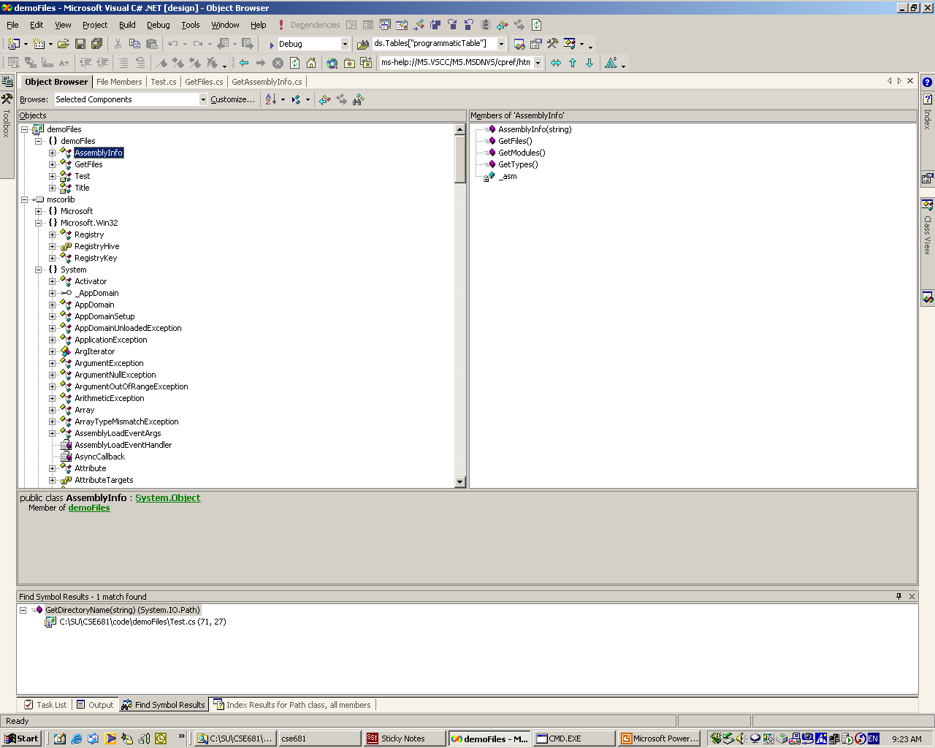
Select Type to See its Members

Slide 39
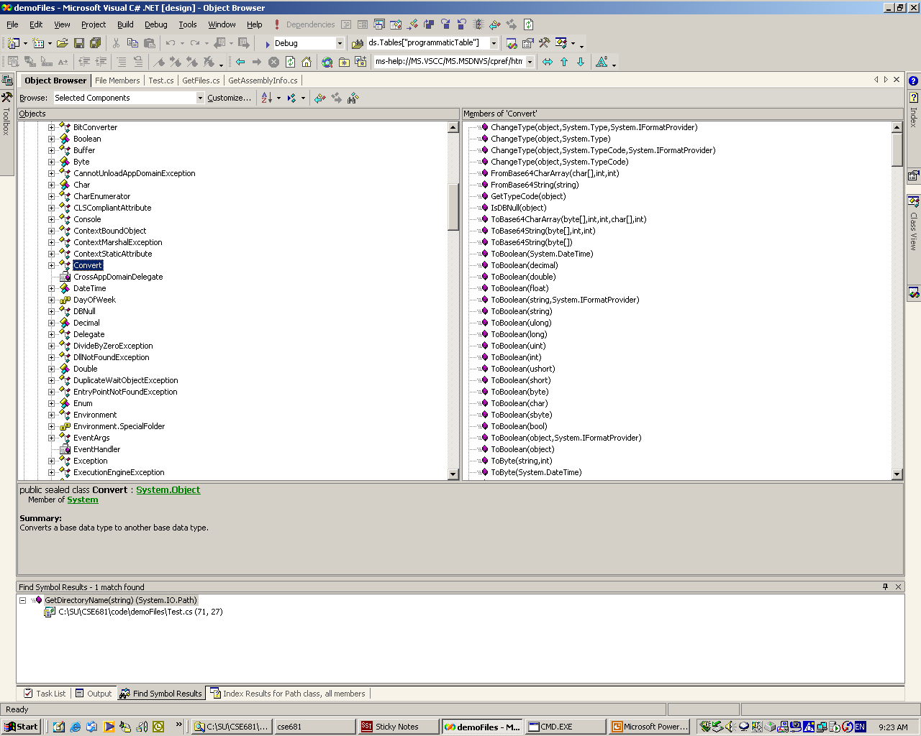
Browsing System.DLL

Slide 40
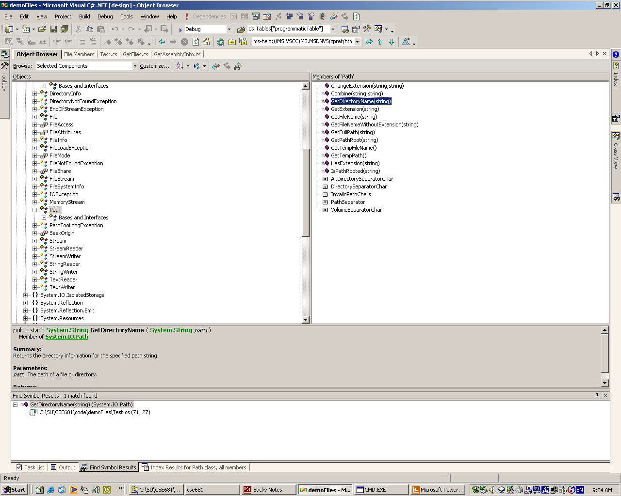
Getting Help on a Selected Type or Member – Just Hit F1

Slide 41
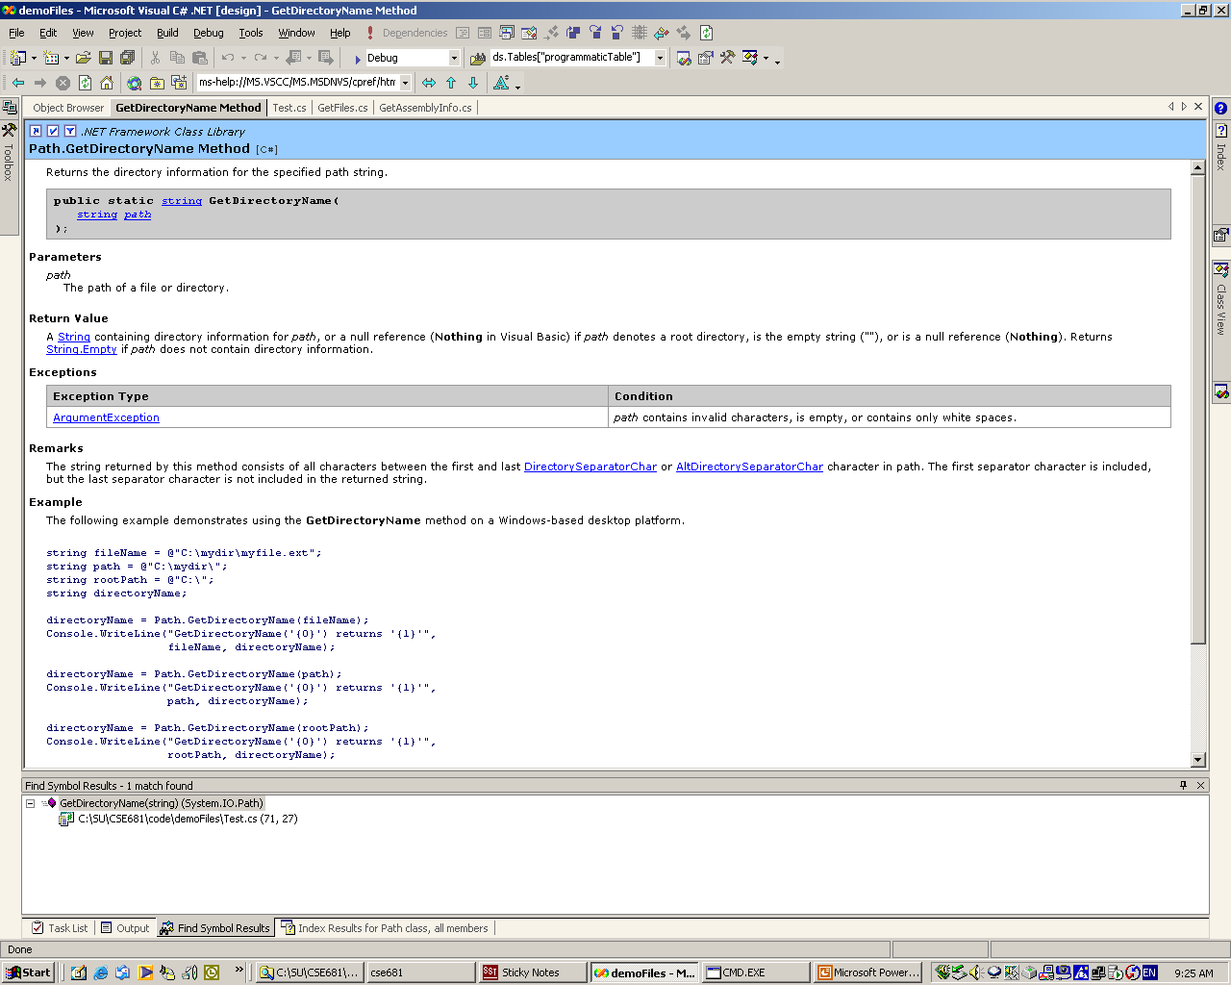
Takes You Immediately to Help Documentation for that Identifier

Slide 42
Components
Because C# classes are reference types, they expose no physical implementation detail to a client. What the client creates on its stack frames are simply handles to the class implementations.
The compiler does type checking for a client from metadata in an accessed assembly.
No header file is included, so the client is not dependent on implementation details of the class.
Consequently, any C# library dll can serve as a component for local access.
To make a component remotely accessible, you need to derive from System.MarshalByRefObject

